Slide 1
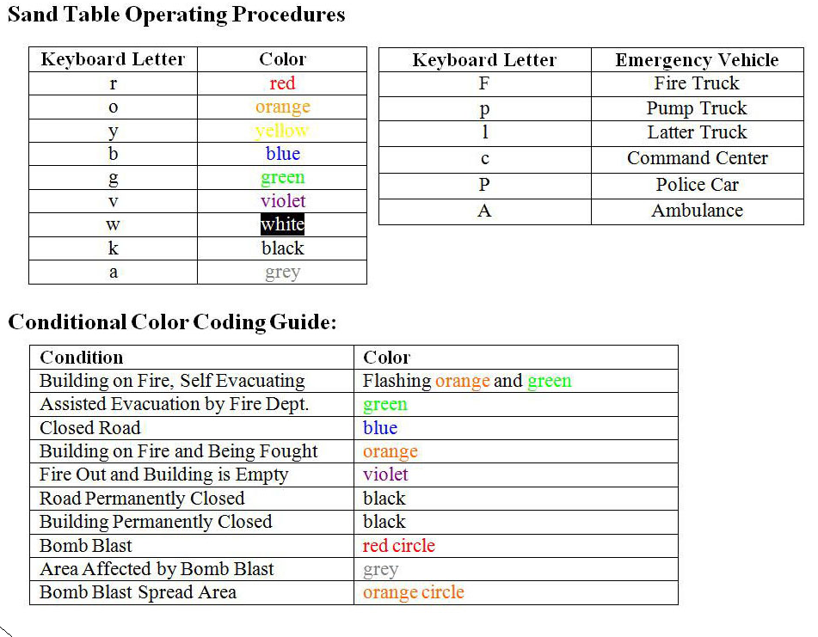
IPRO 317
Spring 2008
Design & Build Chicago Scale Model for
Dynamic Disaster Simulation
Scenario Flow Chart:
Fire Disaster
Instructions for reading Flow Chart:
Begin at the top of the chart
Follow lines to connecting bubbles
Stop at questions and pick corresponding answer
Unless directed, trace only one line at a time, one direction at a time.

