Slide 1
Don’t Be Content With Content: Crowdsourcing as Promotion and Engagement
Adam Strohm
Digital Initiatives Librarian
Paul V. Galvin Library, Illinois Institute of Technology

Slide 3
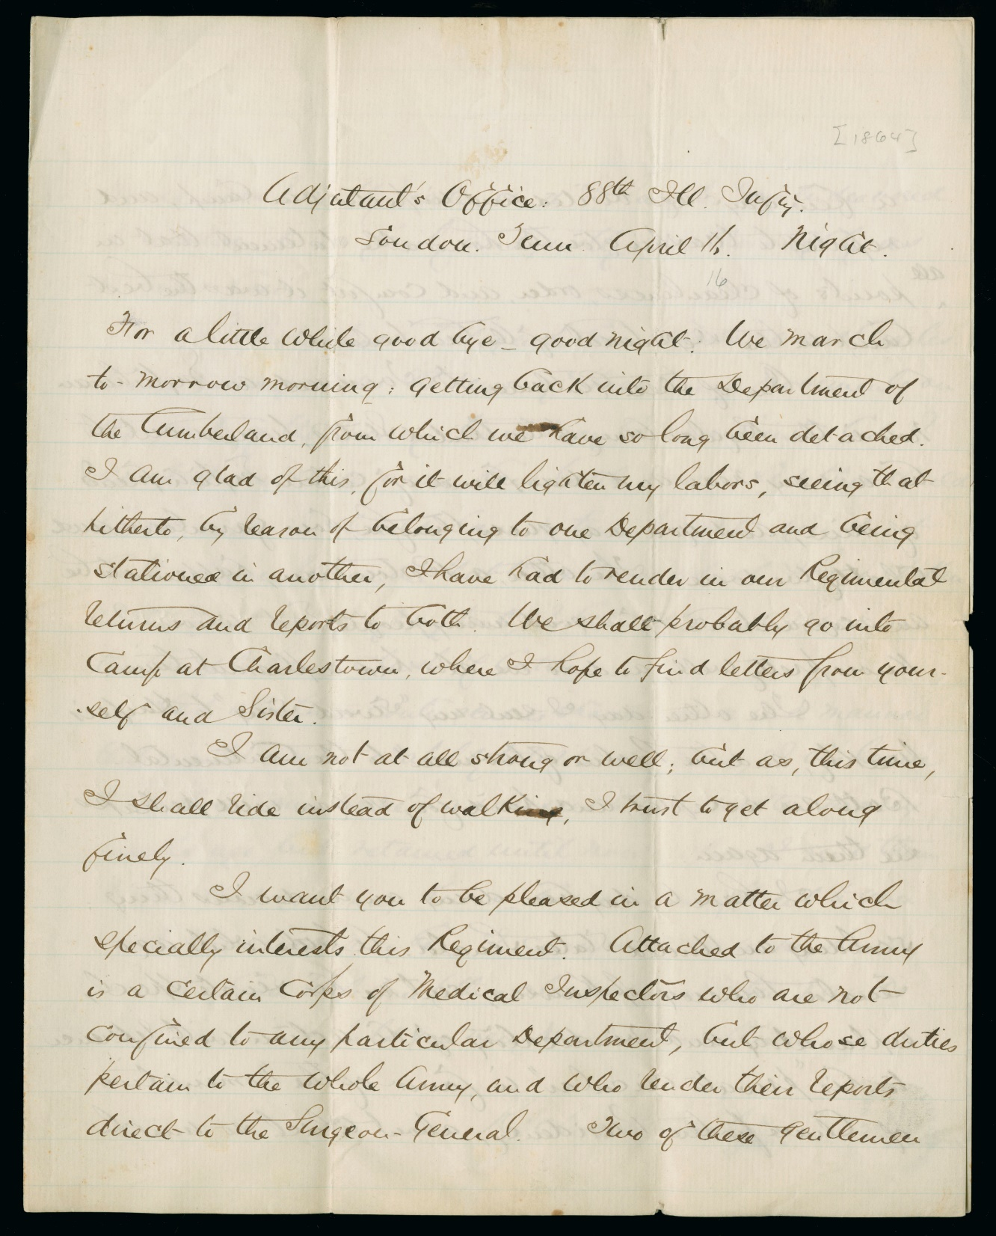
Richard Realf to Laura B. Merritt, Loudon, TN, April 16, 1864
Newberry Library, Case MS 10034

Slide 4
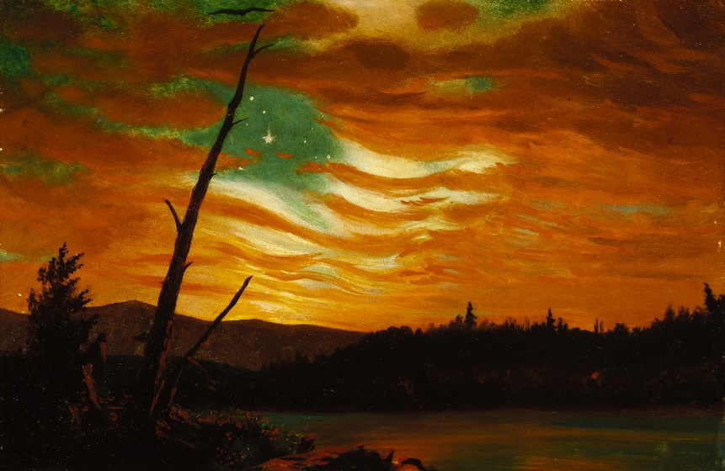
Our Banner in the Sky, Frederic Edwin Church, 1861
Terra Foundation for American Art, Chicago, Daniel J. Terra Collection, 1992.27

Slide 5
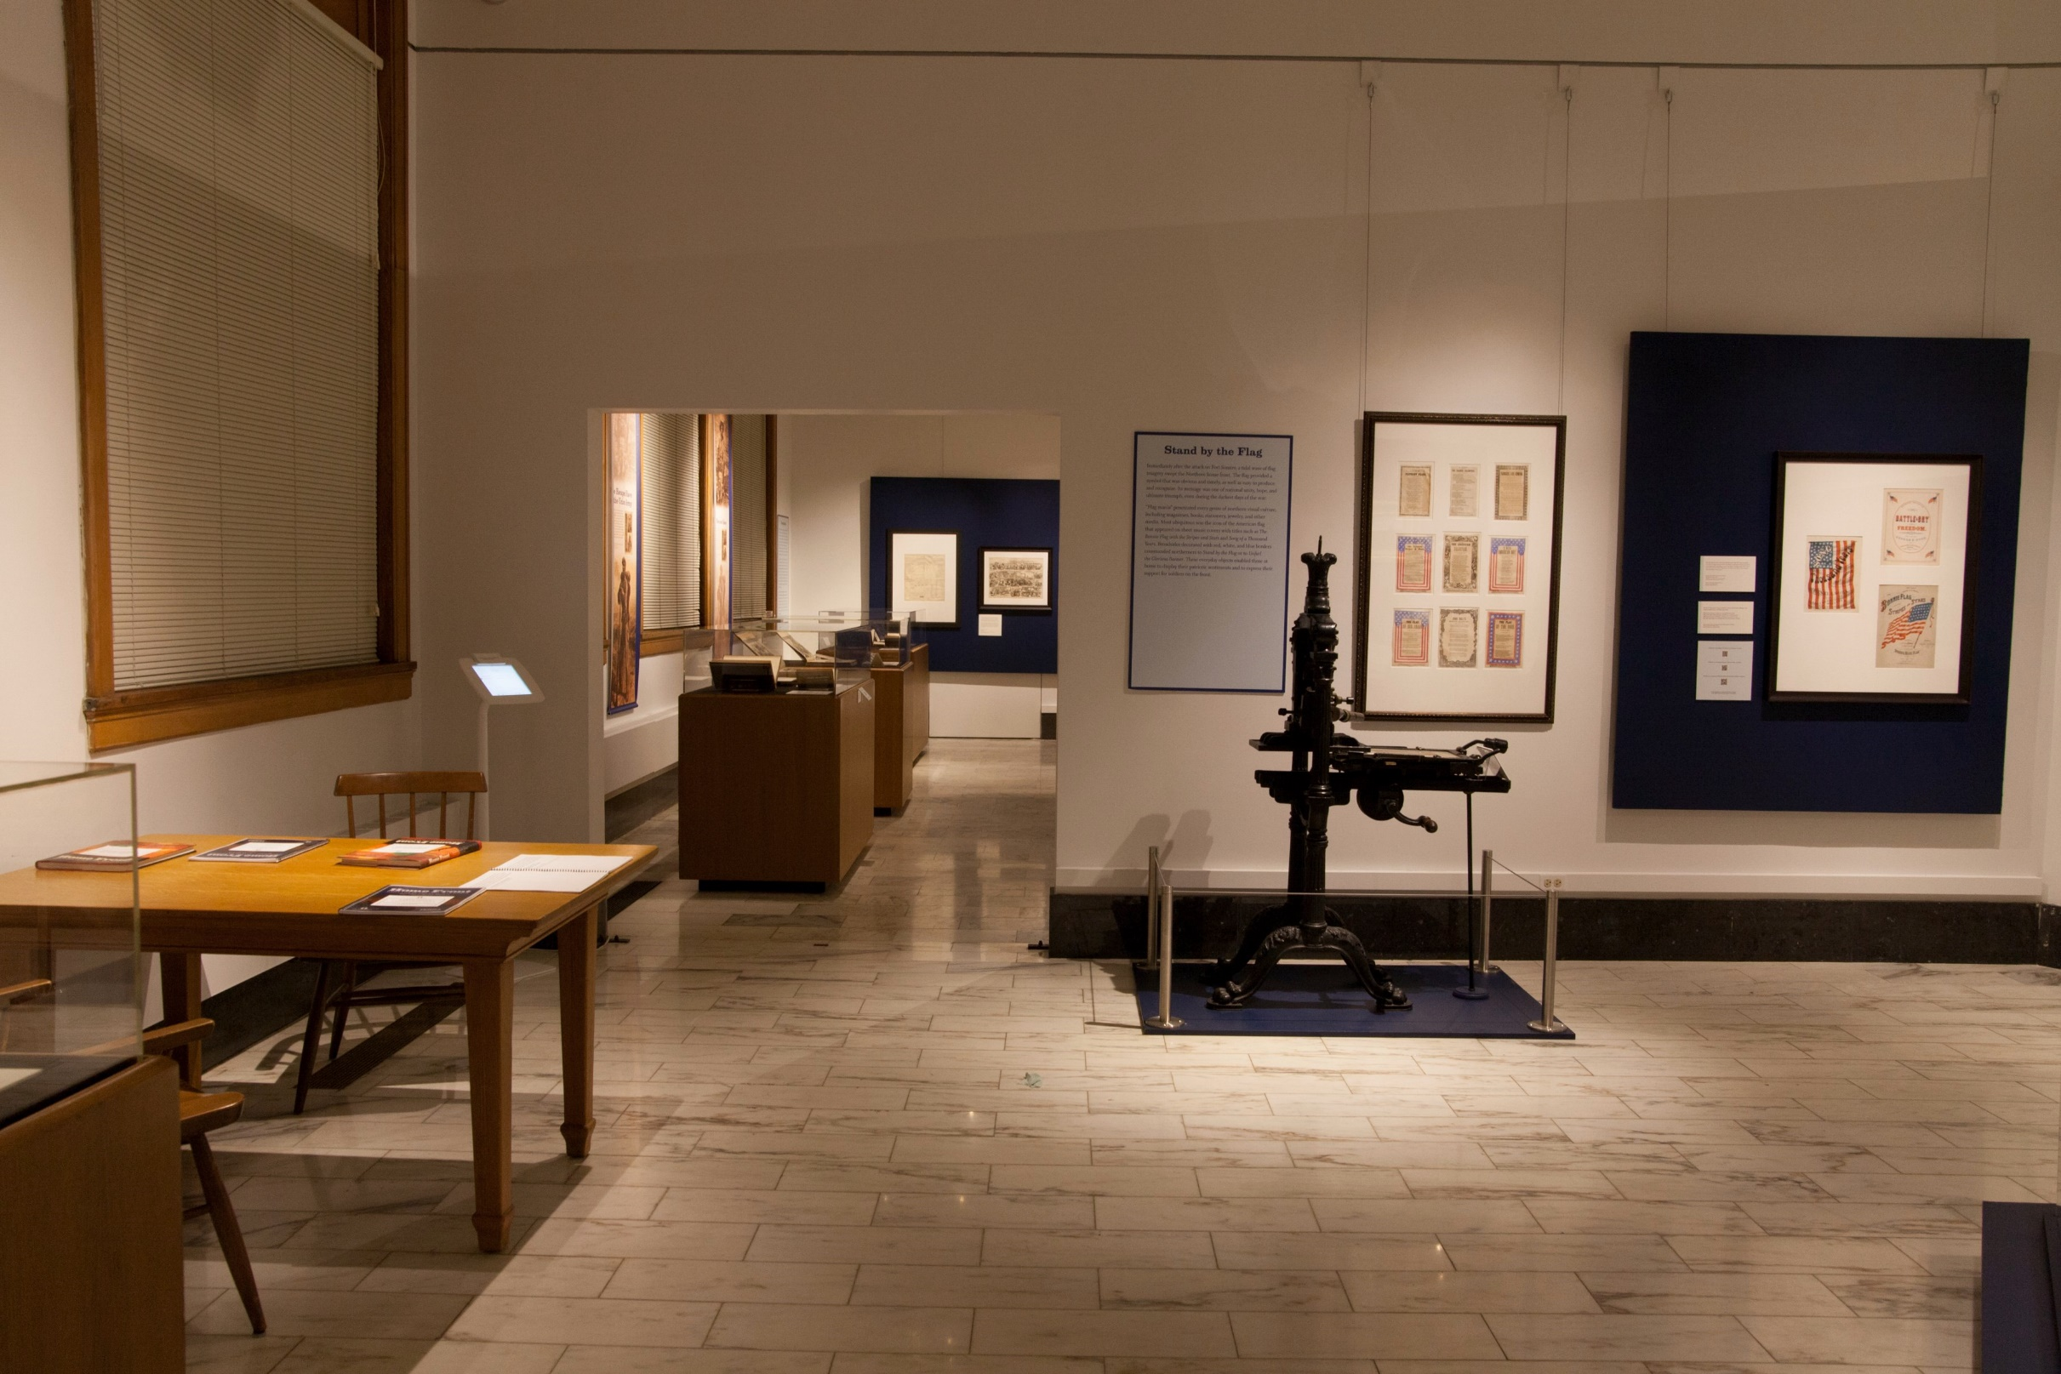
Photo credit: Catherine Gass, Newberry Library, 2014

Slide 6
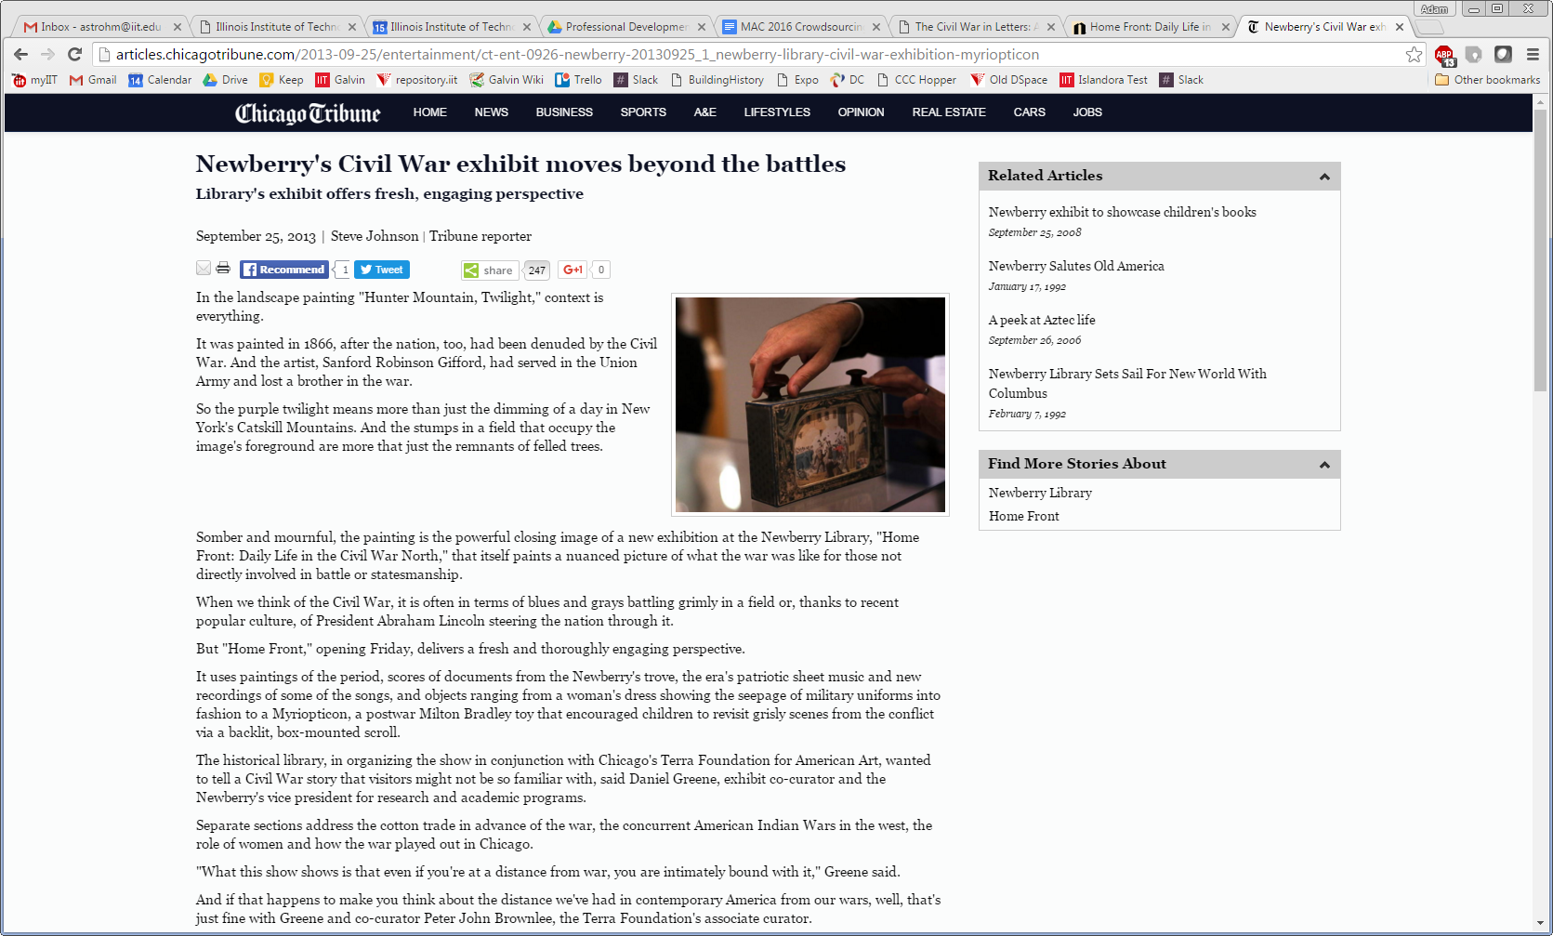
Steve Johnson, “Newberry’s Civil War Exhibit Moves Beyond the Battles,” Chicago Tribune (Chicago, IL), September 25, 2013

Slide 7
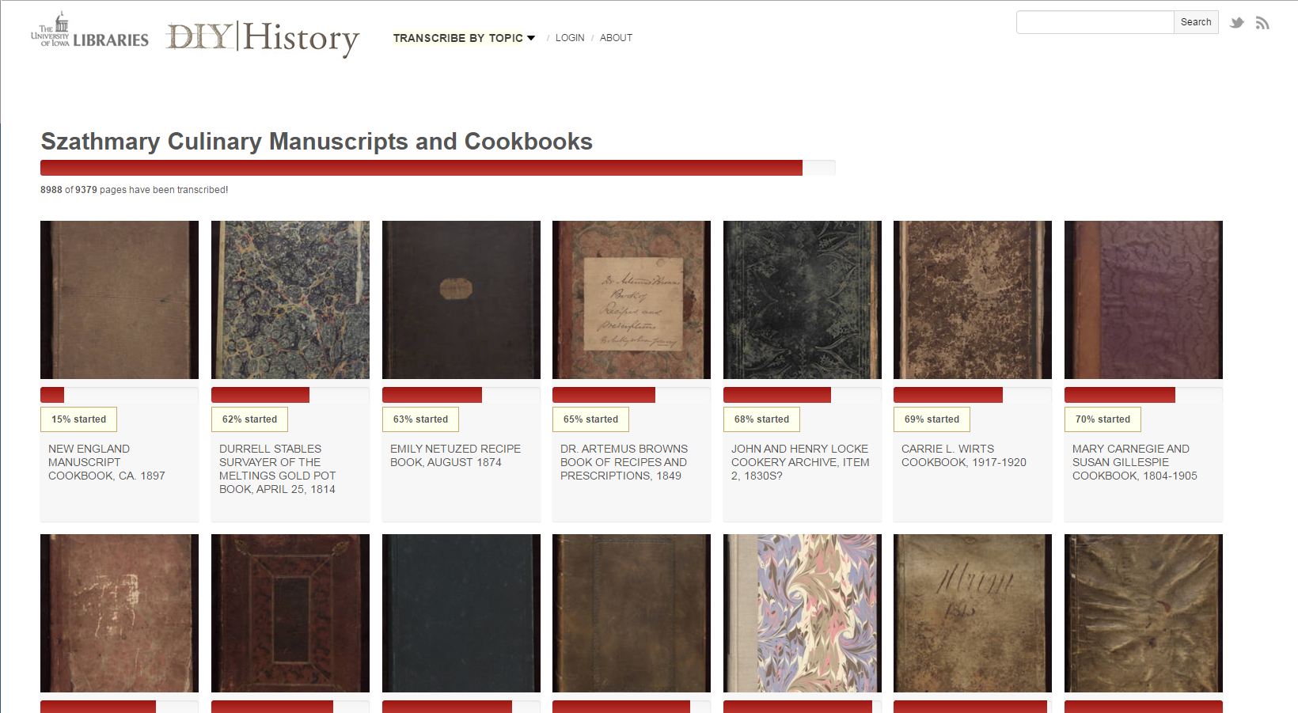
DIY History, The University of Iowa Libraries
diyhistory.lib.uiowa.edu

Slide 8
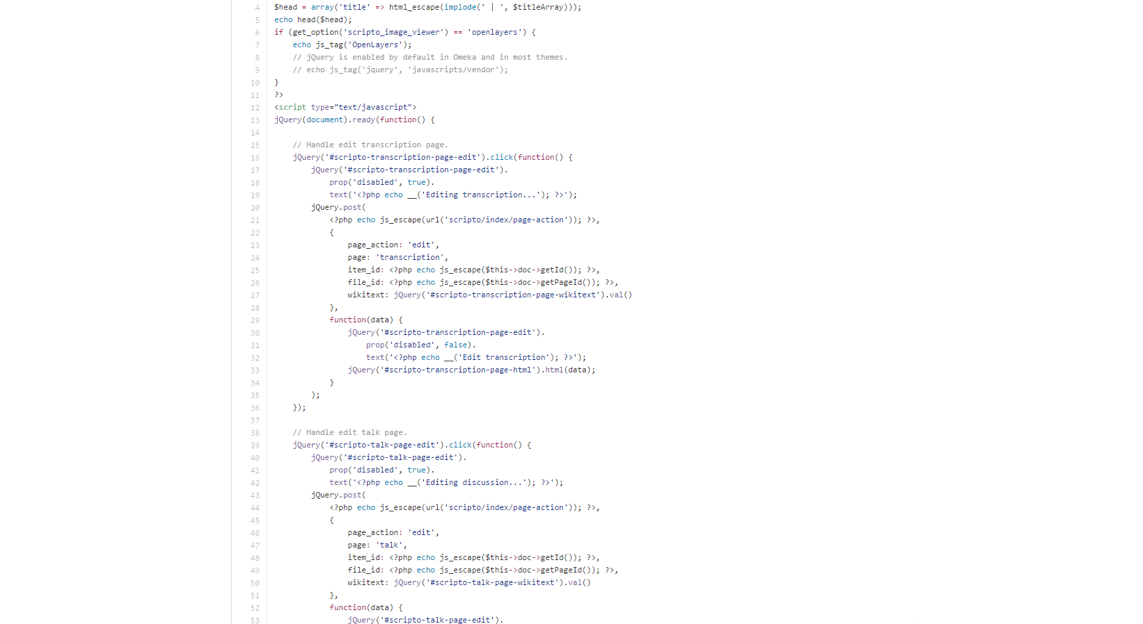

Slide 9
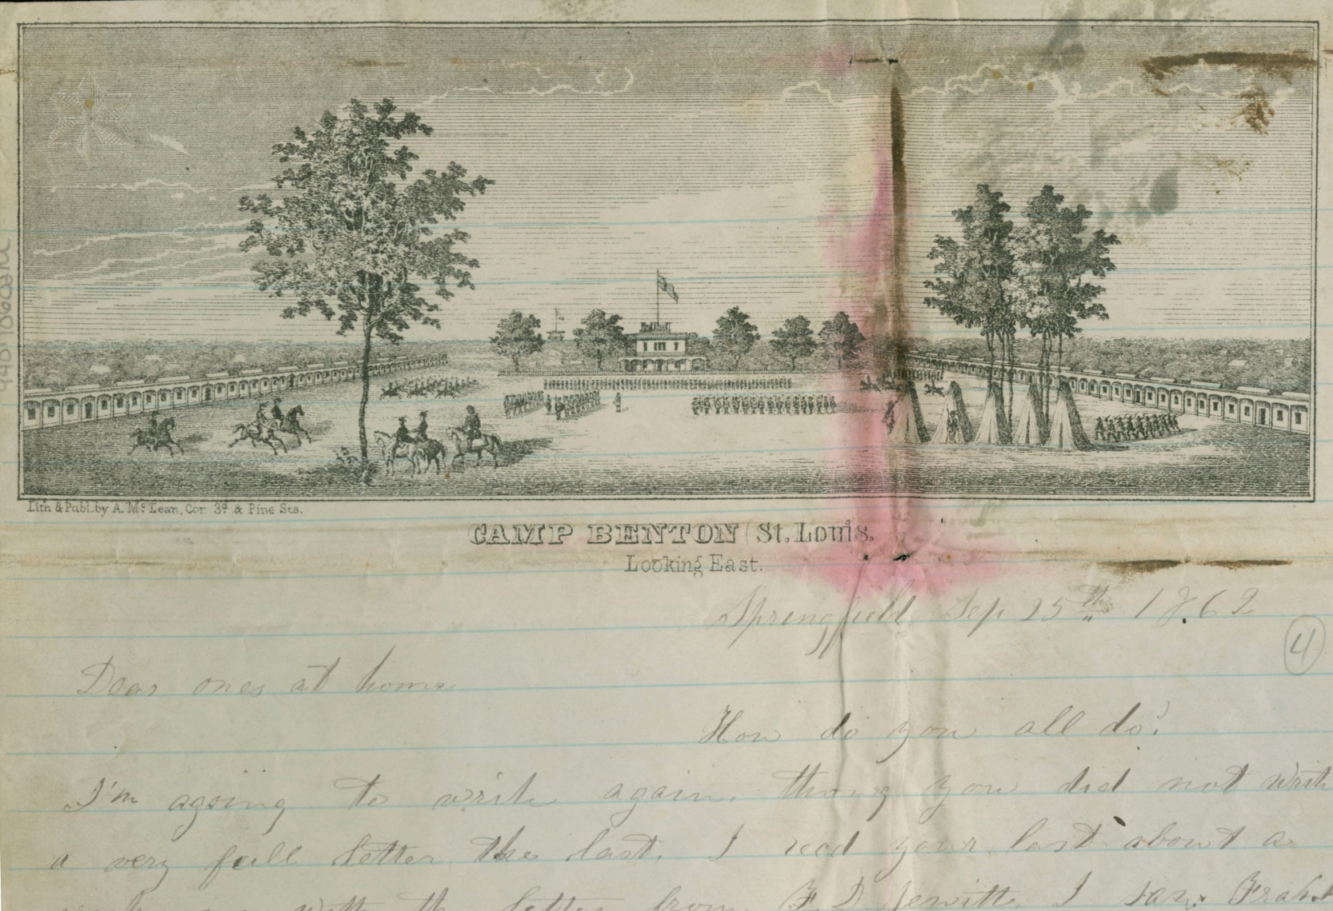
James and Henry Patterson to “dear ones at home,” Springfield, MO, Sept. 25, 1862, Newberry Library, Case MS 10025

Slide 11
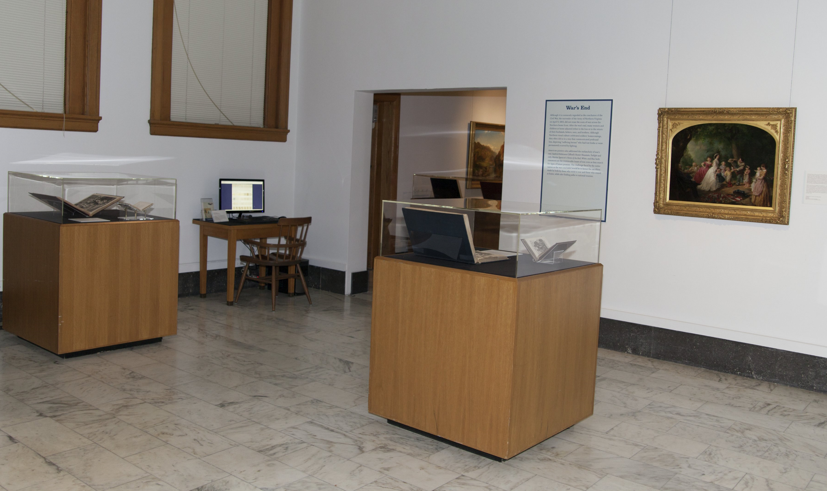
Photo credit: Catherine Gass, Newberry Library, 2014

Slide 12
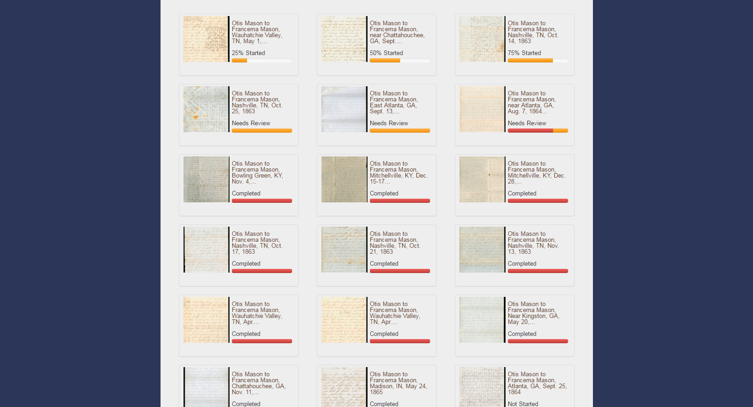

Slide 14
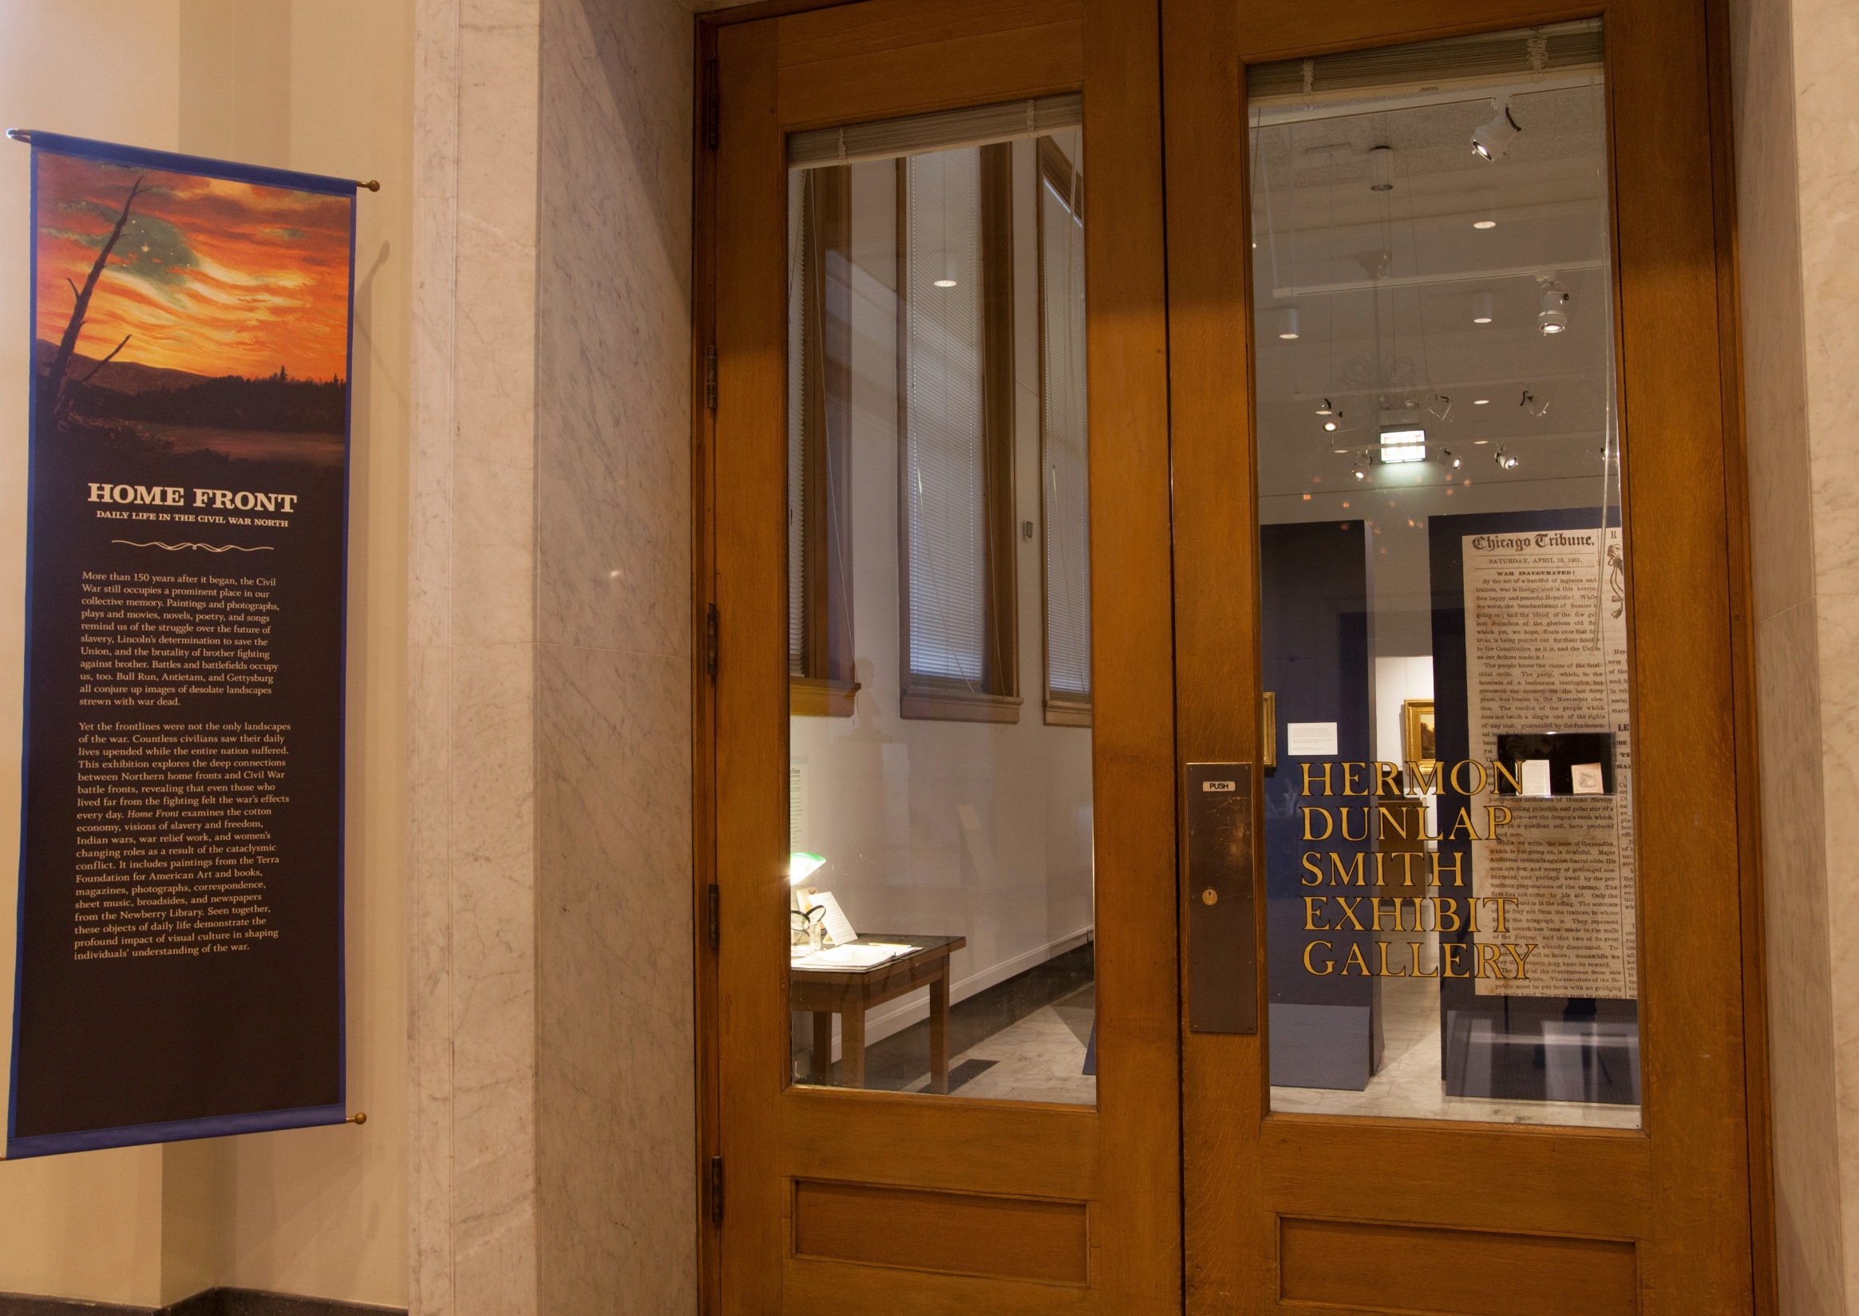
Photo credit: Catherine Gass, Newberry Library, 2014

Slide 15
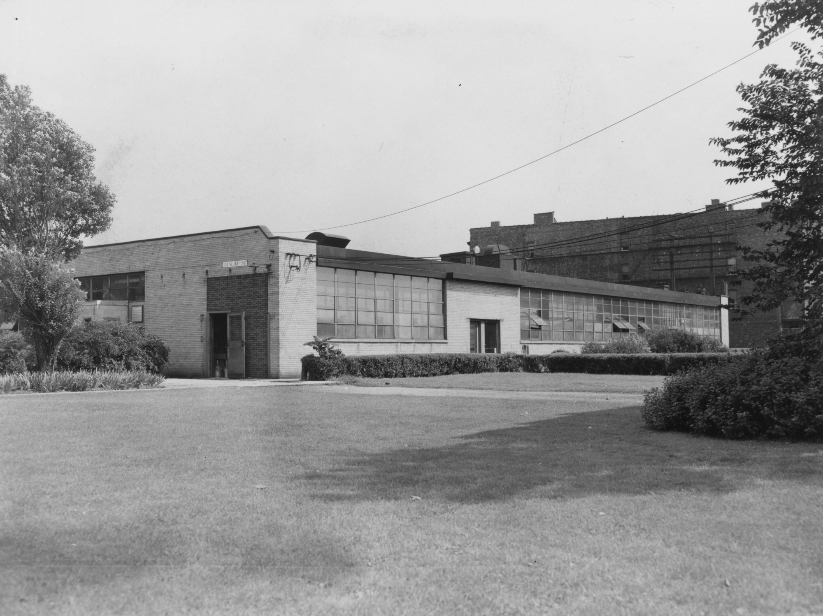
Photo credit: ARF Chemistry Research Building ∙ photographer unknown ∙ Illinois Institute of Technology Archives

Slide 16
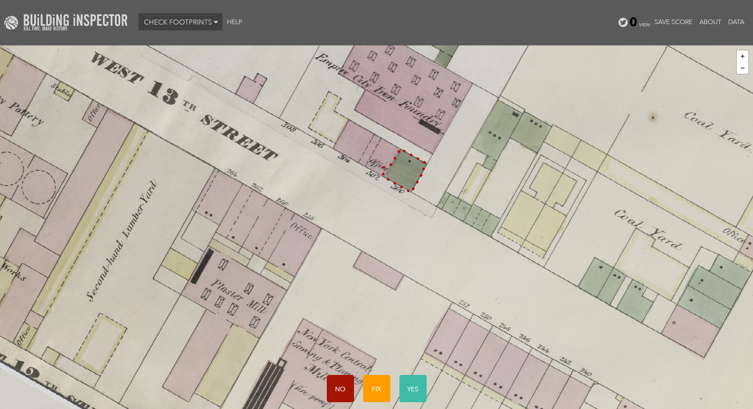
Building Inspector, NYPL Labs
buildinginspector.nypl.org

Slide 17
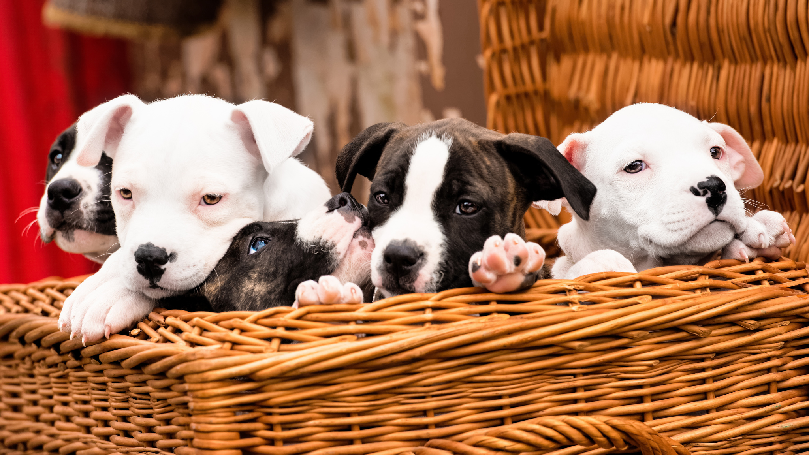
Photo credit: Puppies ∙ Jay Melnick ∙ https://flic.kr/p/nrPLn6

Slide 18
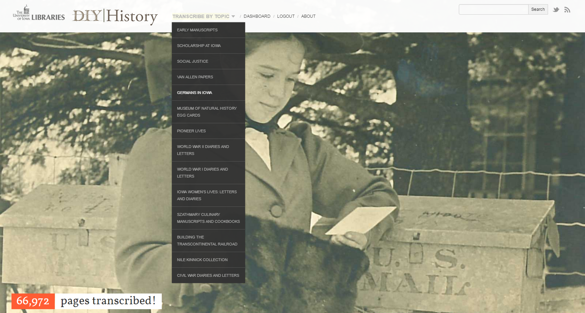
DIY History, The University of Iowa Libraries
diyhistory.lib.uiowa.edu

Slide 19
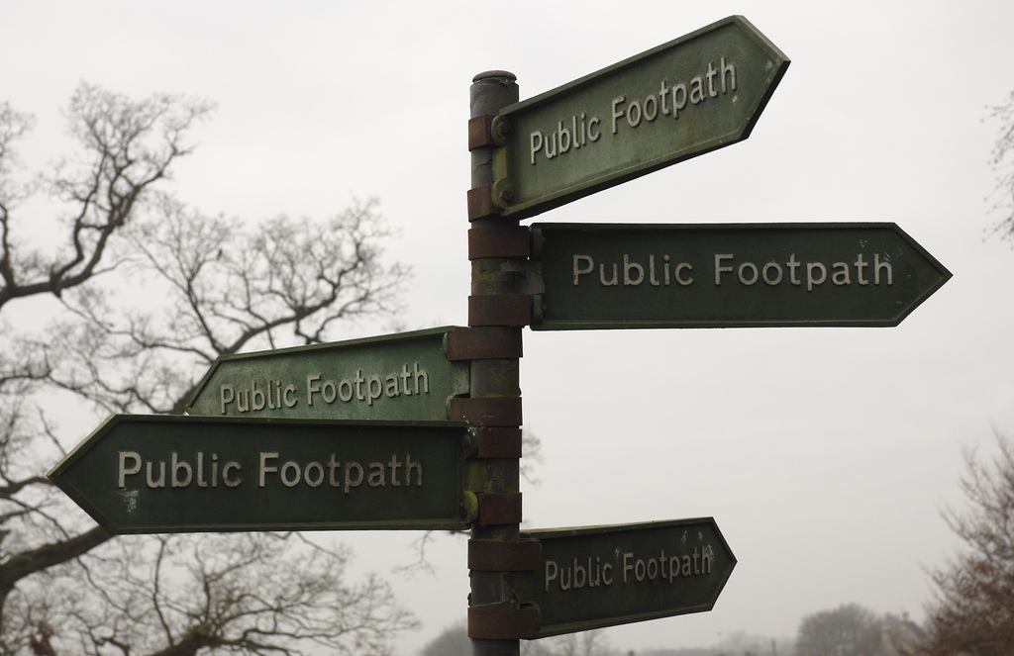
Photo credit: DCS_3537 ∙ Alan Bradburne
https://flic.kr/p/9xDu2

Slide 20
Thank You!
Adam Strohm
astrohm@iit.edu
The Civil War in Letters
publications.newberry.org/civilwarletters
DIY History
diyhistory.lib.uiowa.edu

