Slide 1
Migrating to ArchivesSpace: Lessons Learned
Greer Martin
Paul V. Galvin Library Mini Conference
May 16, 2017

Slide 2
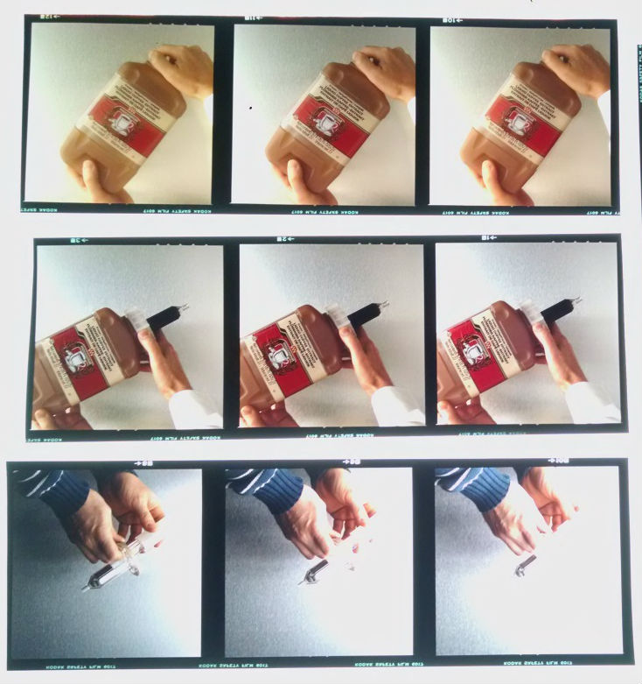
University Archives & Special Collections
1,500 collections, mostly university records and expanded special collections
Variety of materials types
Photographs
A/V materials
Artwork
Furniture
University Archives & Special Collections, Paul V. Galvin Library, Illinois Institute of Technology

Slide 3
Re:Discovery Proficio
What is it?
Records management software, used in museums and archives
Issues
Discovery: can’t link finding aids
Poor collections control
Usability issues for staff
Outdated public interface
$$$
Notes:
Enhanced discoverability for both researchers and staff
Re:Discovery Demo:
Full text search
On public view no linking between hierarchies, but hierarchies are enforced on admin side by record type (collection, series, file).
Subject search - uncontrolled authorities (Corp name: McCuddy’s Tavern)
Also only 2 staff could use at once.

Slide 4
Workflow
Receive material from donor
Create accession record
Process materials
Researcher accesses record
Publish record
Create collection record

Slide 5
Ideal Workflow
Receive material from donor
Create accession record
Process materials
Researcher accesses collection record
Publish collection record
Create collection record

Slide 6
Records
Create accession record
Create collection record
Donor name
Accession date
Use restrictions
Description of contents
Condition
Creator name
Creation date(s)
Biographical information
Subject terms
Hierarchical arrangement (Series, files)
Container list

Slide 7
Records
Create accession record
Create collection record
Donor name
Accession date
Use restrictions
Description of contents
Condition
Creator name
Creation date(s)
Biographical information
Subject terms
Hierarchical arrangement (Series, files)
Container list

Slide 8
Re:Discovery Workflow
Process materials
Receive material from donor
Create accession record
Create collection record
Researcher accesses collection record
Publish collection record

Slide 9
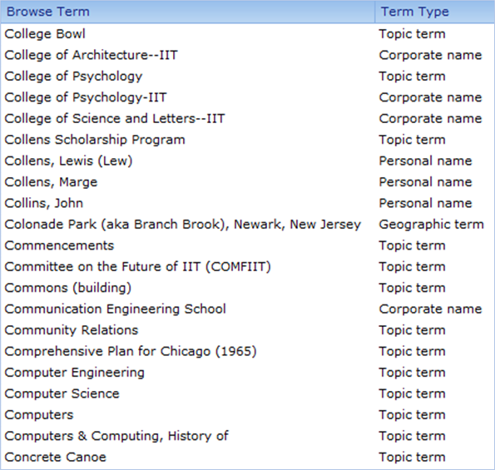
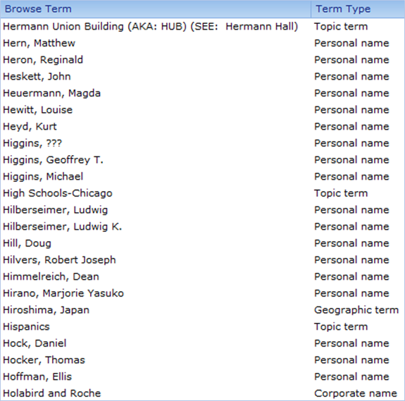
Notes:
Once all the authorities are combined, you see variant spellings, which is an issue for any catalog
Also see reference notes, which are relationships that can be communicated via a the authority record, even for a local term like Hermann Hall.

Slide 10
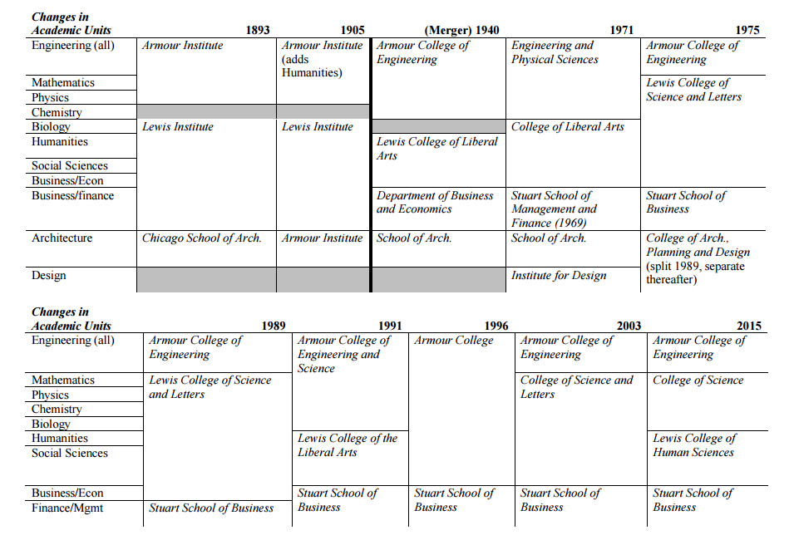

Slide 11
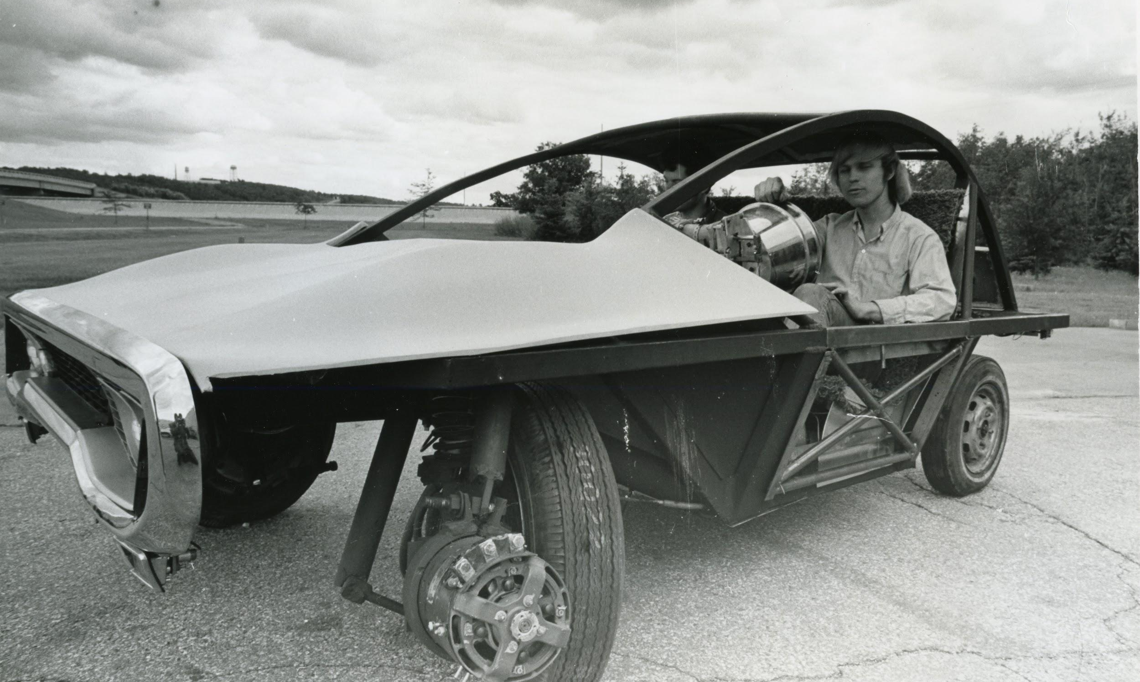
Migration
University Archives & Special Collections, Paul V. Galvin Library, Illinois Institute of Technology

Slide 12
ArchivesSpace
What is it?
Web-based open source archives management system, developed by and for archives
Issues solved
Enhanced discoverability: linking, sharing
Generates and links finding aids
Good levels of system/user control
Enforces standards
Free*
Notes:
Enhanced discoverability for both researchers and staff
Re:Discovery Demo:
Full text search
On public view no linking between hierarchies, but hierarchies are enforced on admin side by record type (collection, series, file).
Subject search - uncontrolled authorities (Corp name: McCuddy’s Tavern)

Slide 13
Workflow Restored
Receive material from donor
Create accession record
Process materials
Researcher accesses collection record
Publish collection record
Create collection record

Slide 14
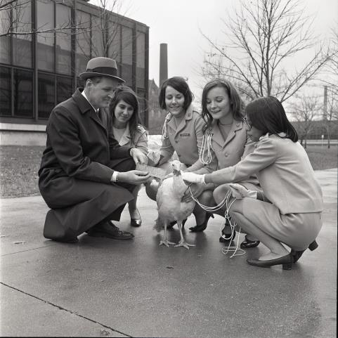
Lessons Learned
Systems influence workflows
Some constraint is good
New interfaces reveal metadata issues
Long-term v. short-term benefits of standardization
Staff are (very!) important users
University Archives & Special Collections, Paul V. Galvin Library, Illinois Institute of Technology

Slide 15
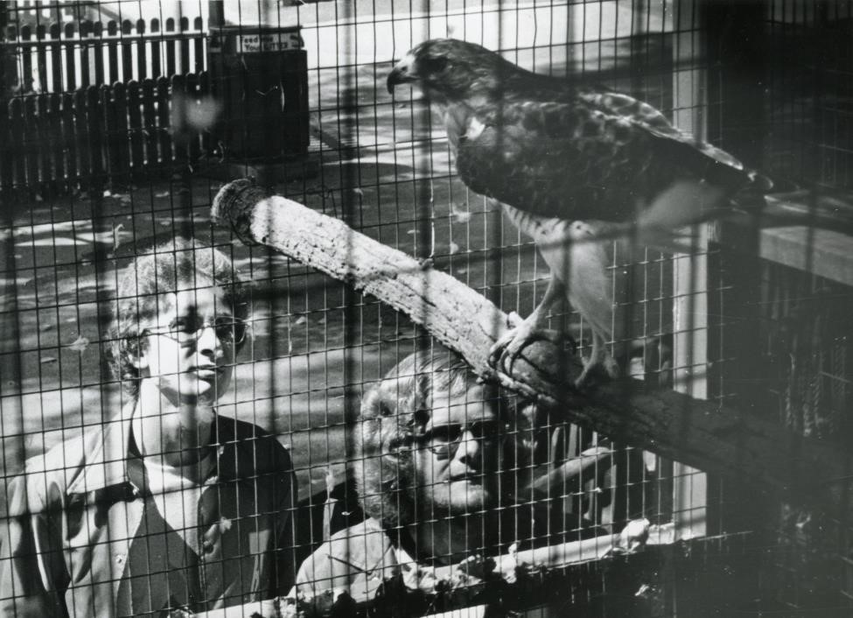
Thank you!
Greer Martin
gmarti15@iit.edu
Slides
https://goo.gl/MVbUjT
University Archives & Special Collections, Paul V. Galvin Library, Illinois Institute of Technology

