Slide 1
Getting to Know the ArchivesSpace API
Greer Martin
Illinois Institute of Technology
Code4Lib Chicago
May 23, 2016

Slide 2
Migration issues
Re:Discovery Proficio to ArchivesSpace
800 accession records to migrate
Can import accessions using CSV
But: associated agents did not import

Slide 3
Migration plan
Solution: Import agents using API, link to accession records in ArchivesSpace
Tools: OpenRefine, Cygwin (if using Windows)
API: http://archivesspace.github.io/archivesspace/api/

Slide 4
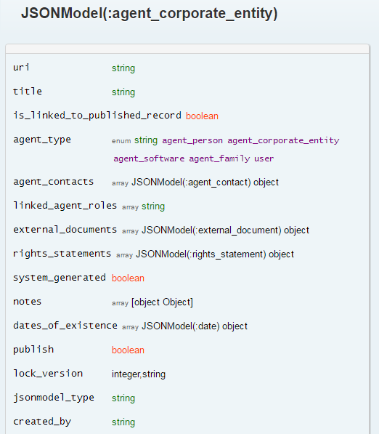
Agent schemas
Map donor data to ArchivesSpace agent schemas
Different schemas for person and corporate agents
JSON-ize records using OpenRefine

Slide 5
JSON template

Slide 6
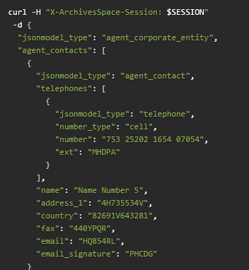
POST agents
Consult API for POST corporate agent command

Slide 7
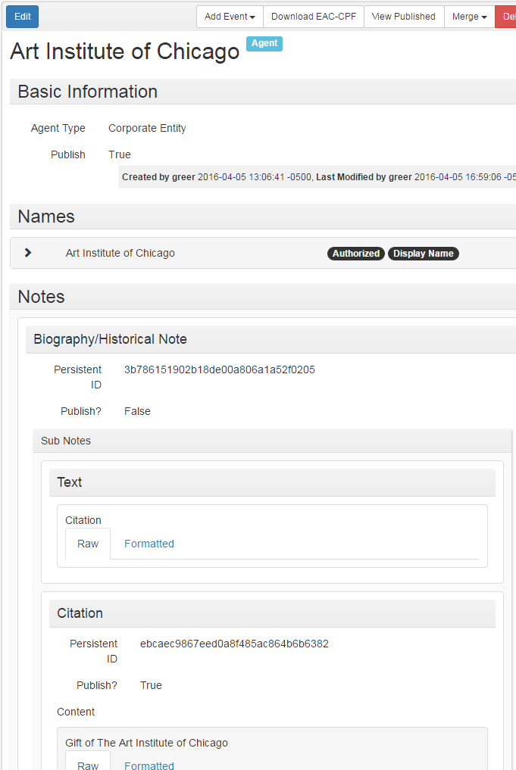
Agent created

