Slide 1
Reconciling Legacy Archival Metadata
Greer Martin
Paul V. Galvin Library,
Illinois Institute of Technology
Mashcat 2017

Slide 2
The Project
Migrate 5,000 records from Re:Discovery Proficio to ArchivesSpace
Over 1,700 are donor/creator records (Agents)
Complete in 1 year
Staff of 1 librarian + 1 volunteer (Alison)
The catch: No authorities were used! And names are not linked

Slide 3
The Plan
Batch export names (100)

Slide 4
The Plan
Batch export names (100)
LC Authorities reconciliation

Slide 5
The Plan
Batch export names (100)
LC Authorities reconciliation
Add local names

Slide 6
LC Authorities Reconciliation
Matches a spreadsheet of names against id.loc.gov
23 matches, 22 suggested matches: 45%
Avg. 1 hour per 100 records
Suggested matches link out to the LC record
Original metadata intact, serves as check for Alison and for me
Identifiers can be pulled in too

Slide 7
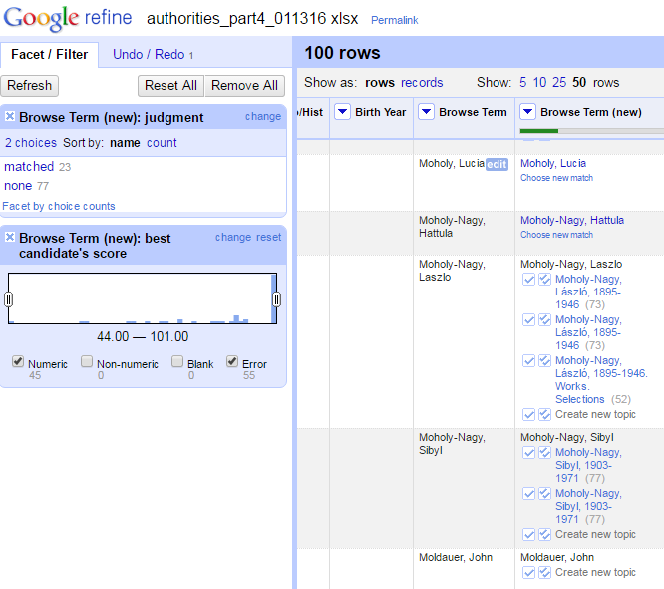
Post- Reconciliation
Matches
Suggested matches
Unmatched

Slide 8
Adding Authority IDs
[screenshot of adding the GREL thing, and added column of URIs]
*Maybe two slides*

Slide 9
The Plan: local names
Batch export names (100)
LC Authorities reconciliation
Add local names

Slide 10
Local Names Authority
[screenshot of local name authority]

Slide 11
CSV Reconciliation
reconcile-csv matches one dataset against another
Found at: http://okfnlabs.org/reconcile-csv/
Need CSV file + java + OpenRefine

Slide 12
The Plan
Batch export names (100)
LC Authorities reconciliation
Add local names
LC-reconciled names
Local name authority

Slide 13
The Plan
Batch export names (100)
LC Authorities reconciliation
Add local names
LC-reconciled names
Local name authority
Master CSV of all names

Slide 14
The Plan
Batch export names (100)
LC Authorities reconciliation
Add local names
LC-reconciled names
Local name authority
Master CSV of all names

Slide 15
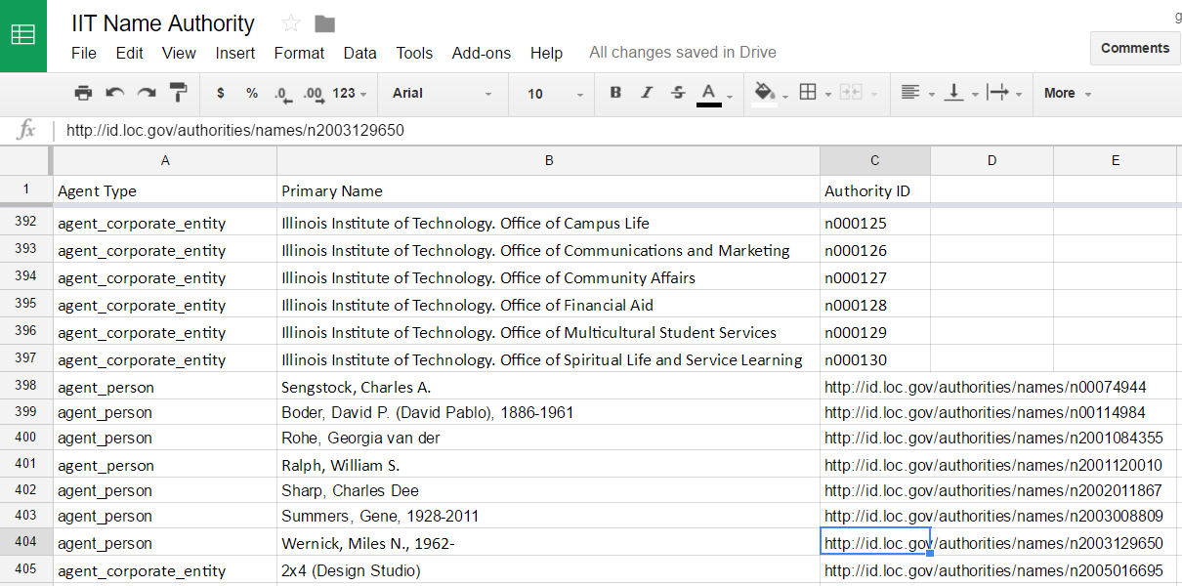

Slide 16
CSV Reconciliation
OpenRefine’s reconcile-csv matches one dataset against another
56 matches, 44 suggested matches: 100%
15 minutes per 100 records
Can also pull in IDs (or any other column) from spreadsheet

Slide 17
Subject Heading Reconciliation
Did I use reconcile-csv for this too?

Slide 18
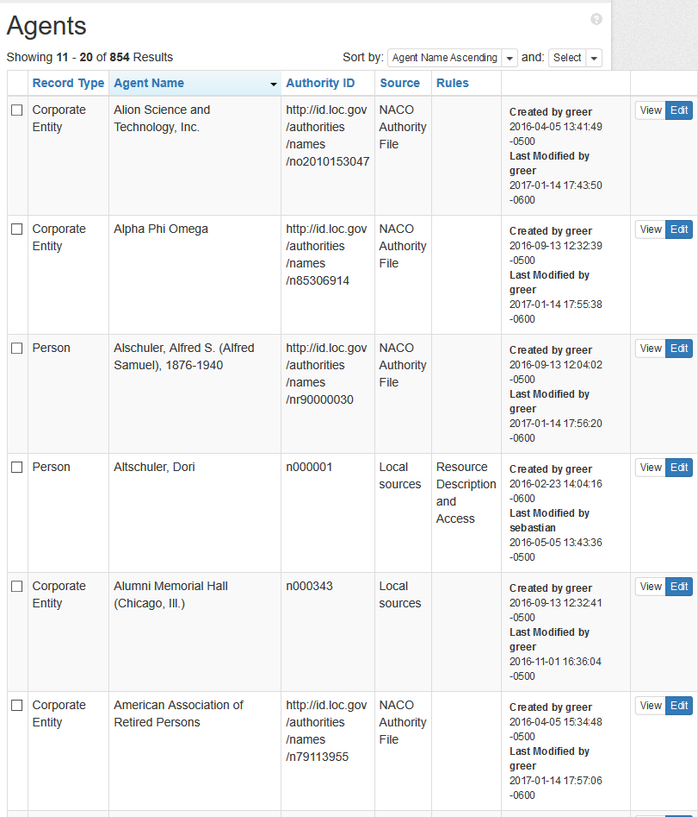
Conclusion
Took the most time = Evaluating LOC matches + creating local names
Took the least time = CSV reconciliation
Next time: concentrate volunteer time on authorities reconciliation, not CSV matching.

