Slide 1
Metadata Librarian’s Little Helper: OpenRefine Reconciliation Services
Greer Martin
Paul V. Galvin Library, Illinois Institute of Technology
Metadata Interest Group Meeting, ALA Midwinter 2017

Slide 2
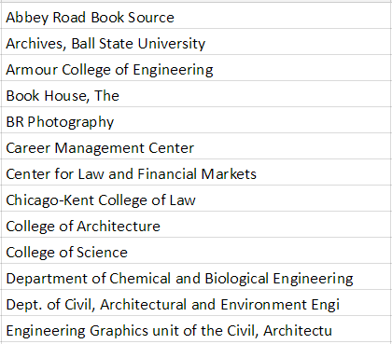
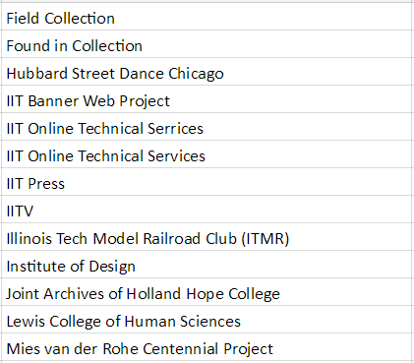

Slide 3
The Plan
Batch export names (100)

Slide 4
The Plan
Batch export names (100)
LC Authorities reconciliation

Slide 5
The Plan
Batch export names (100)
LC Authorities reconciliation
Add local names

Slide 6
The Plan
Batch export names (100)
LC Authorities reconciliation
Add local names
LC-reconciled names
Local name authority

Slide 7
The Plan
Batch export names (100)
LC Authorities reconciliation
Add local names
LC-reconciled names
Local name authority
Master CSV of all names

Slide 8
The Plan
Batch export names (100)
LC Authorities reconciliation
Add local names
LC-reconciled names
Local name authority
Master CSV of all names

Slide 9
Reconcile-CSV
Reconcile-csv matches one dataset against another
Found at: http://okfnlabs.org/reconcile-csv/
Recommended for:
LC Authorities reconciliation
local authorities reconciliation

