Slide 1
Partnering with Librarians
to Teach Research & Tech Skills Across the Curriculum

Slide 2
Goals
Grab Arrow by Adrian Naik
Notes:
https://www.flickr.com/photos/naik_media/14795247888 - Grab Arrow by Adrian Naik
Goals for faculty - adding to the classes
Goals for librarians - getting into the classroom, providing skills

Slide 3
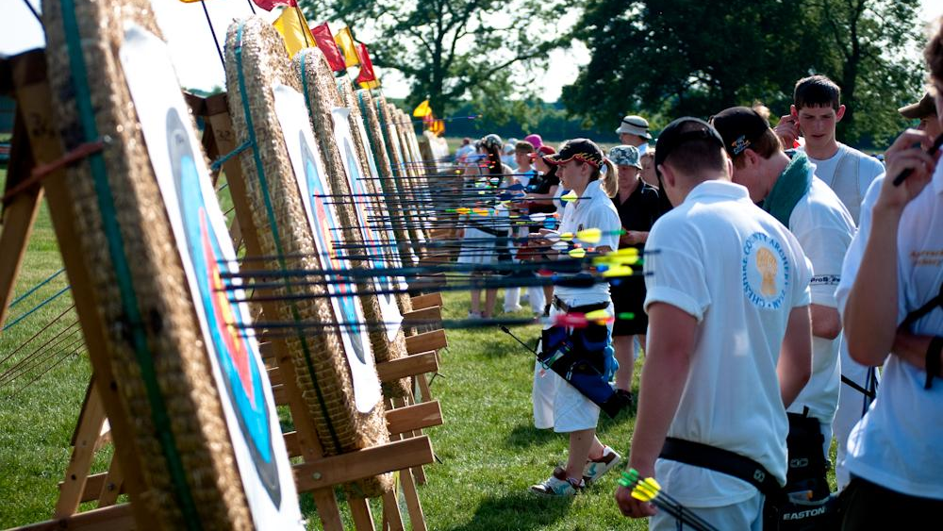
Improve Student Skills
Improve Student Skills
Photo by “laugh like muttley”
Notes:
Goals for students
skills they can use
Skills
https://www.flickr.com/photos/laughlikemuttley/4673016224/ - photo by “laugh like muttley” (Archery Course)

Slide 4
Introductions
Notes:
Research
&
Tech

Slide 5
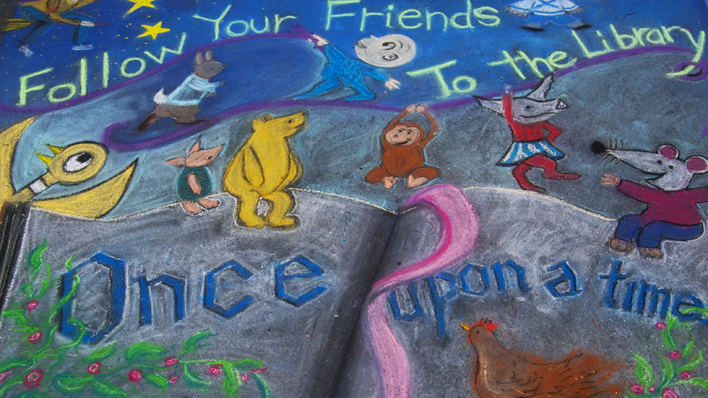
Beginning
Once Upon a Time by Damian Gadal
Notes:
https://www.flickr.com/photos/23024164@N06/3008728691/in/faves-60162443@N00/
Once Upon a Time by Damian Gadal
How it all began: Clare
We do not have our own class
Not in LW I and II, in LW III and IV
Invited to seminars

Slide 6
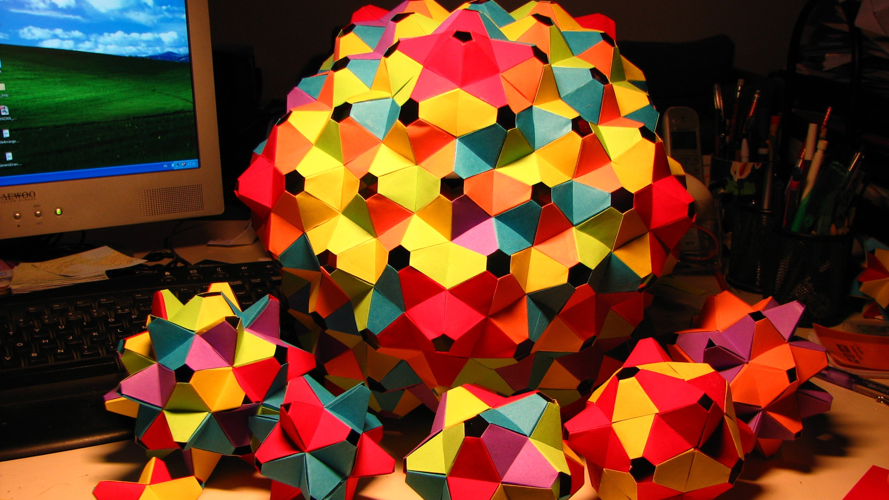
Modules
Modular Origami by “fdecomite”
Notes:
https://www.flickr.com/photos/fdecomite/2983833911/ - Modular Origami by fdecomite

Slide 7
hooks
Prickily Hooks by Derek Gavey
Notes:
Make sure there’s a hook to keep the students interested - anecdotes about previous assignments, job goals, etc.
Adult learners
https://www.flickr.com/photos/derekgavey/6020501642/ - prickily hooks by Derek Gavey

Slide 8
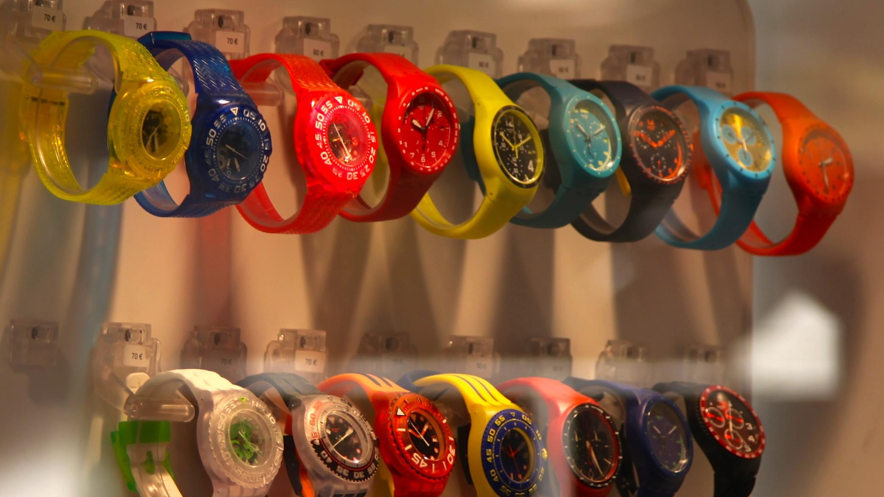
Finding Time
rainbow watches by “torbakhopper”
Notes:
Challenge of finding time in the semester
https://www.flickr.com/photos/gazeronly/15135325225/ - rainbow watches by torbakhopper

Slide 9
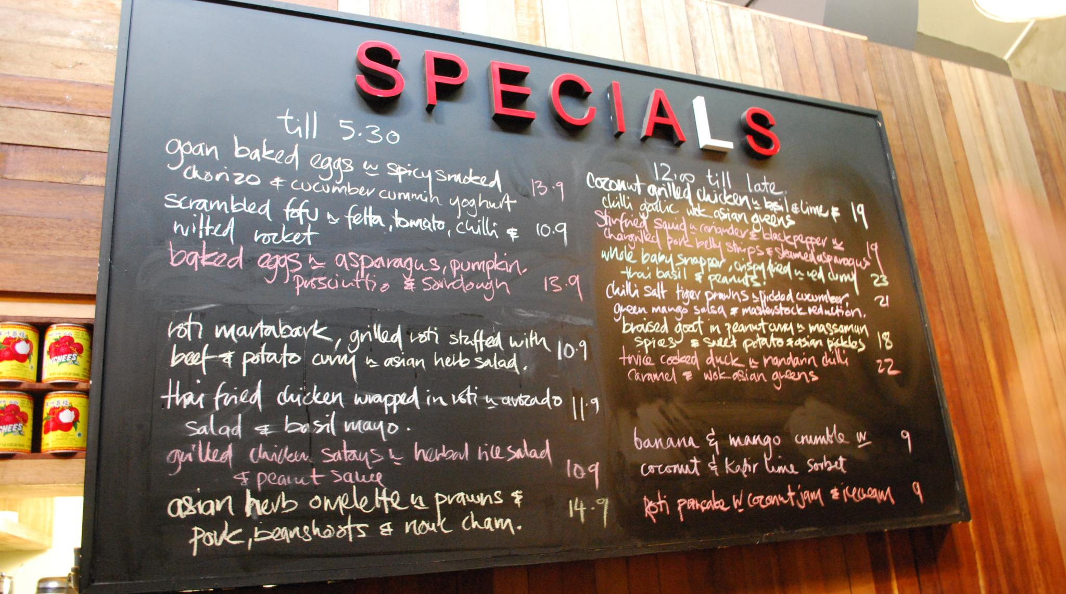
Menu
Specials blackboard menu by “Alpha”
Notes:
Menu for professors to pick the modules that fit best into their course
https://www.flickr.com/photos/avlxyz/4092649360/ - Specials blackboard menu by Alpha

Slide 10
Relevance
You Are Here by Roo Reynolds
Notes:
Match the information they need to the assignments to make sure they’re going to need to use it right away
https://www.flickr.com/photos/rooreynolds/92639417 - you are here by roo reynolds

Slide 11
Managing Time
Notes:
Designed to dovetail with one another, so can be combined
https://www.flickr.com/photos/wwworks/3596406125 - time management for kids by woodeywonderworks

Slide 12
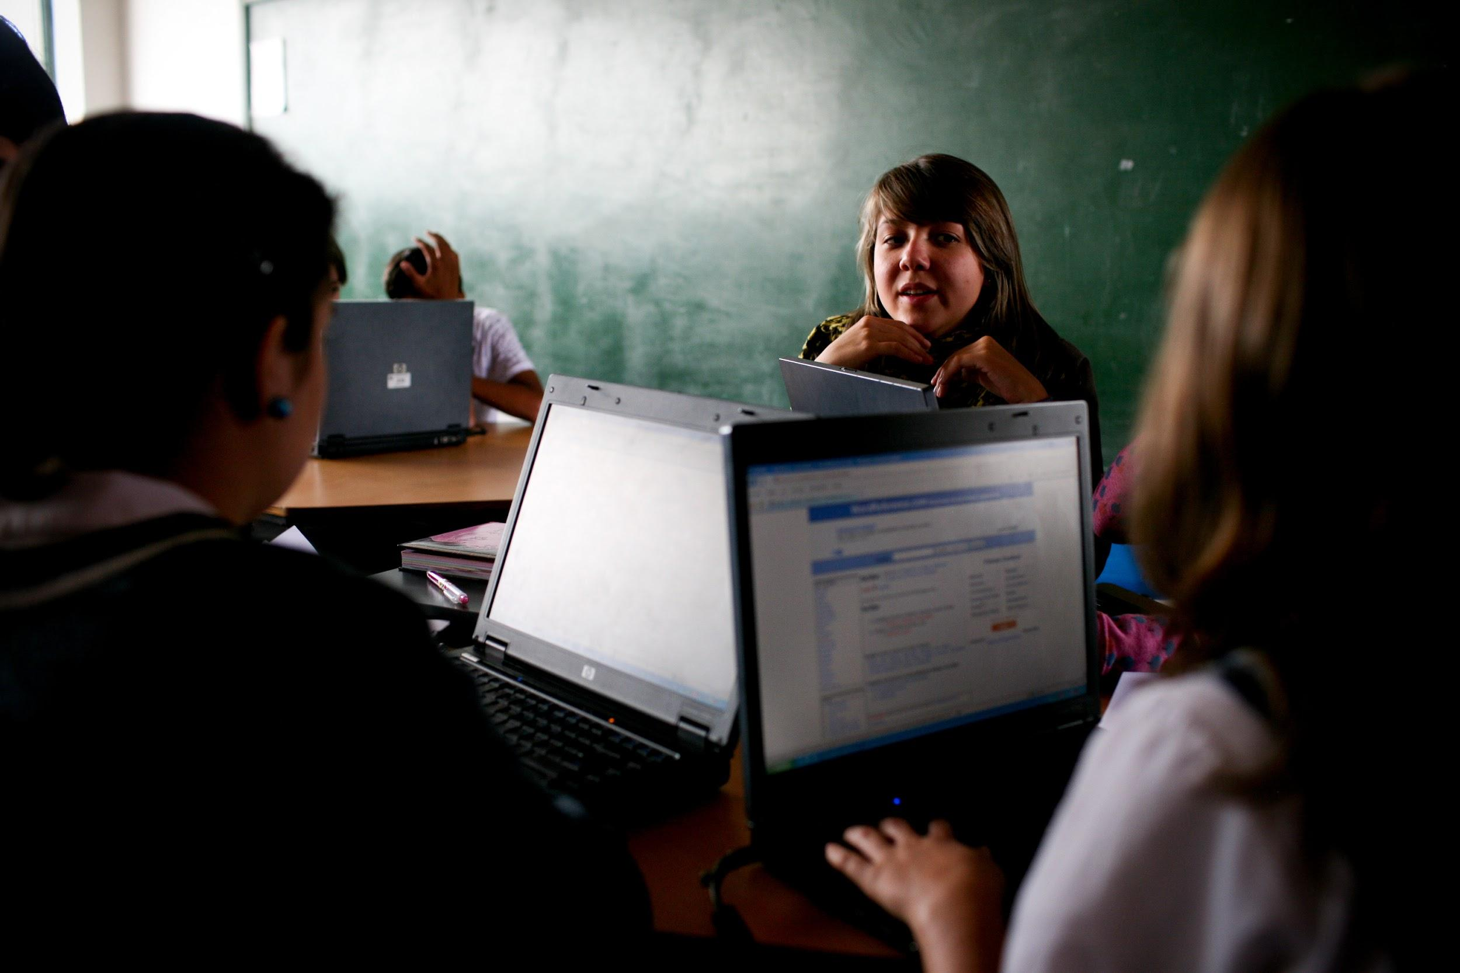
interactive
Notes:
In-class exercises geared to their assignments as much as possible
https://www.flickr.com/photos/worldbank/4700437282 - a technical education class from World Bank Photo Collection

Slide 13
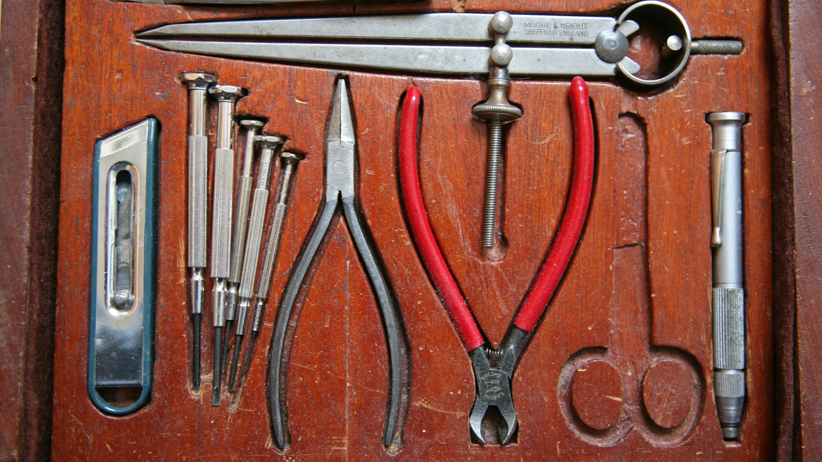
tools / handouts
Notes:
tools & handouts - big upfront cost to create materials, reusable going forward
https://www.flickr.com/photos/sarchi/838786980 - tool box by Peter Harris

Slide 14
Notes:
Iterative
https://www.flickr.com/photos/lhongchou/2934539734/ - spiral of mind by lhongchou

Slide 15
Tech Modules
Tech Modules
Notes:
Took idea from Clare
Modular, scalable, stackable

Slide 16
Why Tech?
Notes:
https://www.flickr.com/photos/emagic/56206868 - Good Question by Eric
Students need tech skills
High level (ediscovery with evidence) handled by other classes
But what about Word and other basic skills? Students think they know, but don’t
Use the modules to teach just in time when they have assignments due

Slide 17
Choices
Notes:
Proposed modules tied to student needs - completing assignments, organizing notes, preparing for projects, studying; just in time
Microsoft Word
Word Foundations (styles, page numbers, footnotes)
Word Advanced (table of contents, table of authorities)
Document Management
Using Google Drive and Cloud Storage (note taking, collaborative editing, file storage)
Working with PDFs (editing and annotating tools)
Other Tech Skills
Creating Videos for Review (useful for oral argument preparation)
Speaking and Listening to Your Computer (useful for creating and reviewing written assignments)kills
Word
Foundations
Advanced
Document Management
Google Drive
PDFs
Other
Creating videos for peer review
Speaking/listening to your computer
Presentation skills

Slide 18
Challenges
Office 2016
Office 2008
Office 2011
Office 2016
logos from “Logopedia”: http://logos.wikia.com/wiki/Microsoft_Word
Notes:
Different versions of word
Different skills
Keeping students focused
Focus on Interactivity
What are they working on?
What versions of Word are current?
Integrate into guide - we can’t teach every version in class
Create hands-on exercise based on current assignment
Use Google Slides to create a structure
Available for tech reference later

Slide 19
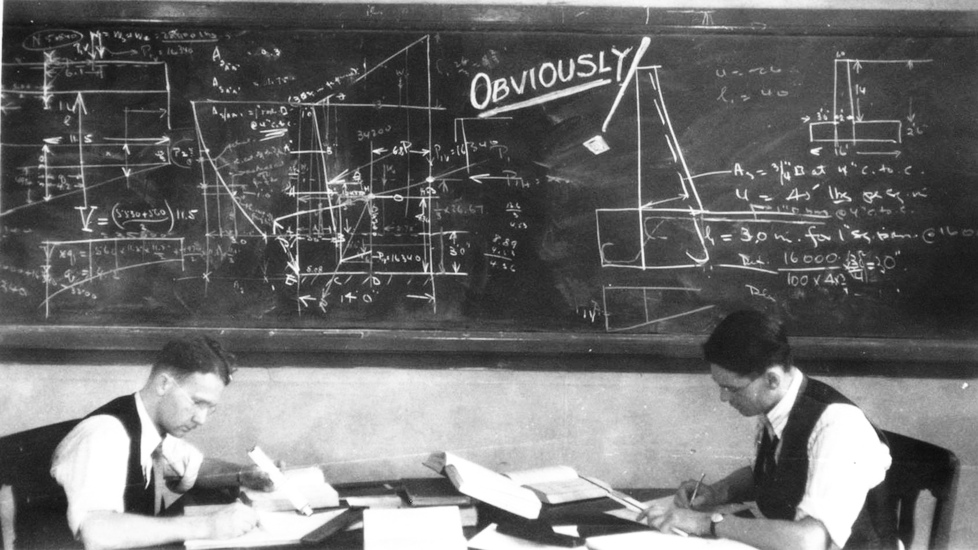
Results
Notes:
Students used the skills
Students used the resources outside of class
Became more familiar with vocabulary

Slide 20
Future of tech
Notes:
https://www.flickr.com/photos/dtwpuck/6369705813 Future Tools of the Future! by Scott Smithson
Flip the instruction - track student performance before class

Slide 21
Results - Research
More collaboration!
Notes:
https://www.flickr.com/photos/aidan_jones/3575000735/ - Handshake by Aidan Jones
Working with staff more - opportunities in other classes.

Slide 22
Results - Tech
Notes:
More student traffic
More classes taught
Students get to know we are a source for help

Slide 23
Questions?
Notes:
Questions?

