Slide 1
Change: Embracing It, Managing It and Changing Again
Sharon L. Bostick, Ph.D
Dean of Libraries, Illinois Institute of Technology
Leipzig, 14 March 2016

Slide 2
What is change? And what is change management?
Change: To make or become different
Change management: the management of change and development within a business or similar organization
Definitions are from the Oxford English Dictionary

Slide 3
Change: it’s a good thing. Inevitable too.
Libraries naturally reflect and react to societal and technological changes.
It is healthy for Libraries to analyze and anticipate changes as our stakeholders needs shift. We adapt and evolve in accordance to the value that our contributions are able to impart.

Slide 4
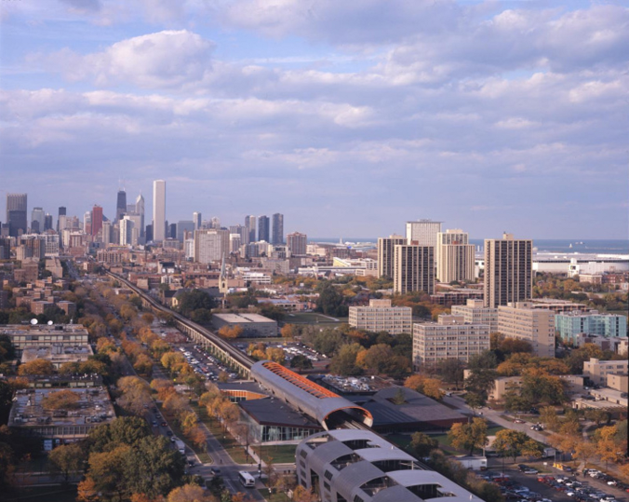
The Illinois Institute of Technology

Slide 5
The Illinois Institute of Technology
A technology-focused, Ph.D.-granting research university
Main campus designed by Mies van der Rohe
Competitive programs in engineering, architecture, the sciences, humanities, psychology, business, law, and design
7,800 students with high retention rate
Intense goal to increase undergraduate enrollment by 5,000 in five years

Slide 6
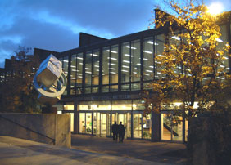
Library
Library is heavily used by students.
Open 24/5.
Most faculty use is virtual.
Known for creativity and a welcoming atmosphere.
Flexible style and seeks to empower students.

Slide 7
Library
Busiest building on campus
New Dean, first from “outside” in over twenty years.

Slide 8
A Change Management Example at IIT Libraries
First…
We began with new Strategic Plan.
We involved the staff to articulate our value, purpose and mission.
We used the framework from the university’s Strategic Plan
We created consensus and a framework for articulating our value, and guiding our efforts.
The staff understand the plan. This is very important in creating successful change management.
Notes:
Note new dean

Slide 9
Strategic Priorities
Service & Teaching
Information Navigation
Meeting Evolving User Needs
Collections & Technology
Improving Technological Infrastructure
Curate Digital Resources for virtual Research Support
Enhancing Spaces
Knowledge Creation
Assessment & Refinement of Virtual Spaces
Partnering with Peers
Integrating in all University Efforts
Perpetual development of Staff
24/7 Full Service
Brokering & Preserving Resources
Interactive Spaces
Adaptive Organizational Structure
Evolving Needs
Seamless Electronic Delivery
Specialist and Generalist Expertise for Research Support
Articulating Library's Universal Value to University

Slide 10
Strategic Planning Implementation, Assessments
A culture of assessment was already in place by time of Strategic Plan, as evidenced by LibQual, Student Speaks university survey, our Student Library Advocates, Assessment in Action grant, and Archival Consultant’s Report.
Implementation included meeting with all staff and having 2 and 5 year plans based on the broader plan.

Slide 11
Digital Initiatives
Digital Initiatives | FY2015 (now) | FY2017 | FY2019
Service & Teaching | IR opportunities for academic depts | ID'ing IR users needs
Service & Teaching | ID IR discussions with COA | ID'ing peer IR dis/advantages
Service & Teaching | Create language for Digital Humanities and CHAT liaison roles for DIL | Proposal for IR strategy finished | Implementation of IR solution finished
Collections & Technology | Dissertations/Theses in IR?
Collections & Technology | ID'ing IR capacities Dspace/Bepress | ID preferred platforms for projects
Collections & Technology | Columbian>Omeka (test case!) | Other digital collections>Omeka
Collections & Technology | short-term DAMS solutions (IR?) | Craft a DAMS/preservation proposal(s) | Implement DAMS/digital preservation solution
Collections & Technology | Revisit IR policies (licensing, UG openness structure)
Enhancing Spaces | Map Collection | Policy-ish Philosophy of DI spaces/resources document
Enhancing Spaces | Envisioning new DI workspace/office
Partnering with Peers | Conversations with GRC, Kent
Partnering with Peers | CCC Portal | Promotion plan for IR?
Partnering with Peers | CARLI Created Content Committee
Partnering with Peers | IR discussions with Cloud Studios
Partnering with Peers | DIG assessment plan
Partnering with Peers | Collaborative Grant Opportunities | Collaborative Grant Opportunities | Collaborative Grant Opportunities
Partnering with Peers | New UASC collaborations | Specific ASC initiatives | Specific ASC initiatives
Strategic directions
IR evaluation, comparison, and implementation of solutions (adaption, transition, etc.)
Implementation of DAMS and digital preservation policies, processes, and technology
Active efforts for collaboration with partners such as Archives & Special Collections for digital initiatives and grant seeking opportunities

Slide 12
First change: Restructuring the Liaison Program
Existing liaison programs were an object of contention, as no particular strategy met with consensus.
All-Liaison meeting helped talk through challenges and opportunities.
Assessment, Reference & Instruction, and Collection Development Department Heads collaborated to lead new way forward.
Liaison duties and job description addendums were created, discussed, and implemented.
Most librarians became liaisons.

Slide 13
Then the First Big Change:
The Collection Development department was dissolved.
A new department, STEM was created to support the major university programs.
Collection Development became team-based, led by a small steering group.
The liaison group became this team with a strong outreach orientation and were empowered to make decisions.

Slide 14
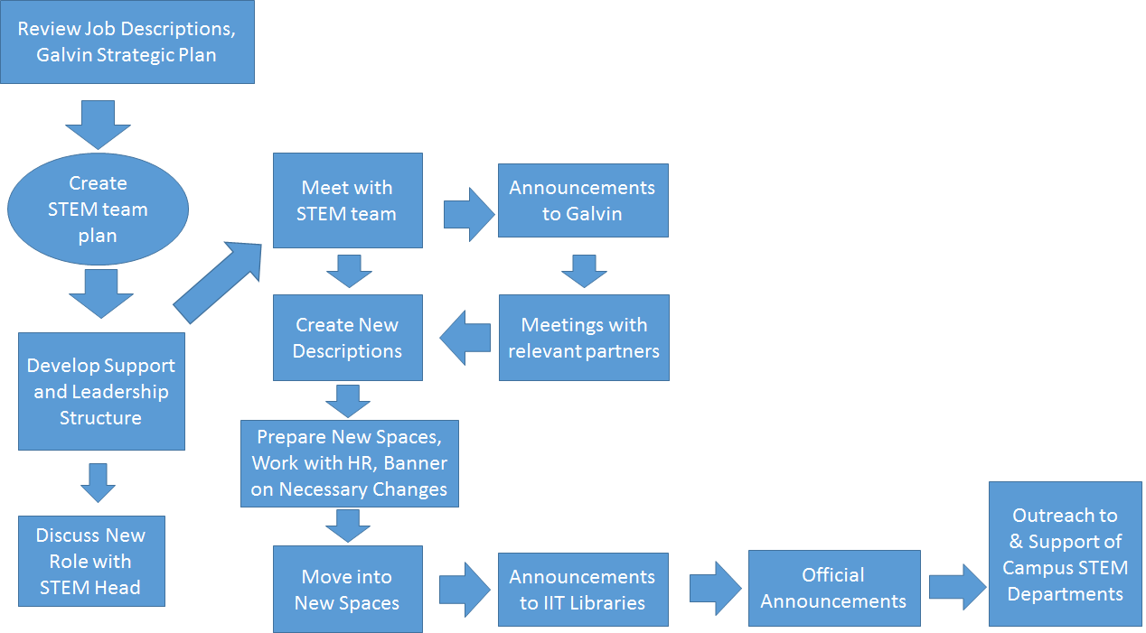

Slide 15
Collection Management turns to Liaisons
All liaisons would be kept informed, given voice on possible changes in their areas.
Liaisons are expected to partake in prioritizing and decision-making reflected in LibGuides, Website Databases, and Collections.
This was also the opportunity seized for a reorganization and more even dispersal of subject area duties.
The first major task for this group was to evaluate the collection and develop a two and five year plan to strengthen it.

Slide 16
Steering Group tackles tough tasks
Understanding basic workflows, data points
Creation of OS ERMS “Coral”
Identification of unsustainable development model for E-Resources
Conversation space for challenges of Print collections, space issues
Evaluation and assessment of entire E-Resource collection (100 DBs, 50,000 ejournals)

Slide 17
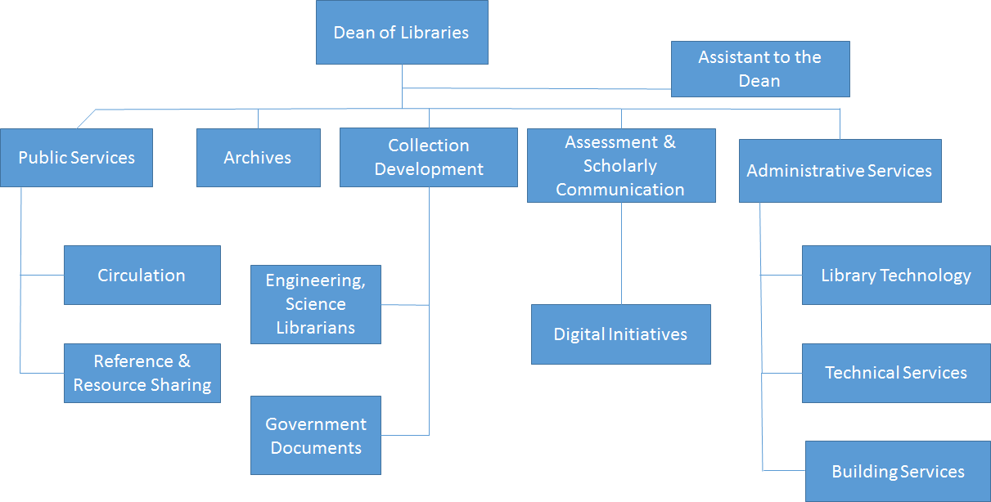
Organizational Chart Before

Slide 18
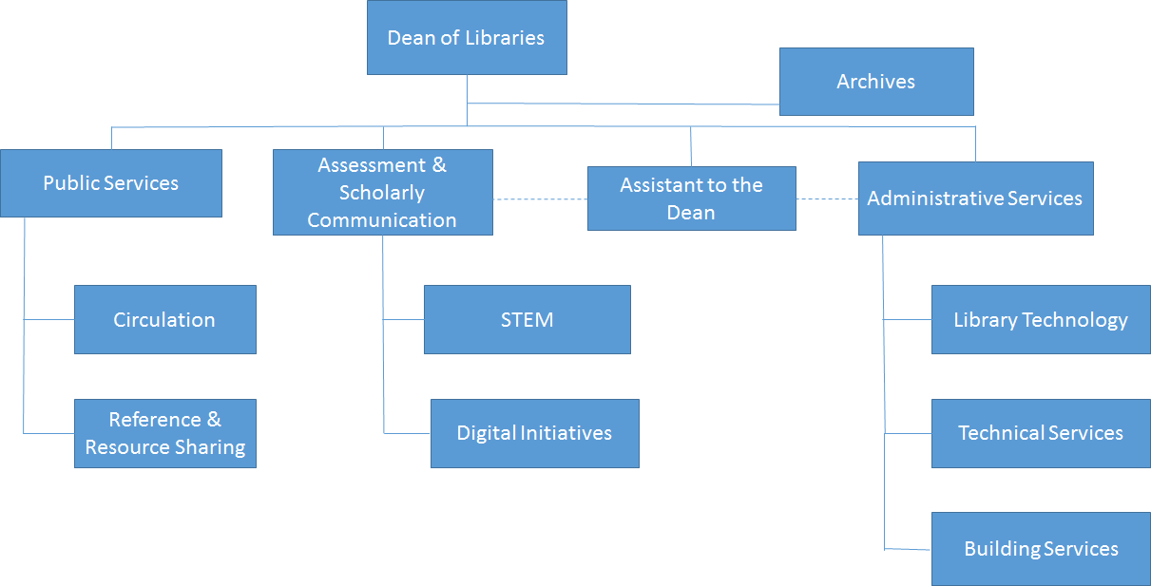
Organizational Chart After

Slide 19
And then the second change happened
A sudden major budget crisis happened unexpectedly.
We had to change rapidly from a long-term systematic analysis mode to an immediate one, utilizing a variety of tools and outreach to faculty.
The team had to review the collections quickly and make significant recommendations for cuts.
They succeeded.

Slide 20
The Good …
Responding to the budget crisis was a good example of changing quickly to achieve a goal, however unhappy.
It was good experience with everyone participating in assessment activities.
The new liaison/collection structure was strengthened.
All librarians understand the collection and we are in a stronger position to rebuild when recovery comes.
There is less fear of change.
We have proven that we can be flexible and proactive.

Slide 21
…And the Bad
The bad—we have a huge budget cut!
Future changes will be heavily influenced by this negative budget situation

Slide 22
Another Change, With No Additional Funding
The unexpected retirement of the University Archivist gave us the opportunity to change the entire service with no new funds.
Expanded the department to become University Archives and Special Collections and hired a new Head of Department.
Reassigned staff who now work there but collaborate with other departments.
Provide strong outreach to the students, university and community and raised the visibility of the university and the library.
This change was easy.

Slide 23
Conclusion: Change!
Change is good and inevitable.
Processes that value trust, staff input, and assessment will be rewarding.
Be strategic.
Have an overreaching plan that will guide you when the unexpected happens.
Communicate.
Assess.
Experiment.

Slide 24
Thank you!
Sharon L. Bostick, Ph.D
sbostick@iit.edu
Devin Savage, Assistant Dean for Assessment and Scholarly Communication at Illinois Institute of Technology contributed to this presentation.

