Slide 1
Balancing copyright and access in digital collections
Greer Martin
Paul V. Galvin Library Mini Conference
May 18, 2016

Slide 2
OUTLINE
Basics of copyright law
Why challenging for libraries and archives
Case study: 3 works from the UASC’s Institute of Design Records, 1937-1955
Fair Use
Rightsstatements.org
Notes:
Go through a journey of determining copyright, along the way we’ll cover the major amendments and provisions that you may encounter.

Slide 3
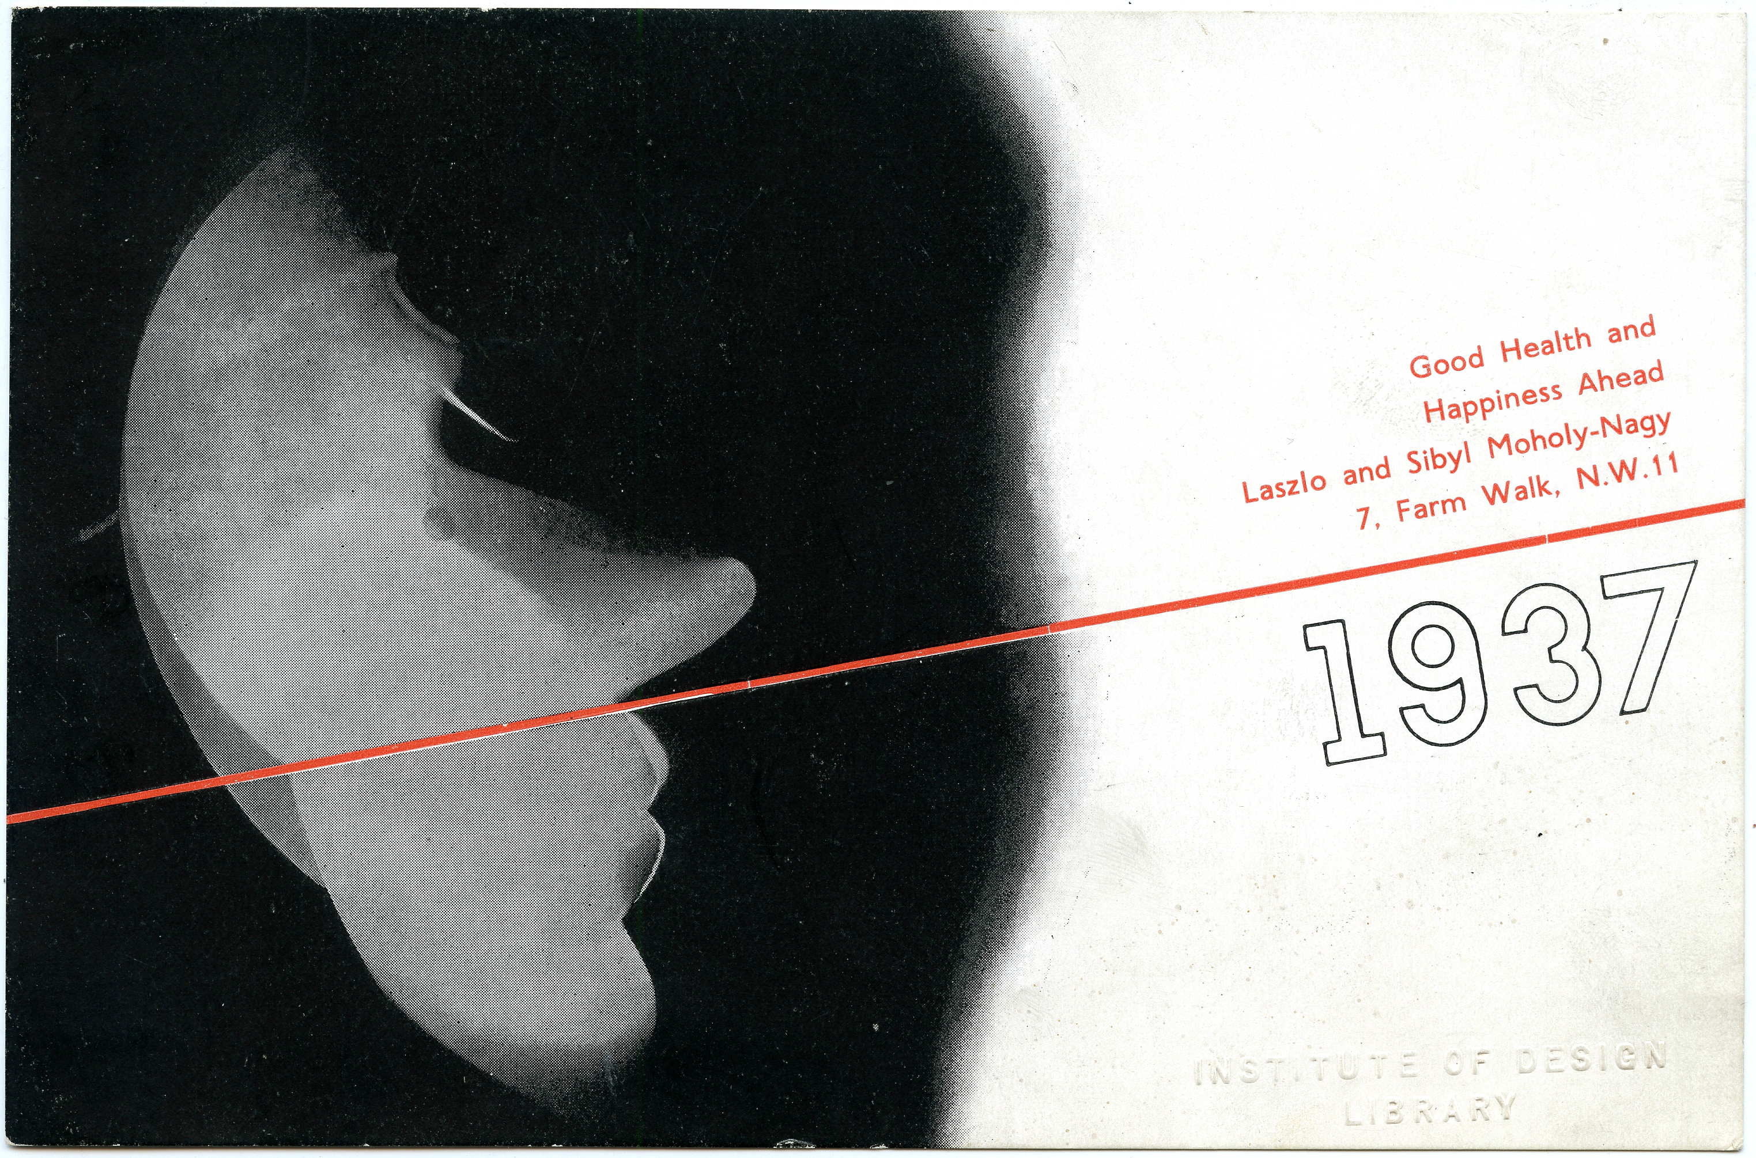
CASE STUDY
Institute of Design Records, 1937–1955
34 boxes: administrative records, photographs, correspondence, publications
Applied for a CLIR grant in April 2016 to digitize collection and make available online
Begin risk assessment so that we digitize safely
Illinois Institute of Technology, Paul V. Galvin Library, University Archives & Special Collections, Institute of Design Records, 1937-1955
Notes:
Mixed material. Not all created by the Institute of Design, so a variety of creators. Some published material, some is not. Dates of creation and/or publication is between 1937 and 1955, so as we will see, we are right in that sweet spot of copyright status grey area (after 1923, before 1989).

Slide 4
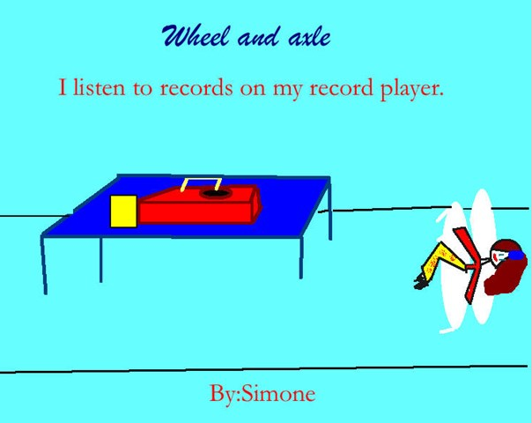
PRINCIPLES OF COPYRIGHT LAW
The Copyright Act of 1976 (U.S.C. Title 17)
Section 106 grants the owner of copyright the exclusive right to perform certain acts:
Reproduce (includes digitization)
Distribute (including online access)
Display (including on a computer)
For the life of author + 70 years
When the above acts are performed without a license = Infringement
Except if covered by exemptions (Fair Use)
Notes:
“To promote the Progress of Science and useful Arts, by securing for limited Times to Authors and Inventors the exclusive Right to their respective Writings and Discoveries.” Article 1, Section 8 U.S. Constitution.
Is an economic incentive for creators to keep creating and DISTRIBUTING work, not just keeping for themselves
Since 1976 this is the term, and since 1989, no requirement to register copyright = anything that is an original expression, created through human effort, and manifested in tangible form is copyrighted automatically for this period of time. No publication or sale is necessary, no registration or copyright notice required
Infringement when above acts are performed on a copyrighted work without a license from the copyright holder.
Copyright Act includes exemptions, one of these is the Fair Use Doctrine, which we will get into later

Slide 5
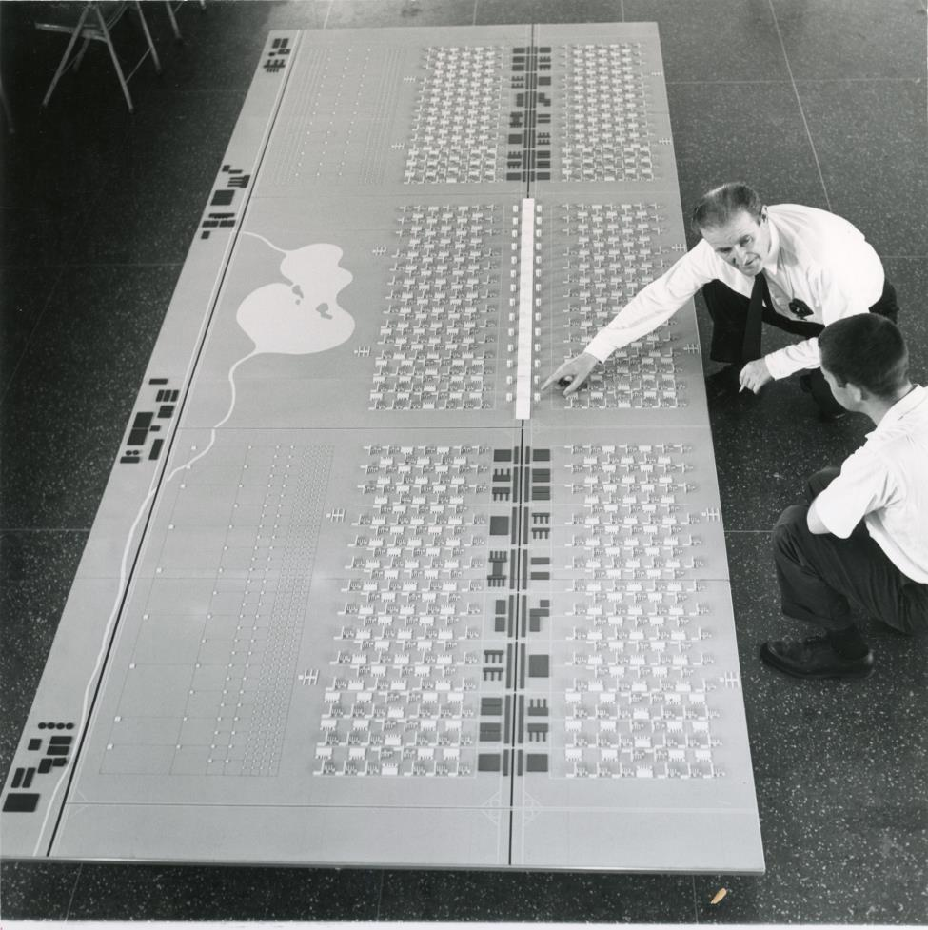
LIBRARIES + ARCHIVES DIGITIZATION
We have works that were created before 1989
Historical amendments not completely retroactive
Status will depend on
Life of creator
Date of publication
If copyright was renewed
All of the above might be unknown
What kind of rights statement do you use?
Illinois Institute of Technology, Paul V. Galvin Library, University Archives & Special Collections, Unprocessed Photo Collection, Box 2
Notes:
Amended many times throughout history.
Not retroactive in full – so can’t say that because currently the term of copyright is life of author + 70 years that we can apply that to everything in the archive. For works published before 1978, copyright runs for a fixed period of time according to the rules in place when copyright was originally secured.
Sometimes a combination of these things.
Challenging when you

Slide 6
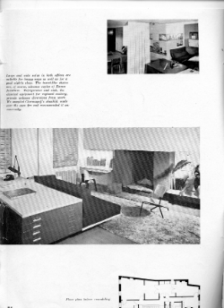
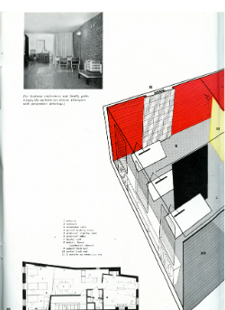
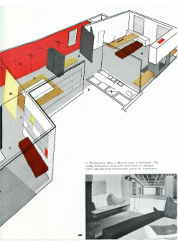
ITEM 1: PUBLISHED, KNOWN CREATOR
Article from Interiors magazine, February 1947

Slide 7
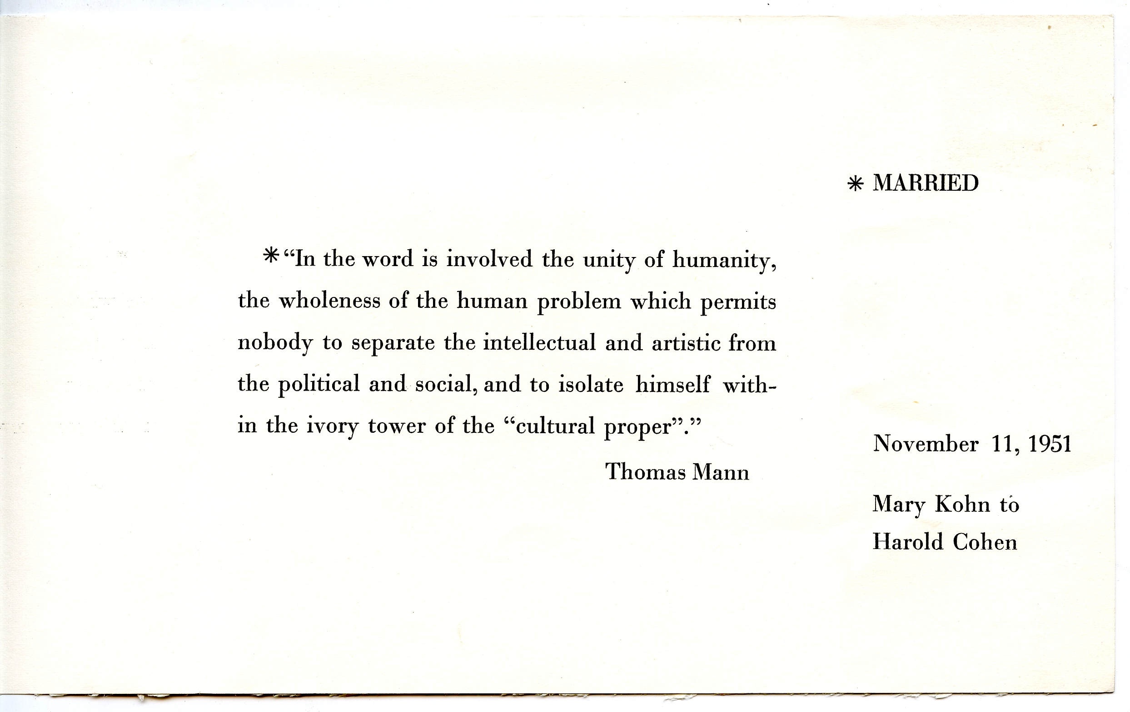
ITEM 2: UNPUBLISHED, KNOWN CREATOR
Wedding invitation by Harold Cohen
Notes:
Student at Institute of Design

Slide 8
ITEM 3: UNPUBLISHED, UNKNOWN CREATOR
Photograph of Institute of Design students, vehicle design project, circa 1960
Notes:
Photograph

Slide 9
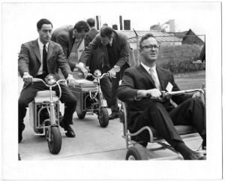
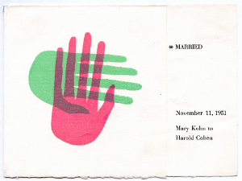
WAS THE WORK PUBLISHED BETWEEN 1923 AND 1989?
Article: Yes (1944)
Invitation: No (unpublished)
Photograph: No (unpublished)
Notes:
Anything published before 1923 is in the public domain, because before the Sonny Bono Copyright Term Extension Act in 1998, the longest copyright term was 75 years. The Extension Act added 20 years to that. But, what had already lived its 75 year protection at that point (in 1998) remained in the PD. This means everything published up to 1923.
1989 is important because after this date, a work does not have to even be registered with the copyright office to receive protection. If this had been published in 1989 or later, then our investigation would be over since it would with certainty be under copyright.

Slide 10
DOES THE PUBLISHED WORK HAVE A © NOTICE?
Maybe
Was it published before 1964?
Yes
Notes:
Not visible in tear out, and not visible in the issue that the library has. Might be on the back cover, which is not included.
Whether it has a copyright notice is important because between 1923 and 1989, there was the requirement that a volume contain a copyright notice. If not, it entered the public domain. Also will need to be renewed if you want it to remain in copyright. Copyright Renewal Act of 1992 made renewal optional for any work in its first term of copyright (published less than 28 years before passage of the Act, so anything before 1963 will only have the 95 yr term if their copyright was renewed, otherwise falls ).
http://www.ibiblio.org/ccer/

Slide 11
WAS COPYRIGHT RENEWED?
1950-1963 at copyright.gov/records. Index for periodicals at upenn.edu
1923-1949 in Catalog of Copyright Entries (CCE). Some online at ibiblio.org/ccer
1950-1992 books searchable through Stanford.edu

Slide 12
SO WAS IT RENEWED?
Yes
Protected for 95 years from publication date

Slide 13
UNPUBLISHED WORK: WAS IT REGISTERED WITH THE COPYRIGHT OFFICE?
Invitation: No
Photograph: No
Notes:
Extremely rare

Slide 14
WHO CREATED IT?
Invitation: Individual
Photograph: Possibly work for hire
Notes:
Harold Cohen, student at ID
Possibly work for hire by IIT, School of Design

Slide 15
CREATION BY INDIVIDUAL: Is the author still alive?
I don’t know
Protected for 120 years from date of creation
Notes:
Life of author + 70 years

Slide 16
COPRORATE AUTHORSHIP: What year was the work created?
Around 1960
Protected for 120 years from date of creation
BUT
Illinois Institute of Technology is the rights holder
Notes:
Life of author + 70 years

Slide 17
COPRORATE AUTHORSHIP: What year was the work created?
Around 1960
Protected for 120 years from date of creation
BUT
Illinois Institute of Technology is the rights holder
Notes:
Life of author + 70 years

Slide 18
FAIR USE EXEMPTION
Purpose
Nature
Amount
Market impact

Slide 19
RIGHTS STATEMENTS
Rightsstatements.org
11 standardized rights statements for cultural heritage institutions
Communicates how works can be used
Include statements for works in copyright and of unknown copyright status (orphan works)

Slide 20
RIGHTSSTATEMENTS.ORG
In Copyright (InC)
In Copyright – NonCommercial Use Permitted (InCNC)
In Copyright (InC)

Slide 21
RESOURCES
Copyright Renewals
copyright.gov/records
Index for periodicals at upenn.edu
ibiblio.org/ccer
Copyright term calculator
http://www.publicdomainsherpa.com
Copyright Genie
http://librarycopyright.net/resources/genie/genie.php
Copyright Term and the Public Domain in the United States
http://copyright.cornell.edu/resources/publicdomain.cfm
ALA Copyright Slider
http://librarycopyright.net/resources/digitalslider/

