Slide 1
IIT CARES
Creating Access to Remote Electronic Support
Facility Dr. Elie Geisler, Professor of Management
* Carolyn Kos * Nicole Valio * Hazel Michael * Unubold Chinzorig * Kendra Johnson *

Slide 2
The Problem
Diabetes costs the U.S. $174 billion dollars annually (Center for Disease Control and Prevention)
Telemedicine allows for patients to easily record and send their glucose readings to the hospital through mobile devices
IPRO 345 will help Mount Sinai hospital decrease the costs and increase the quality of care for diabetes patients
Notes:
Imagine that you have just been diagnosed with the chronic disease diabetes. Every day for the rest of your life, you must remember to check your blood sugar levels. You must keep a log of all your readings, and remember to bring these to the hospital for regular check-ups. Imagine the time you will lose waiting at the hospital, filling out paperwork, repeating your medical history to your nurses and doctors.
Now imagine this scenario: What if you could use technology to automatically send your medical data to the hospital? What if this technology sent you daily reminders to log your data? What if this technology automatically signaled you if your glucose levels were too high or too low? What if this technology helped prevent unnecessary doctors appointments and the high costs of hospitalization?
What if this brighter scenario became a reality? The goal of IPRO 345: IIT CARES is to make this happen. By Spring 2012, we hope to create a data support center to aid diabetic patients within 500 meters of Mount Sinai Hospital.
Diabetes is a chronic and debilitating disease that affects 25.8 million people in the United States. The cost of care and treatment of diabetes in the United States in 2007 was $174 billion dollars according to the Center for Disease Control and Prevention. In 2010 1.9 million people were newly diagnosed with diabetes, and the number is expected to rise as more American show signs of pre-diabetes.
Blood glucose monitoring is the main method for a patient to manage diabetes. Maintaining a record of blood glucose levels allows health care providers to understand the patient’s response to the current treatment plan. Currently, patients test their glucose level with a glucose meter and hand writes the results. Later this data is transcribed into a digital record that is shown to the doctor during a consultation.
The need for diabetes patients to repeatedly schedule consultations with doctors to review their blood glucose levels is costly and wastes time. Doctors are frequently given incomplete records of the patients’ glucose levels and health providers must take the additional step to digitize the information to display trends of the patients’ response to treatment.

Slide 3
OUR PLANS
Suggest best possible devices and software for Mt.Sinai Hospital to use to build the Diabetes Support Center
Find most suitable software for the Support Center
Suitable for the doctors, nurses and technicians
Find most suitable device for the diabetic patients
One that has the most simple functionality
One that is most affordable
One that has the most benefits

Slide 4
Progress Toward Goals
Research glucose meters and other options for remote testing
Create a report detailing our findings of the most promising technologies

Slide 6
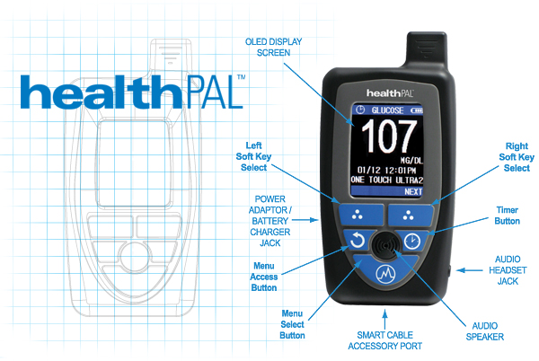

Slide 7
HealthPal demo

Slide 8
Processes of exploration
Clinical Path
Data collected from patients at home
Analysis of data in hospital
Clinical action following analysis
Administrative Path
Management, organization, administration at Mount Sinai of data
Storage , interpretation, connectivity of data
Studies performed

Slide 9
Obstacles Encountered
Late change in the head of our project at Mount Sinai
Issues finding a time to meet with Mount Sinai officials
Delay in project timeline

Slide 10
The Future OF IPRO 345
PHASE 1
Research available technologies
Interview Mount Sinai administrators
PHASE 2
Lead experiment with chosen testing equipment
PHASE 3
Implement technology

Slide 11
Questions?

