Slide 1

IIT C.A.R.E.S.
Instructor Dr. Elie Geisler,
Unubold Chinzorig *Kendra Johnson* Carolyn Kos Hazel Michael * Nicole Valio

Slide 2
Diabetes
An estimated 285 million people, corresponding to 6.4% of the world's adult population, will live with diabetes in 2010.
  25.8 million children and adults in the United States—8.3% of the population—have diabetes.
Diabetes was the 5th leading cause of death in 2005
Diabetes costs $185 billion dollars in 2010 (U.S.)
  2/3 of this cost is for in-patient care
Patients can monitor diabetes treatment by periodically checking their blood glucose levels

Slide 3
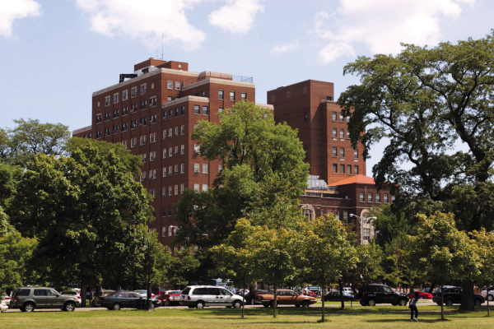
Mount Sinai Hospital
Mount Sinai Hospital is located on the west side of Chicago
The hospital facilities include a main building and a rehabilitation center
  Approximately 600 beds
It primarily serves underprivileged patients in the surrounding community

Slide 4
The Problem
Telemedicine allows patients to send glucose readings to doctors via mobile devices
IIT C.A.R.E.S. is collaborating with Mount Sinai hospital to decrease the costs and increase the quality of care for diabetes patients
Target audience are underrepresented and low-income patients of Mount Sinai Hospital

Slide 5
Organizational Structure
Vendor
IPRO
Mt. Sinai Hospital

Slide 6
First Phase Objectives
Study the feasibility of implementing mobile devices
  Clinical Path
  Administrative Path
Research recent technological developments for monitoring of chronic diseases
Utilize all team members skills

Slide 7
Clinical Path
Research various medical devices to collect blood glucose readings and transmit to Mount Sinai
  Investigated stand alone devices and also mobile phone applications
Criteria:
  Easy to use interface
  Automatic transmission
  Online database
  Measures other vitals

Slide 8
At Home Care
At Home Care
Mt. Sinai Hospital
Patient enters data into mobile phone application
Vitals transmitted to DESC
Blood glucose device confirms reading to patient
Glucose device automatically collects vitals
Patient measures vitals
Clinician provides feedback to patient

Slide 9
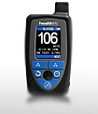






Blood Glucose Devices
Devices Features | HealthPal | Glucotel | Telcare | Bayer Contour USB Blood Glucose meter
Measures other vitals
Under 3 clicks
FDA approval
Online database | HealthCOM | BodyTel Center | MyTelecare | Glucofacts Deluxe
Data availability | Patients & Clinician | Patients & Clinician | Patients & Clinician | Patients
Our Choice | 1 | 2 | 3 | 4

Slide 10



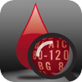
Mobile Phone Applications
APPS Features | Glucool | Log for Life | Glucose Meter | Glucose Buddy
Platform | Android | iOS | Android | iOS
Online Database Sync
Auto-Sync with Blood glucose meter devices
Under 5 taps (to add data)
Other features (++++)
Our choice | 4 | 3 | 1 | 2

Slide 11

Vendors

Slide 12
User Needs
1
Effective communication between patient and clinician
2
Medical information is communicated to the patient in simple and understandable terms
3
Secure web portal that can only be accessed by authorized individuals
4
User friendly web portal that is intuitive to work with
5
Ability to integrate with existing EMR databases for information retrieval of patient’s medical records
6
Ability to verify information input before it is published in the web portal

Slide 13
Product Concept
DECS: Diabetes Electronic Support Center
Communication and Access to information
Clinician – Clinician
Communication
Clinician – Patient
Communication
Patient-Relatives
Communication
Establishes a clinician network
Exchange information with other healthcare facilities
Better patient diagnosis
Comprehensive patient data
reduce visitation cost and time for patients
Better patient diagnosis
Establish familial support network
Delivering positive reinforcement

Slide 14
DESC Outline
At Home
Mount Sinai Hospital
DESC
Vitals logged into patient record
System evaluates data
Patient measures vitals
Administrated by a clinician
Alert patient of danger
No danger alert

Slide 15


Health Servers
 | DESC | Google Health | Cerner | Atrius | Versus
Simplify & Manage Official Medical Records
Simplify & Manage Medical Information
Connect Patients to Clinicians
Connect Clinicians to Clinicians
Home Access of Medical Information
Remote Patient data tracking

Slide 16
Demo
www.wix.com/hmichae2/DESC

Slide 17
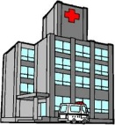



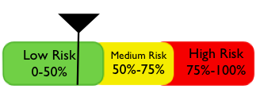
Overall Vision
Allow for medical records
to be mobile and transferable
Diabetes Electronic Support Center (DESC)
Create and effective Network of Doctors
HOSPITAL SERVER
Integrate with Hospital’s existing EMR database
Allow to accurately transcribe
patient medical records for patient
Allow to effectively
track patients

Slide 18
DESC outcomes
Reduction in hospital visits by diabetic patients
Cost reduction in diabetes treatment
Improved quality of care
Increased communication between clinician and patient
Shift from paper records to electronic medical records

Slide 19
Ethics
Started IRB requirement
During the course of this IPRO, students will follow HIPAA policy to ensure privacy and security of patient information
The Belmont Report
  Respect for Persons
  Beneficence
  Justice

Slide 20
Obstacles
Unable to meet with Mount Sinai Hospital during the summer 2011 semester
Small group size
Large amount of research
Limited amount of time

Slide 21

Accomplishments
Acquired knowledge about basic healthcare technology management for chronic diseases
Solid foundation for Fall 2011 IPRO
Completed project ethical evaluation
Work in a multi-disciplinary team

Slide 22
Future of IIT C.A.R.E.S.
PHASE 1 –Summer 2011
Research available technologies
PHASE 2-Fall 2011
Interview Mount Sinai administrators
Perform trial experiment of chosen device to a group of 25 diabetic patients
PHASE 3-Spring 2012 to Summer 2012
Implement diabetic support center at Mount Sinai
Administer devices to Mount Sinai diabetic patients

Slide 23
Citations
http://www.medapps.com/HealthPAL.html
http://www.bodytel.com/en/patient/products/glucotel.html
http://www.telecarecorp.com/
http://bayercontourusb.us/
http://www.glucosebuddy.com/
https://sites.google.com/site/glucosemeterandroid/home
https://www.logforlife.com/
http://www.glucool.com/

Slide 24

Questions?

