Slide 1
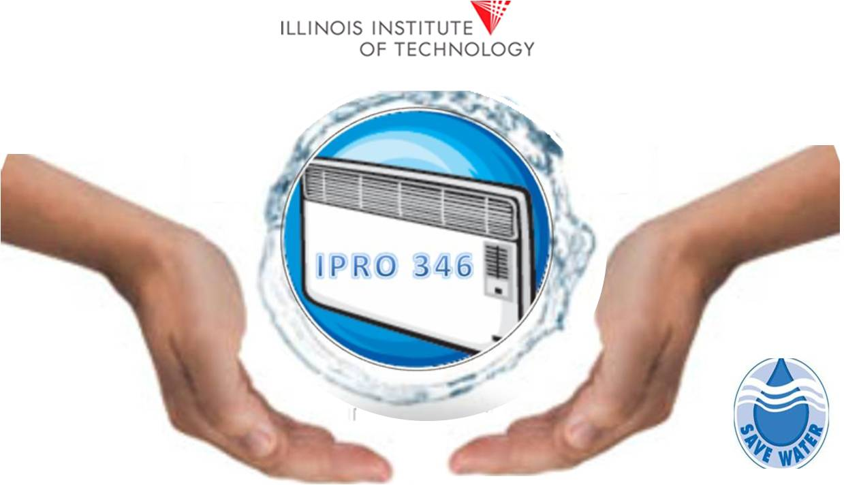
Harvesting & Beneficial Use of Condensate from Air Conditioning Systems

Slide 2
Statement of the Problem
The condensate from A/C units produces water of high purity that is currently wasted in spite of its potential for saving tap water.
The biggest obstacle for harvesting A/C condensate are regulations. Building a system to tap into this condensate is not contemplated in the building’s code and thus, it is not permitted.
This IPRO will help reduce the barriers for accepting the use of this wasted resource through education of the general public and officials of the City of Chicago. This will be done by showing the potential to use this for various purposes.

Slide 3
Goals of the Project
Build public awareness
Set up social networking sites such as Twitter and Facebook
Correspondence with other organizations
Alter current policy to move forward the practice of harvesting air conditioning condensate.

Slide 4
Goals of the Project
Demonstrate different uses of the condensate
Build a 3D model
Harvest and use condensate at IIT
Make an awareness video

Slide 5
Goals of the Project
Stimulate a government or environment organization to work towards implementing this idea.
Draft ordinance
Draft resolution
Study Group
Advocacy Group

Slide 6
Organization of the Team
Create Public Awareness:
Create Twitter and Facebook Media Web-Pages

Slide 7
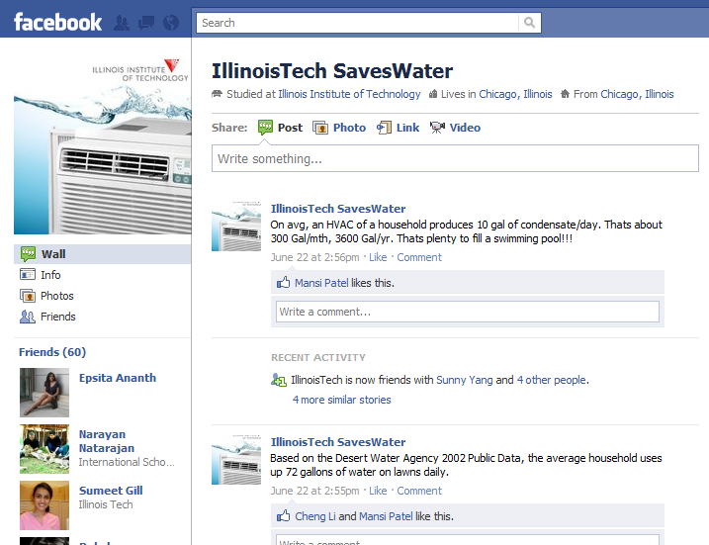
Add data, pictures & results to social media pages.

Slide 8
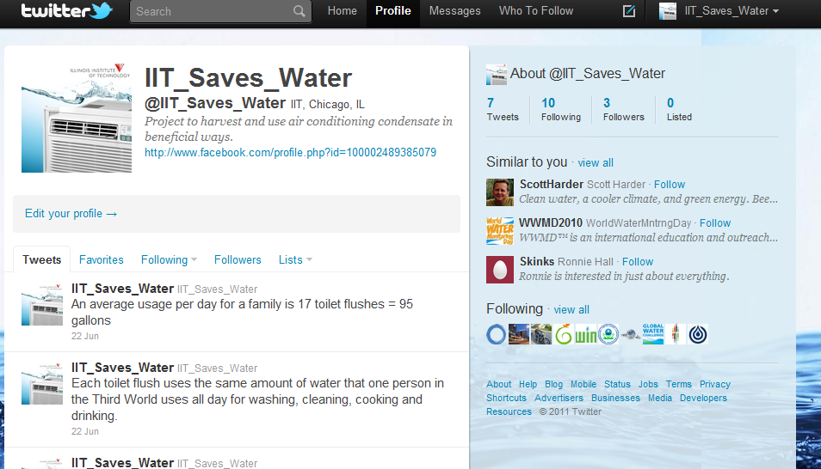
Maintain social media sites by updating as project moves forward and milestones are reached

Slide 9
Present social media sites to
governmental and environmental officials

Slide 10
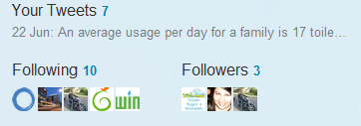
Accomplish goals by having numerous followers and fans as possible.

Slide 11
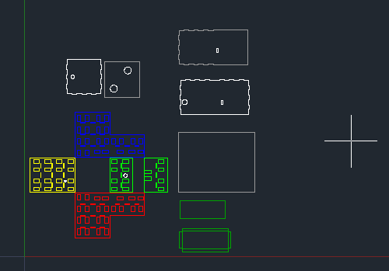
Organization of the Team
Full Size Model
Decide on prototype for presenting ideas that the group wants to implement.
CAD 2D Modeling
3D-Model

Slide 12
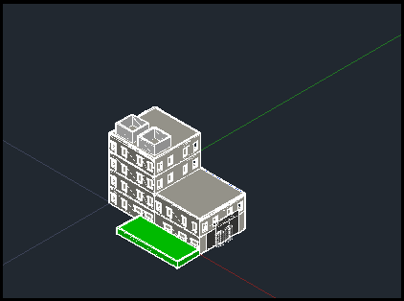
Implement prototype in CAD 3D software to create full size model
CAD 3D MODEL

Slide 13
Prototype Team
Implement prototype in CAD 3D software to create full size model
Create full size model to present to government and environmental entities.
Meet and display model to officials to represent our ideas and views.

Slide 14
PROGRESS TOWARDS GOALS
Spreading the word : Facebook and Twitter
Contacted 6 government and non-governmental organizations
Chicago centre for green technology
Chicago dept. of environment
Metropolitan planning council
Naperville Park district
American society of plumbing engineers
Illinois Environment Protection Agency
Created an awareness video
Created an awareness model

Slide 15
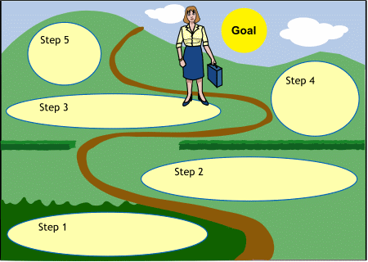
GOALS
Combining Results
s
Prototyping
Creating MODEL and Video
Contacting organizations
Public Awareness

Slide 16
Awareness video

Slide 17
Major Obstacles Encountered
CAD Design:
Re-Learning 3D Modeling in CAD
Creating a Drawing Suitable for Demonstration
Modifying Drawing (scaling etc.) For Printing
CAD Drawing

Slide 18
Major Obstacles Encountered
Getting a response from government organizations.
Little response to emails
Little response to Phone Calls
Little response to social network
We have 121 followers so far on Facebook, whereas we have minimal response on twitter.

Slide 19
Anticipated Major Challenges
One challenge our team faces is getting environmental and governmental entities to support our initiative.
These entities might have different views/goals/approaches than us.
We plan to overcome this challenge by seeking to speak/meet with different groups and organizations, not just 2 or 3.

Slide 20
Anticipated Major Challenges
Secondly, our team might not always have the resources necessary to complete certain tasks or projects.
Our team will need to have access to different air conditioning systems as well as land to try various proposed solutions.
Finally, a major challenge in all projects is time.
With so many ideas and directions, we may not have enough time to complete our goals.
Notes:
We plan to overcome this obstacle by getting access to various locations and resources around IIT campus with the help of Maintenance and IIT’s Dean. Along with this we hope to get in contact with other states and countries whom already have these procedures in place.
We will plan ahead, distribute work, and come together in order to meet every expectation and goal. By working effectively and relying on each individual to accomplish different tasks, our goals will be met in a timely manner.

Slide 21
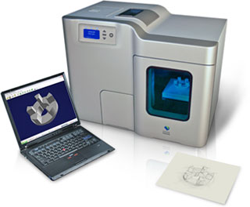
Helpful Support
The IPRO requires special permission from the Dean’s office towards the implementation of a Prototype condensate collection and recycle system on IIT’s Main Campus.
The IPRO needs to use the Idea Shop’s Rapid prototype printer towards the creation of an Illustrative model of How condensate can be collected and recycled in a commercial building.
Support from IIT students and Faculty by spreading the message on the use of condensate through social media and by other means

Slide 22
Link of facebook and twitter
http://www.facebook.com/profile.php?id=100002489385079&sk=wall
http://twitter.com/#!/IIT_Saves_Water

Slide 23
Questions??Comments??Concerns??

