Slide 1
IPRO 320: PB OUR SPACE
Final Presentation
Faculty Member: Laura Batson
PB Advisor: Tom Coleman
Team Members: Abigail Vargas, Ciaran Kohli-Lynch, David Wilkinson, Hao Nguyen, Matthew Kavicky, Nick Leevathana, Phillip McBride, Taimoor Khan, Vince Bell

Slide 2
Introduction
Currently 63% of all cell phone sales are Smartphones.
Over 36 Million smartphones in use as of April 2011.
Projected to grow to 525 Million Smartphones by 2015.
Source: The Nielsen Company

Slide 3
Background
Parsons Brinckerhoff
Implementing Solutions
Project
Development
Information Collection

Slide 4
Purpose
Currently information is collected through:
Surveys
Town hall meetings
PB Our Space will collect information through:
A mobile application
Website
Notes:
Currently in the pre development phase of a project information is collected using meetings … but with this application it will help close the gap and reach out to a wider audience.

Slide 5
Team Approach
Providing a solution based on the research conducted
Appointing a Team Leader
Understanding the needs of Parsons Brinckerhoff
Dividing the team into research groups

Slide 6
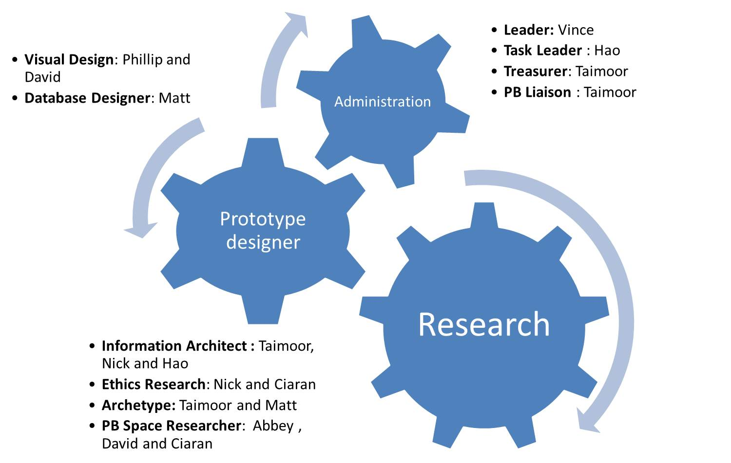
Team Organization

Slide 7
Objectives
Multiplatform Support
Forum Style board for comments
Multimedia upload feature
PB Our Space Application
Notes:
Emphsis that objective is to come up with a STORY BOARD for the APPLICATION not the real application

Slide 8
Obstacles
Coding
Different languages for each platform
Visual Design
Graphic design
Governance
Ethical issues pertaining to the application

Slide 9
Accomplishments
Understanding the needs of Parsons Brinckerhoff
Creating an effective and diverse team by assigning tasks based on each individual’s strengths
Conducting research on different mobile platforms
Completing a visual design of the application

Slide 10
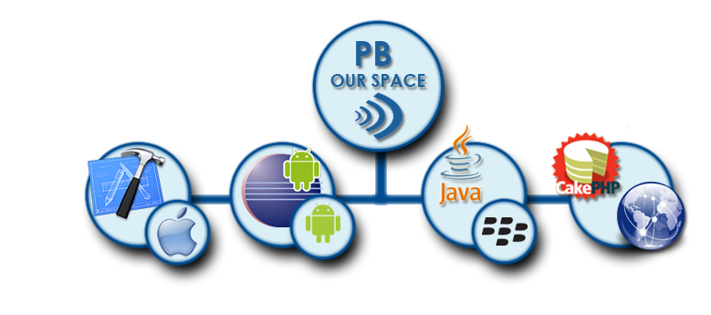
Accomplishments

Slide 11
Accomplishments

Slide 12
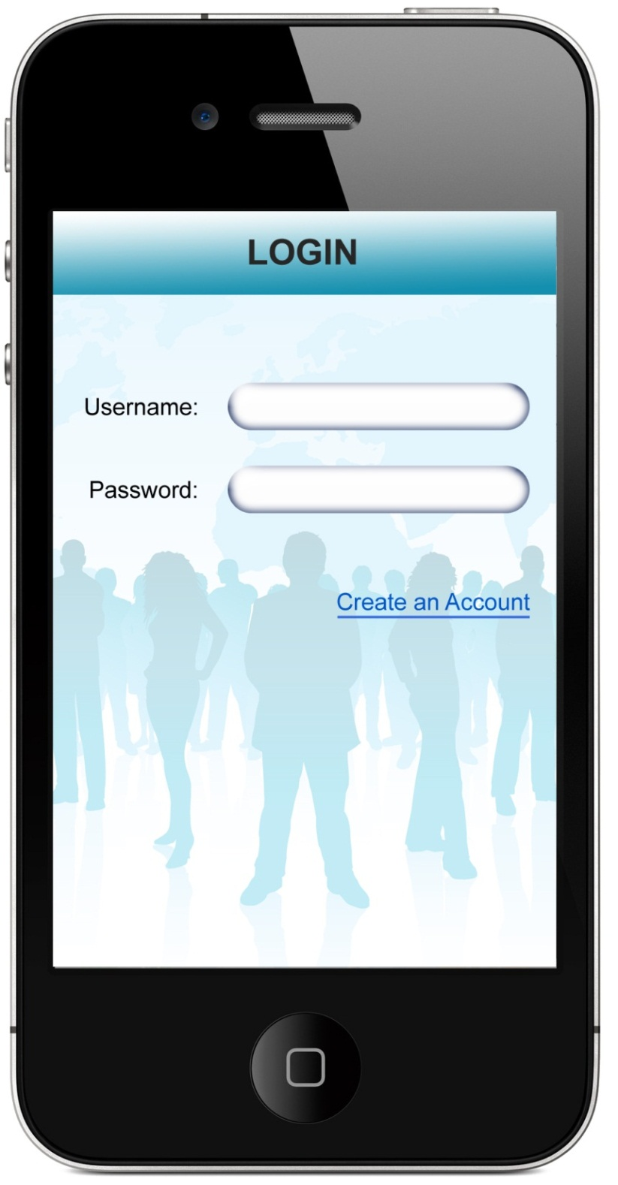
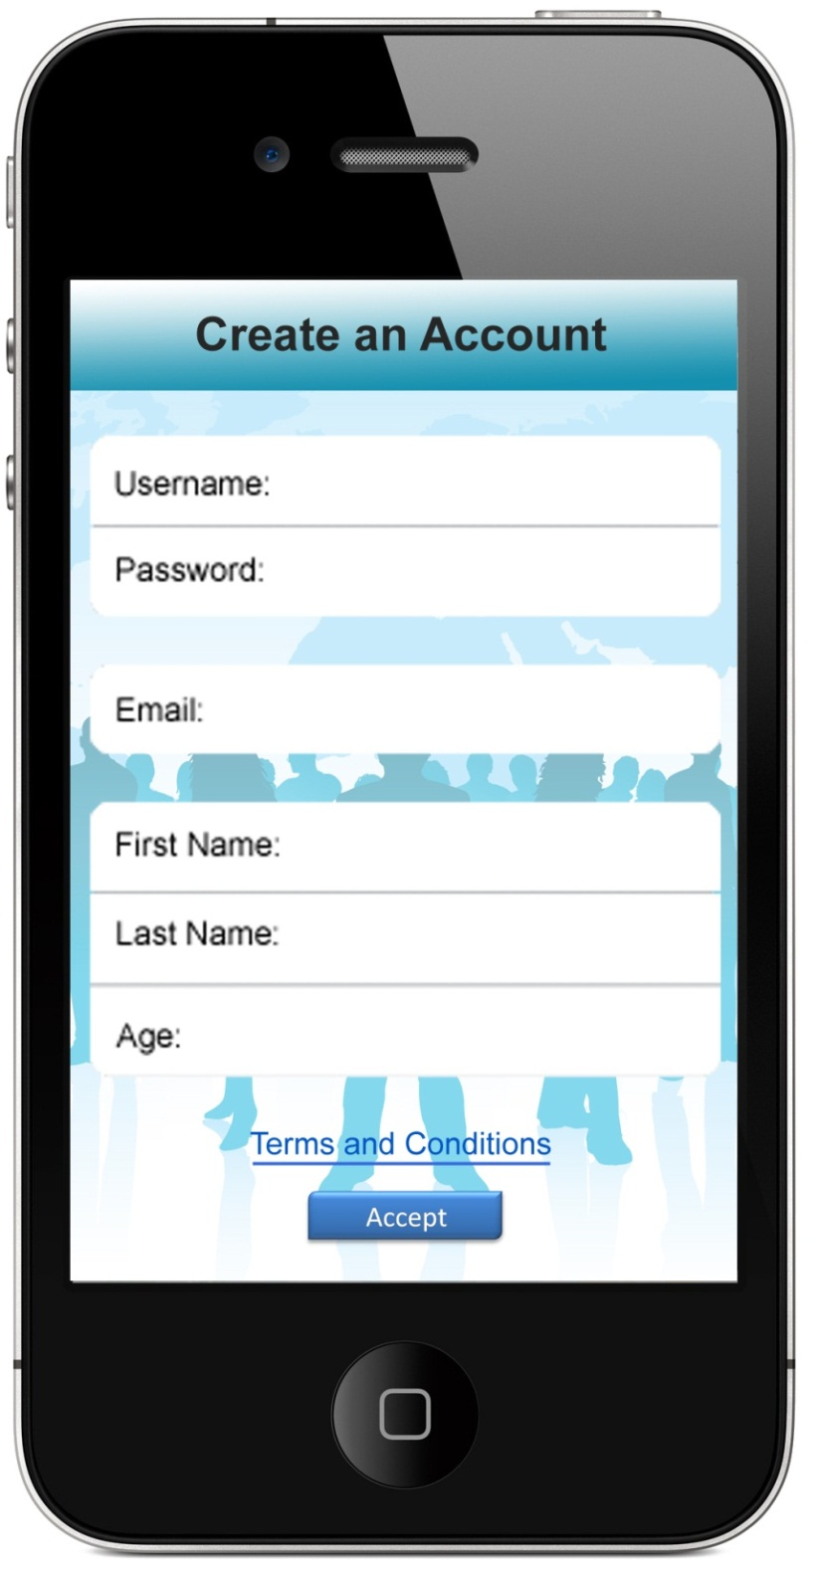
Login & New Accounts
Notes:
User is brought to login screen
New user clicks on create an account to continue
LOGIN
New user creates new account:
User enters access code to make sure that they are accessing the appropriate project.
Email, username, and password required
First and last name, occupation, median income, affiliation with PB, age, and address optional
User must agree to terms and conditions
New user sent to PB to be accepted or denied

Slide 13
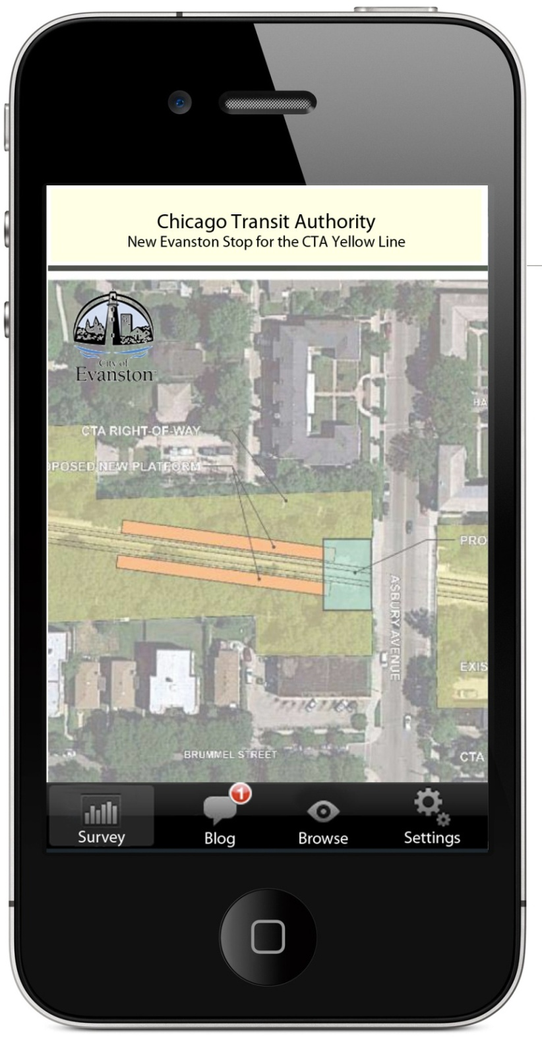
USER
PB Our Space – Mobile Application
Survey
Blog
Browse
Settings
Notes:
THIS IS WHAT THE APPLICATION CAN DO:
Survey – Take a survey associated with the project, view poll results
Blog – View previous posts, post text or multimedia related to the project
Browse – Allows the user to view background information about other projects, no posting without the appropriate access code
Settings – Modify user info (age, occupation, etc.), fill in user profile, adjust privacy settings, contact PB

Slide 14
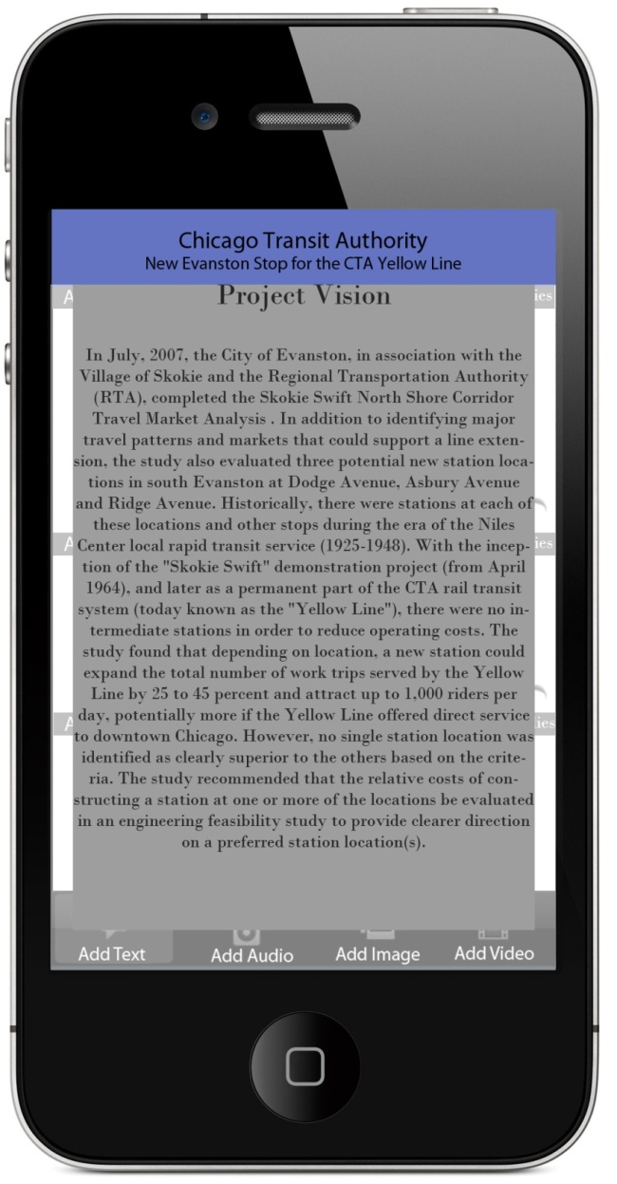
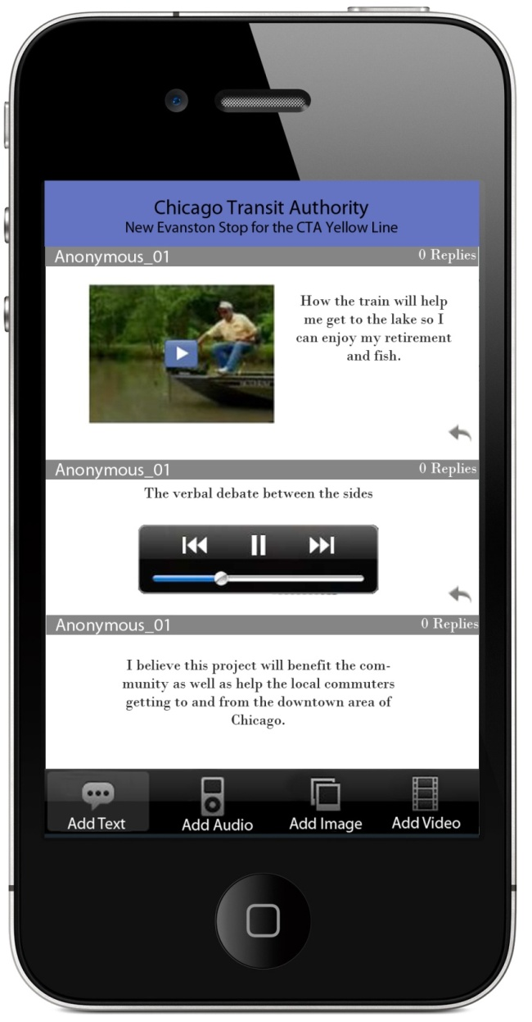
Background information screen
Blog tab screen
Notes:
Background information screen
User clicks top area to pull down background information on the PB project
Blog tab screen
View previous posts by other users
Add text, audio, image, or video posts

Slide 15
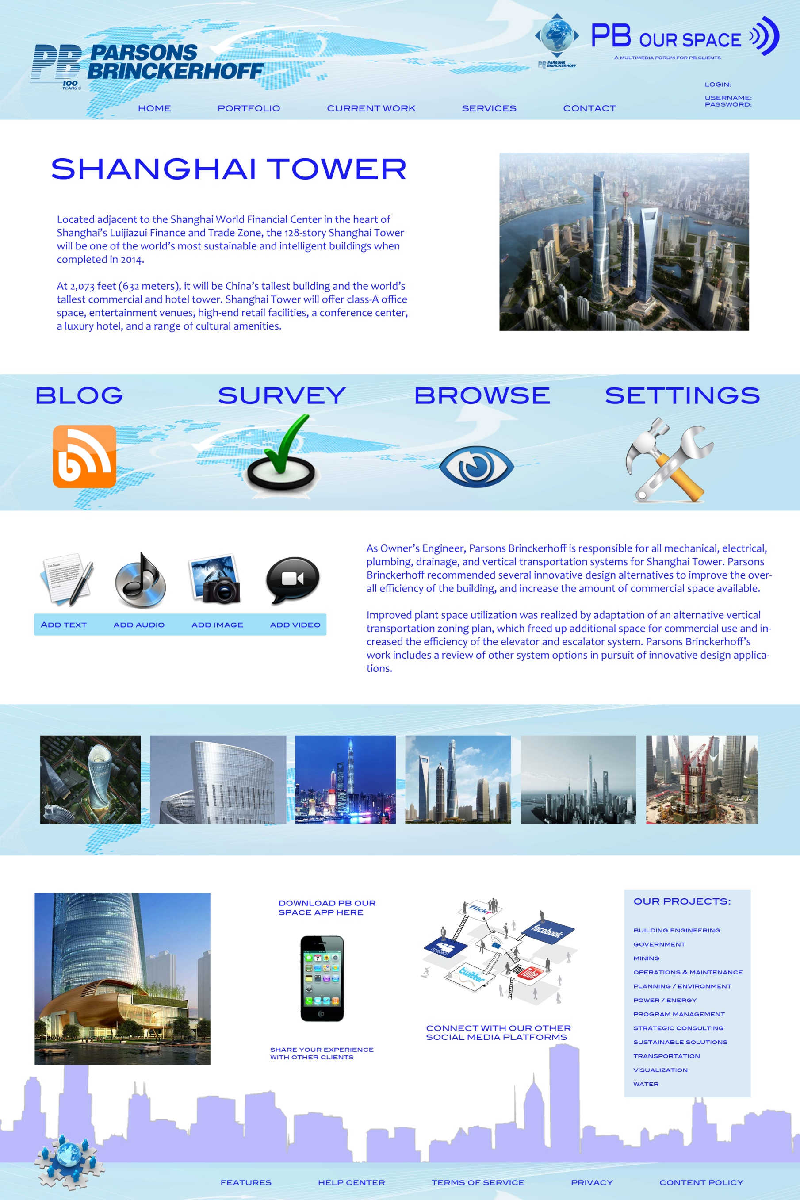
WEBSITE
Notes:
The website does everything the mobile app does in a website format.

Slide 16
Notes:
DATABASE
This is how PB moderates the app. The database stores all of the information from the mobile app and the website and connects them to each other.
The database stores and organizes the projects into different categories and links information posted by users to the corresponding project.
The website design lets PB add a new category or project (on the left)

Slide 17
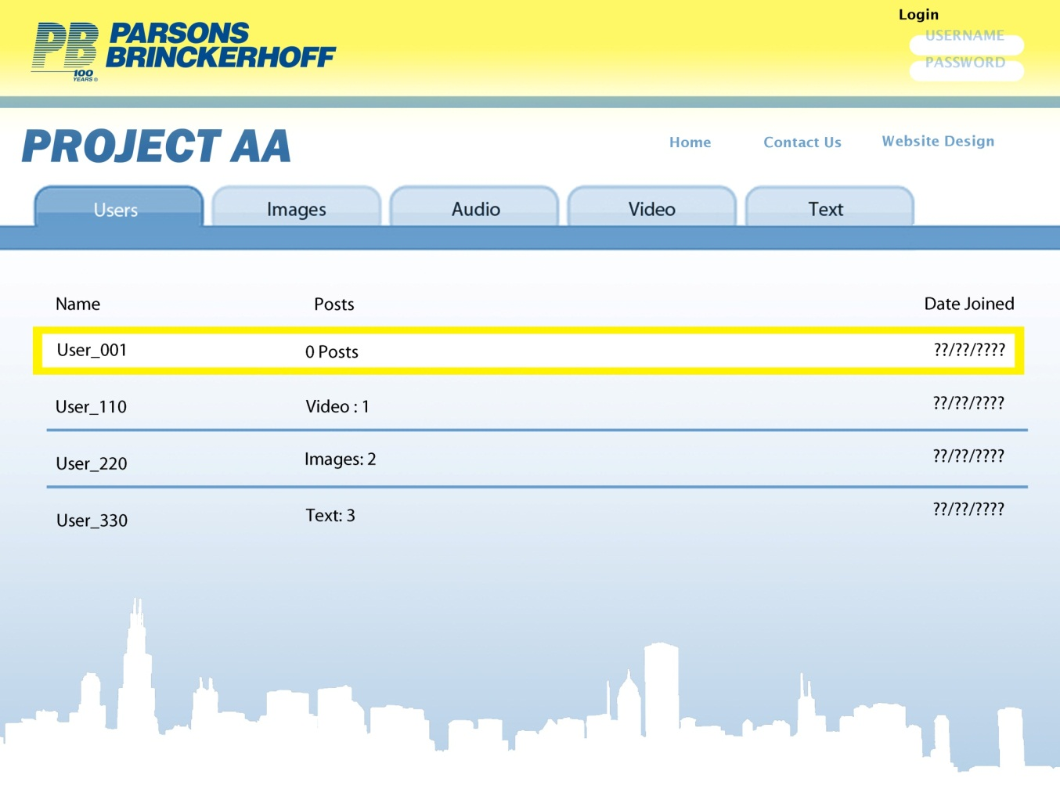
Notes:
This is after PB clicks on a project. All of the information including users who have access to the projects, texts, posts and multimedia posts separated into the appropiate tabs for organizational purposes. Administration can click on each post to view it and give them the ability to accept or deny a post before it gets posted to the forum. This allows PB to have control of what gets put on the forum.

Slide 18
Notes:
DATABASE
This is the screen to add a new project to the database. PB can add a logo and text description of the project.

Slide 20
Future Plans
Research
Developing a prototype application
Testing of the application and deployment across all platforms
Usability testing

