Slide 1
Make a Connection: Library Services for International Students
Yi Han
International Student Library Services Liaison
Jannelle Ruswick
Instruction Coordinator

Slide 2
International Enrollment
Institute of International Education. (2010). "International Student Enrollment Trends, 1949/50-2009/10." Open Doors Report on International Educational Exchange. Retrieved from http://www.iie.org/opendoors

Slide 3
Academic Level
Institute of International Education. (2010). "International Students by Academic Level, 2008/09-2009/10." Open Doors Report on International Educational Exchange. Retrieved from http://www.iie.org/opendoors

Slide 4
Fields of Study
Institute of International Education. (2010). "International Students by Field of Study, 2008/09-2009/10." Open Doors Report on International Educational Exchange. Retrieved from http://www.iie.org/opendoors

Slide 5
Private PhD-granting institution in Chicago
7,787 students
35% undergrad, 65% grad
STEM+ (Science, Technology, Engineering, Math)
Psychology, Business, Law, Architecture

Slide 6
Highest ratio of international students of all PhD-granting institutions
43% international
over 100 countries represented

Slide 7
Top 3 Countries of Origin
Institute of International Education. (2010). "Top 25 Places of Origin of International Students, 2008/09-2009/10." Open Doors Report on International Educational Exchange. Retrieved from http://www.iie.org/opendoors

Slide 8
Paul V. Galvin Library

Slide 9
Textbook Rejection
NO

Slide 10
Did your last library give you all your textbooks?

Slide 11
Do you find anything confusing about the library?
“Yes ,,, finding one book is like finding a pin in a haystack, and something I've noticed is that most international students are too shy to ask for help.”
“How the books are sorted, they should be by departments.”

Slide 12
Fixes
QR Codes for ends of stacks
How to Find Books LibGuide
More explanation at orientation
Walk with student to find the book

Slide 13
Do you find anything confusing about the library?
“There is a couple of tables and chairs on the first floor reserved for eating. But frequently I found it occupied by group studiers. Then I have to walk to MTCC to finish lunch or dinner.”
“where is quiet seats”

Slide 14
Fixes
Simplify signs
Not “Intersession Hours” but “Hours for August”
Bilingual signs
Large clear signs for special spaces

Slide 15
Unique Needs
English Barrier
Cultural Differences
Listening difficulties
Strong accent
Need time to translate words into their own language first
Library cultures
Classroom cultures
Writing styles
Different perspectives of certain concepts
Plagiarism
References

Slide 16
Articles
International Students Needs
Shaffer, C., Vardaman, L., & Miller, D. (2010). Library Usage Trends and Needs of International Students. Behavioral & Social Science Librarian, 29 (2), 109-117.
Culture Differences
Eberly Center for Teaching Excellence Intercultural Communication Center. Recognizing and Addressing Cultural Variations in the Classroom. Retrieved from http://www.cmu.edu/teaching/resources/PublicationsArchives/InternalReports/culturalvariations.pdf

Slide 17
Library Staff Training
Listening and speaking skills
Speech Accent Archive at George Mason University (http://accent.gmu.edu/)
Speak clearly at a normal rate of 10 to 15 percent slower, (not louder)
East Asian Students
Thinking patterns
Nonverbal communication

Slide 18
Build Relationships
Stage 1
Stage 2
International Center
Orientation Committee
Admissions
Student life
Friendly professors
ESL courses
Writing Center

Slide 19
Outreach to New Admits

Slide 20
Provide Online Materials
Learn before arriving
Multi-lingual guides are welcoming
Get information without having to ask

Slide 21
Library.iit.edu/students
Guides are compiled in a popular place.

Slide 22
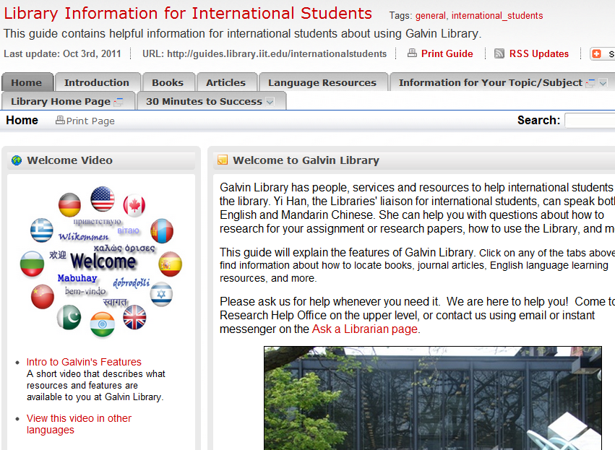

Slide 23
Reuse and Repurpose
Most content already existed
In user-friendly location
Inclusive feeling

Slide 24
Multilingual Library Virtual Tour
English
Chinese
Korean
Spanish
Hindi
Translated by volunteer students.
http://guides.library.iit.edu/multilingualguides

Slide 25
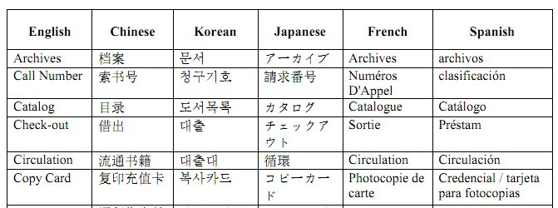
In New Student’s Flash drive
Top 9 differences between Galvin Library and Your Country’s Library
Multilingual Glossary Wordlist
Multilingual Glossary Wordlist: words are selected from http://www.ala.org/ala/mgrps/divs/acrl/about/sections/is/projpubs/languagetble.pdf.

Slide 26
New Student Orientations

Slide 27
What is the best orientation method?
Big auditorium lecture
Library tours
Library workshops
Resource fairs
All of the above

Slide 28
Auditorium Orientations
Pros
Cons
Reach wide audience
Surface topics only
No promotion needed
Legitimized
Advertise other events
Impersonal
Surface topics only
One of many lectures

Slide 29
Fall 2011 Orientation

Slide 30
Combat Boredom
http://www.flickr.com/photos/vissago/3786690528/in/photostream/

Slide 31
Snooze deterrents
Use Prezi (or anything other than PowerPoint)
Co-present
Cover “your first week” needs only
Step away from the catalog

Slide 32
Library Tours and Workshops
Textbooks
Library Catalog
Reference services

Slide 33
Make up for the cons
Auditorium Orientation’s cons
Workshop’s pros
Impersonal
Surface topics only
One of many lectures
Personal
In-depth topics
Top questions asked by international students
Interactive with students

Slide 34
Library Orientation in Chinese
Fully attended
Showed interest
Asked a lot of questions

Slide 35
Student Resource Fairs

Slide 36
Library Instruction

Slide 37
General Writing Courses at IIT
Writing for Nonnative English Speakers
Comm 111 and English 053
Professional Learning Programs
Visiting cohort

Slide 38
Class Content
Comm 111 / Eng 053
PLP
Different writing styles in the U.S. and other countries
Scholarly information
Database search tips
Thesaurus: finding synonyms
Ebsco: Translation
Plagiarism
Basic Library Introduction
IIT/I-Share library catalog
A library tour
For your assignment
Search for journal articles by using library databases
Plagiarism

Slide 39
Subject-Specific Courses
PhD Environmental Engineering Group
Master of Public Administration Program
Subject Research Guide
Recommended databases
Databases search
Thesaurus: finding synonyms
Book search
Plagiarism
Yi:
Different writing styles in the U.S. and other countries
Scholarly information
Plagiarism
References
Public Administration Librarian:
Recommended databases
Databases search
Book Search

Slide 40
Open workshop sessions
Bilingual sessions: finding journals and articles
30 Minutes to Success
Free Internet vs. Library Databases
Databases search training session
Avoiding plagiarism

Slide 41
Bilingual library guides
Print guides
Online research guides in Chinese
Research papers guide
Finding journals and articles
中文

Slide 42
Next Steps
Surveys and focus groups
Collaboration with Writing Center
Expand to more departments

Slide 43
Recommendations
Know and consult your international population
Assess confusing building signs and set-up
Train your staff
Library instruction begins before classes start
Repackage current materials/classes
New content priority list

Slide 44
Recommended Book
Jackson, P. and Sullivan, P. Eds. (forthcoming 2011). International Students and Academic Libraries: Initiatives for Success. Chicago: Association of College and Research Libraries

Slide 45
Thanks
Yi Han
International Student Library Services Liaison
yhan27@iit.edu
Jannelle Ruswick
Instruction Coordinator
ruswick@iit.edu
http://library.iit.edu/students

