Slide 1
Lewis Institute, 1896 – 1940:
Higher Education on Chicago’s West Side
Researched, written, and produced by Catherine Bruck, University Archivist, Illinois Institute of Technology
© Catherine Bruck, 2004
Notes:
Title Slide

Slide 2
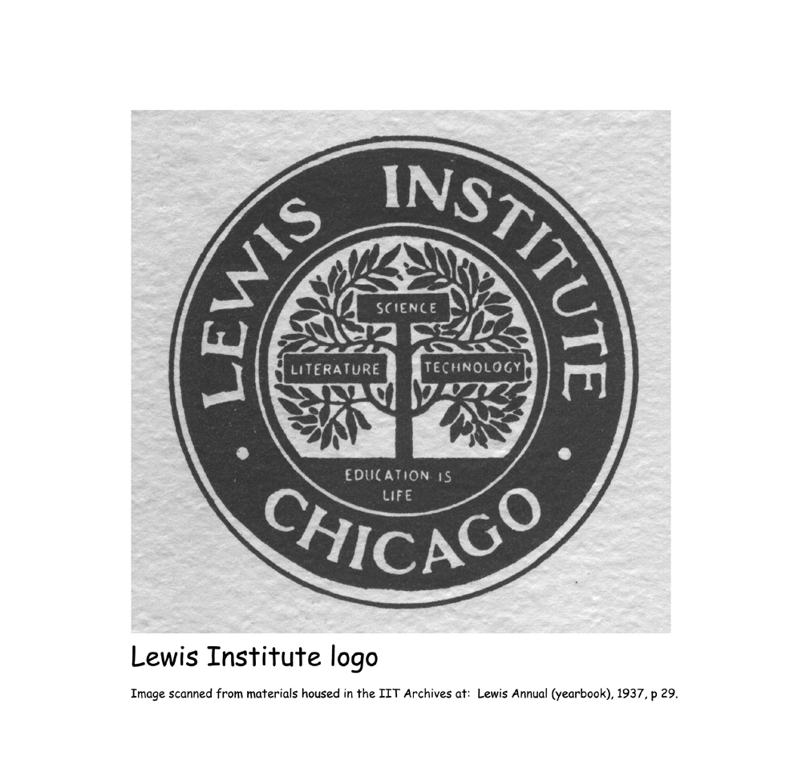
Notes:
Lewis Institute represents the distaff side of the 1940 merger, with Armour Institute of Technology, which created Illinois Institute of Technology. I refer to Lewis as the distaff side not because of its female student body (Lewis educated roughly equal numbers of men and women) and not so much to connote feminine qualities, but rather to identify it as a nurturer. Lewis Institute nurtured its students, but even more, it nurtured higher education, as perhaps few other colleges ever did. Logo

Slide 3
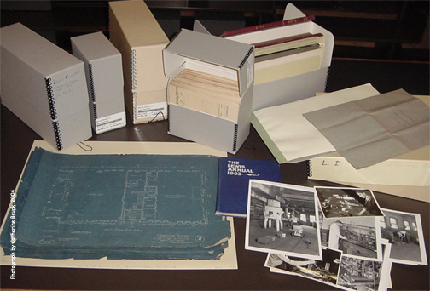
Notes:
The story of Lewis Institute writes itself, taken as direct quotes and vintage images from the thousands of pages of documents in the Lewis Institute Records collection at IIT. These documents include contemporary historical essays, letter and minute books, annual reports, real estate and blueprint materials, academic catalogues, student files, yearbooks and serial publications, alumni association materials, and photographs. Records layout on table

Slide 4
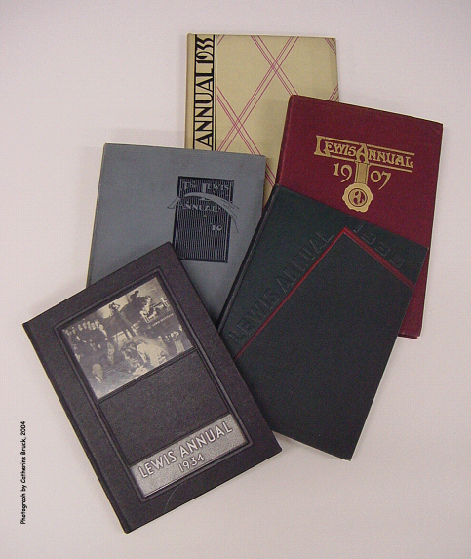
Notes:
One of the richest sources of Lewis history is the school yearbook, published every year from 1903 to 1940. Many of the images for this program come from its pages. Yearbook covers

Slide 5
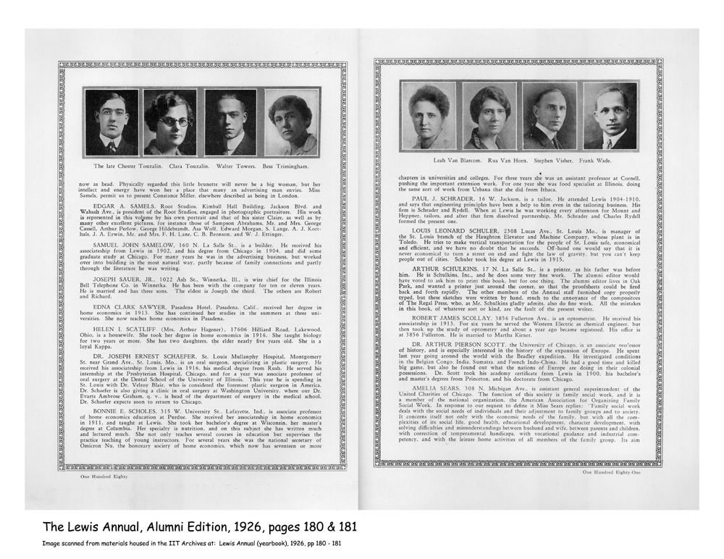
Notes:
In 1926, the Lewis Annual published an Alumni Edition which contains 201 pages of one-paragraph biographical entries on hundreds of the school’s alumni.

Slide 6
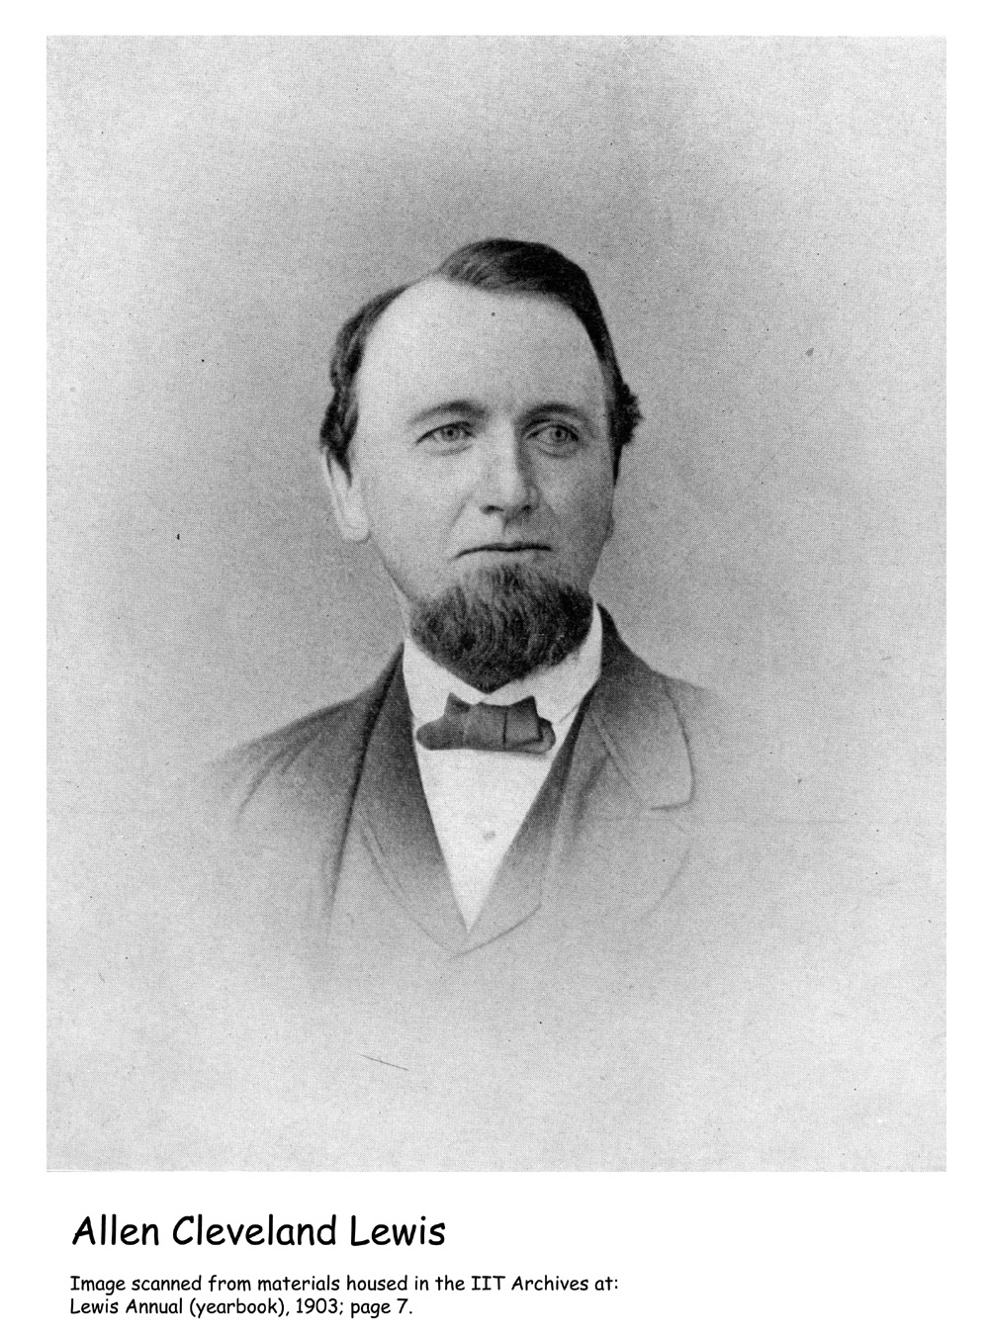
Notes:
Lewis Institute owes its existence to Allen Cleveland Lewis whose Will of 1875 directed the establishment of a school to bear his name and specified many of the details concerning the school. One of the most important of which was that it should provide a practical education, by which he meant that students were to be able to earn a living upon graduation, a program of particular significance to the women who attended the school. Bow tie

Slide 7
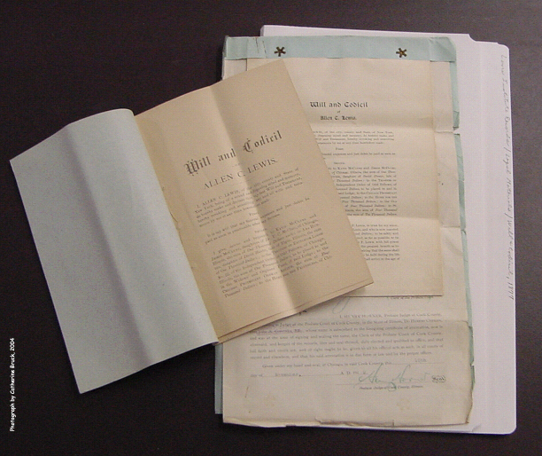
Notes:
Lewis designated that the school was to be built when his estate, valued at $535,000 at his death, had grown to $800,000. Within a generation of his death, his estate was worth $1.6 million, at which point, the trustees requested a charter for the school which was granted in November 1895. The school opened the following September and the first college degrees were awarded in 1901. But I’m getting ahead of myself… Will

Slide 8
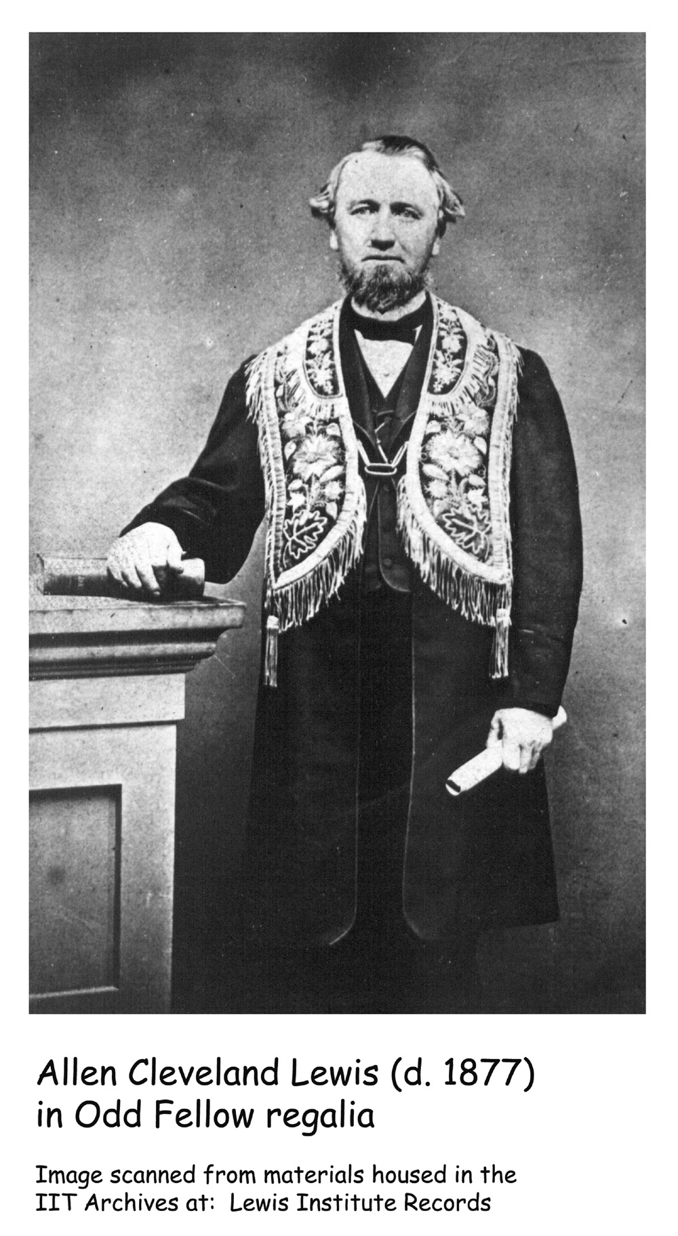
Notes:
Allen C. Lewis was a descendant of John Lewis, one of New England’s earliest immigrant families. Allen moved as a young man from Connecticut to Elgin, Ill. where he was a druggist. Following the death of his wife and infant son, he moved to Chicago where he became a businessman and managed a growing number of investments. He inherited some wealth from a brother who died in 1874, much of which was in railroad bonds. Lewis added real estate to the portfolio, including property in Chicago’s original plat. And in the few short years he lived after the Chicago Fire (he died in 1877), he was a merchant of one of the most valuable commodities the city had – land in the area devastated by the fire and ripe for development. Odd Fellow

Slide 9
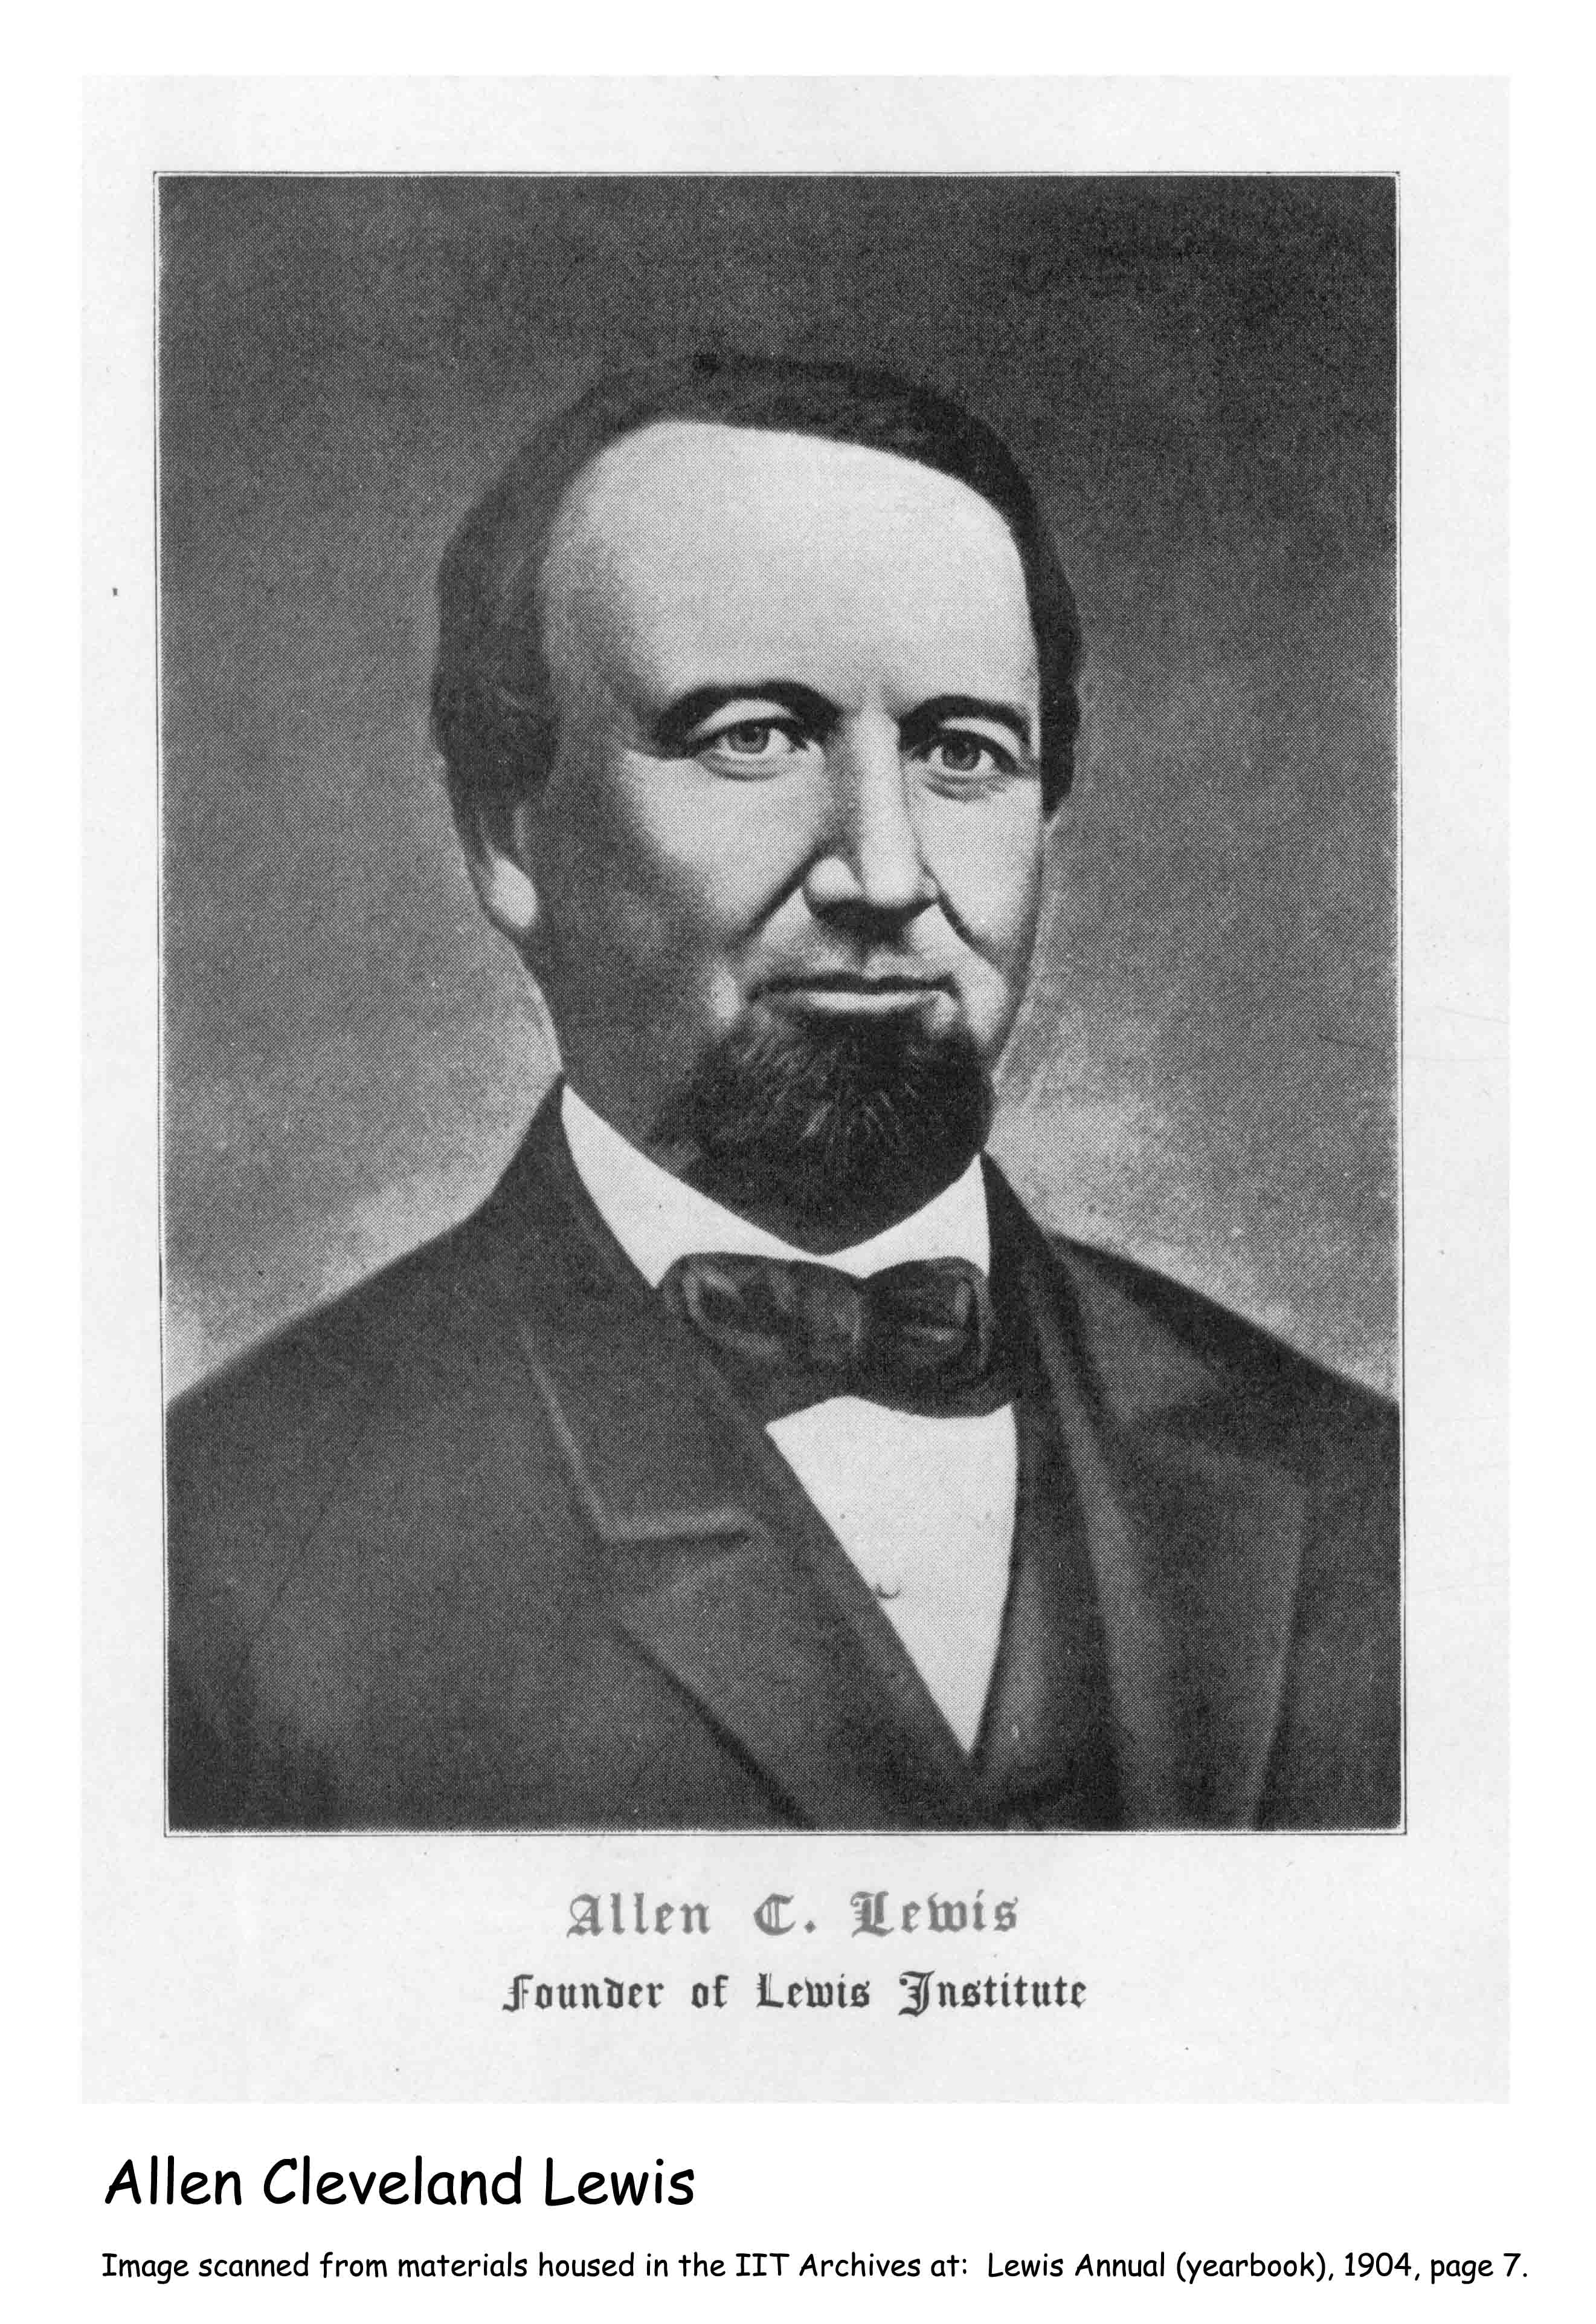
Notes:
Allen Lewis died without a direct heir, but his legacy could hardly be greater even if he had had several children. As the person responsible for giving thousands of Chicagoans their chance at higher education and practical job skills, he was recalled as their “father” every time they sang the words of the school song: “Allen Pater, Alma Mater...L E W I S Lewis. Here we are.” Like a good father, he provided them with the prerequisites to earn a living, support families, and contribute to their community -- an incredible return on his original $535,000 investment. Painting

Slide 10
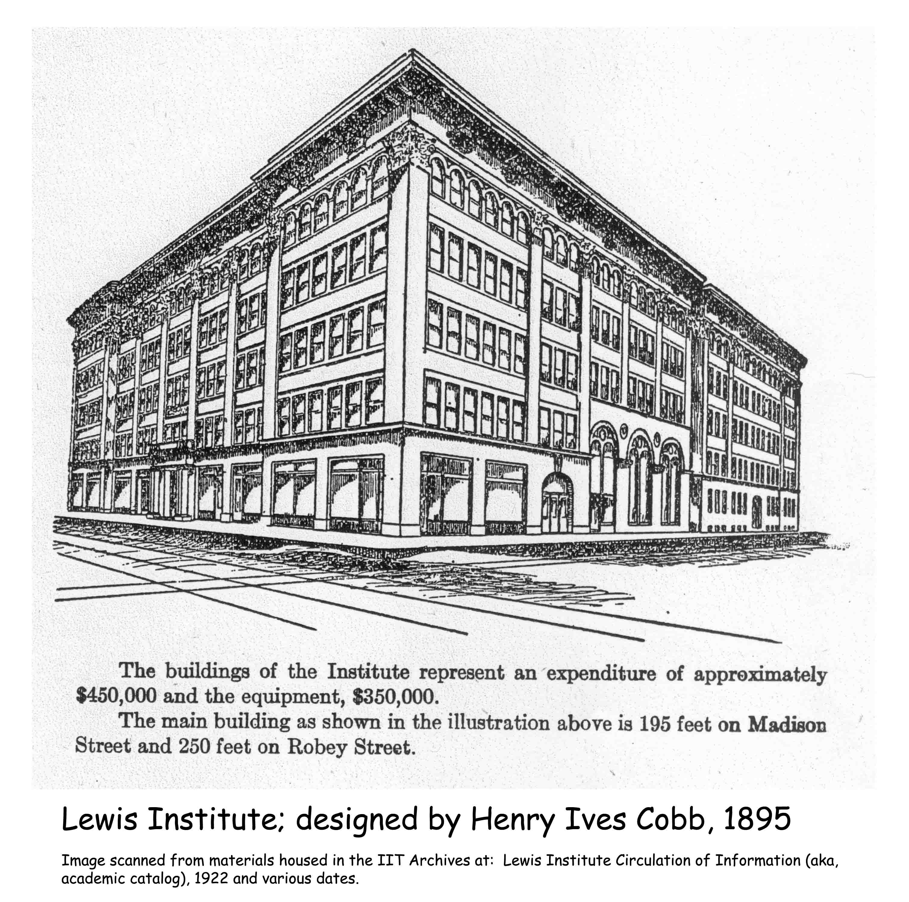
Notes:
In this talk, we’ll discover the character of Lewis Institute as revealed in images and words of people associated with the school during its 44 years of existence. Keep in mind, however, that whatever I show you is only a small portion of what is available in the Lewis Institute Records collection.
Line drawing

Slide 11
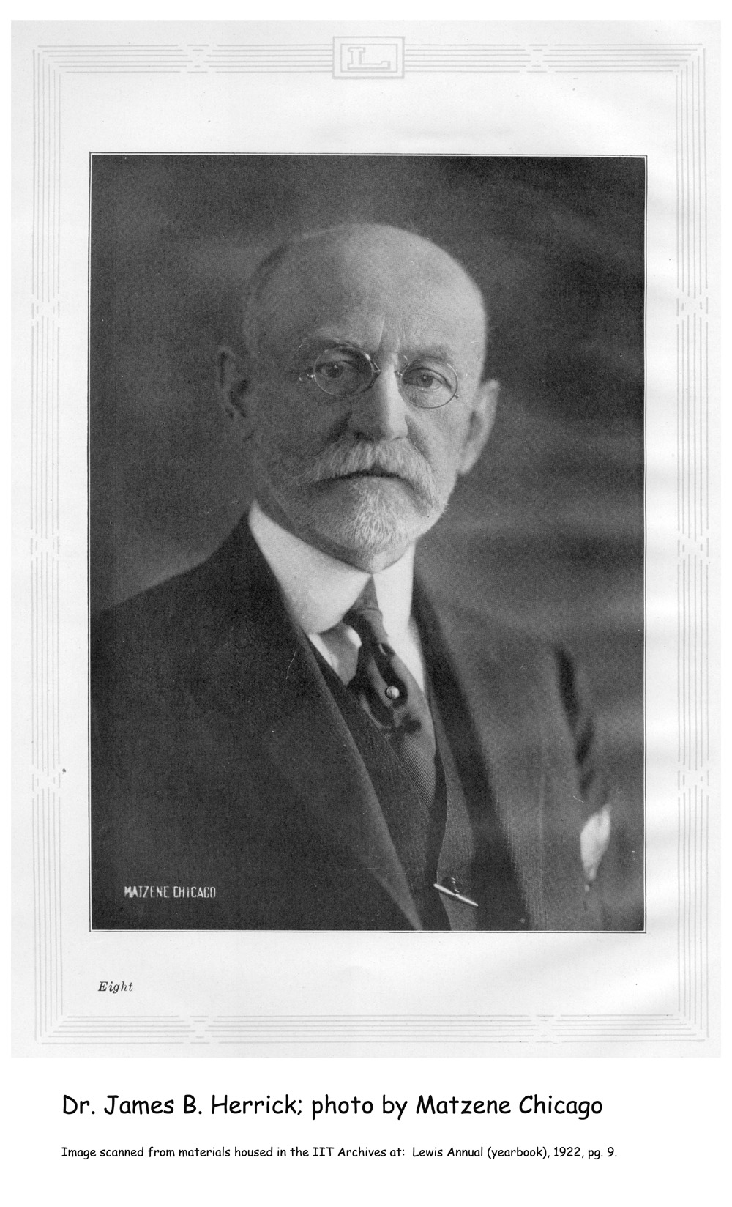
Notes:
We’ll start with one of the trustees, Dr. James [Brian] Bryan Herrick, a noted Chicago heart physician. One of the items in the Lewis Institute Records is a speech entitled “Tolerance” by Dr. Herrick. In the 1922 Lewis Annual, students wrote: “He is gentle, firm, kind, without a trace of arrogance or shadow of pretense. Had the Institute no other debt to Dr. Herrick, it could never forget what he did, as medical adviser, for the Director.” The reference here is to some debilitating ailment which plagued George Noble Carman for several years before being cured.

Slide 12
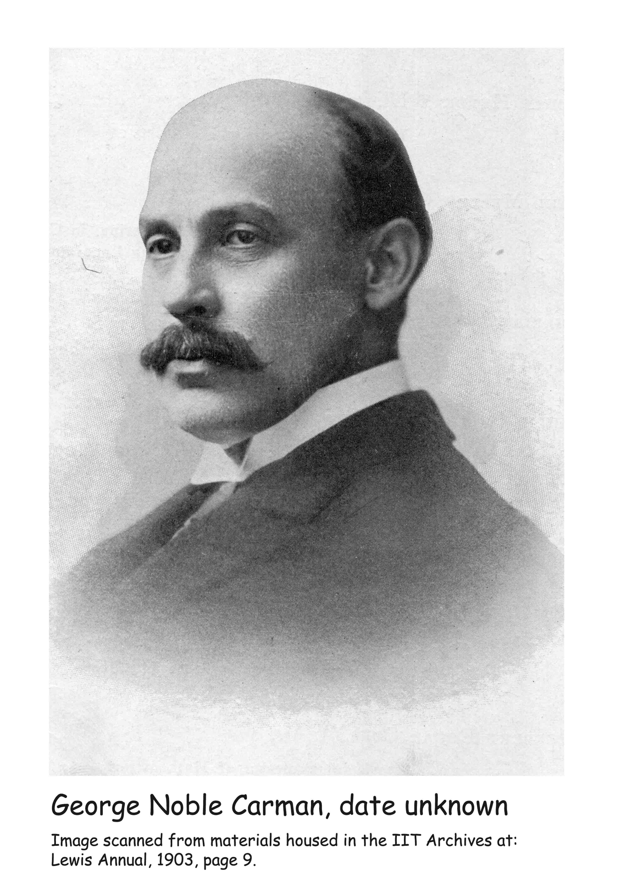
Notes:
Director Carman (the school didn’t use the title president) was a protégé of William Rainey Harper, President of the University of Chicago. Carman was teaching English at the U. of C. and serving as Dean of Morgan Park Academy when President Harper recommended him as the founding director of Lewis Institute. Carman began as director when the school opened Sept. 1, 1895, … Photo of young Carman

Slide 13
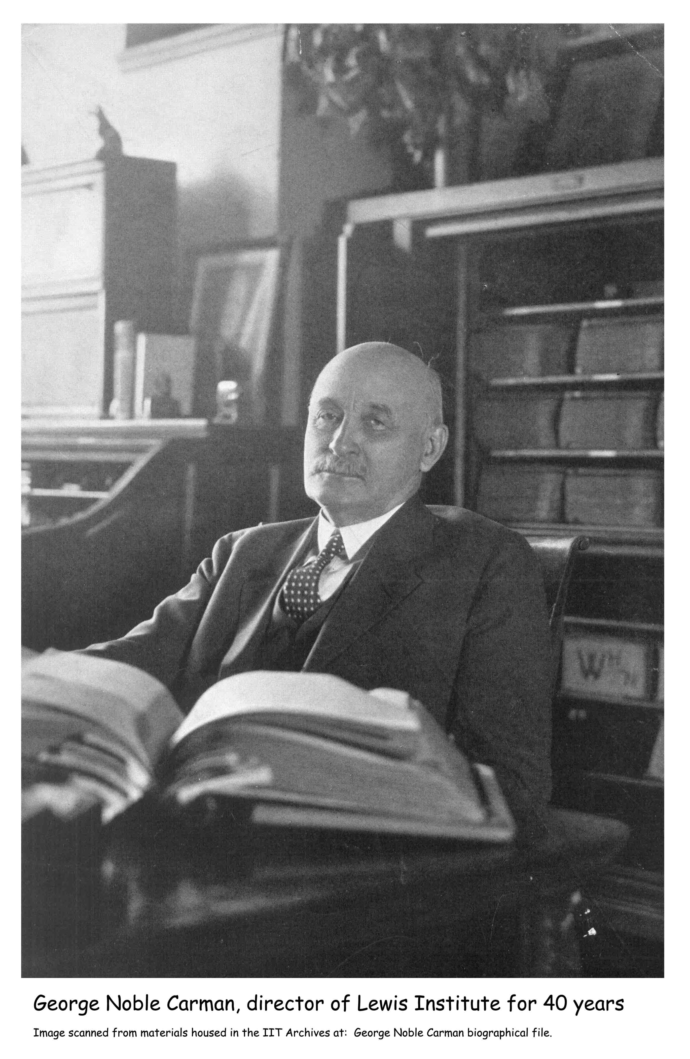
Notes:
…and he retired 40 years later on Sept. 1, 1935 at age 79. Carman reportedly met personally with each day student who enrolled, and in the early years at least, helped set their program and counseled them “like a father.” At desk

Slide 14
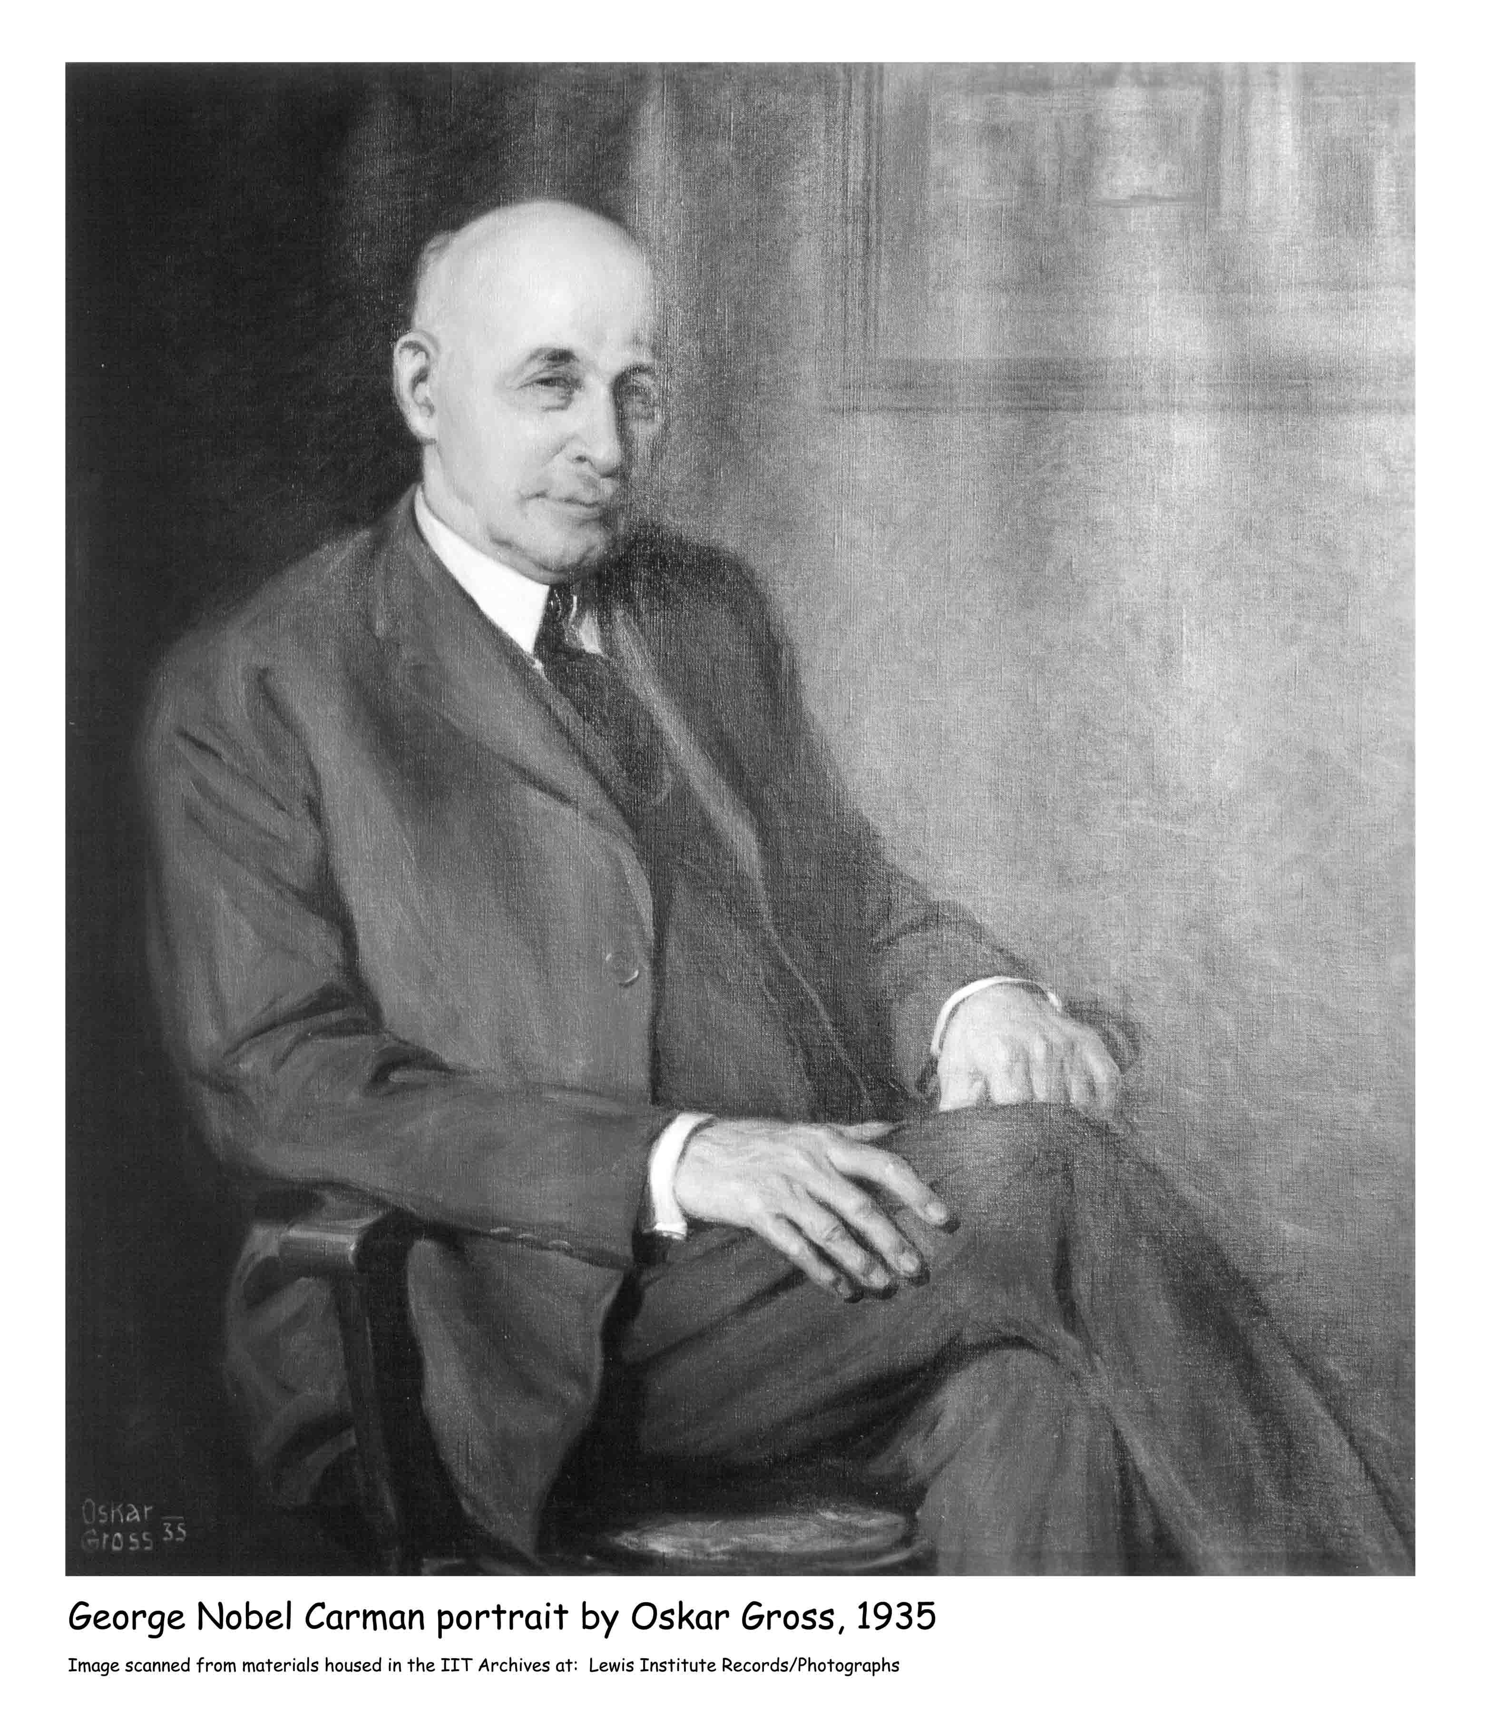
Notes:
This poem, written by a member of the Lewis faculty, tells us much about Carman’s character as an educator. Portrait by Gross
Carman likes to make a man, and now you’ll all agree
He did his level best to make a man of you and me.
Carman likes ’em different, and too, we’ll all agree
I ain’t no copy of you, my dear, you ain’t no copy of me.
For one by one he studied us, he studied you and me,
And always he respected individuality.
A great expert in persons and maker of them, too –
That’s what the dear old boy has been to all he ever knew.
Poem by Edwin Herbert Lewis

Slide 15
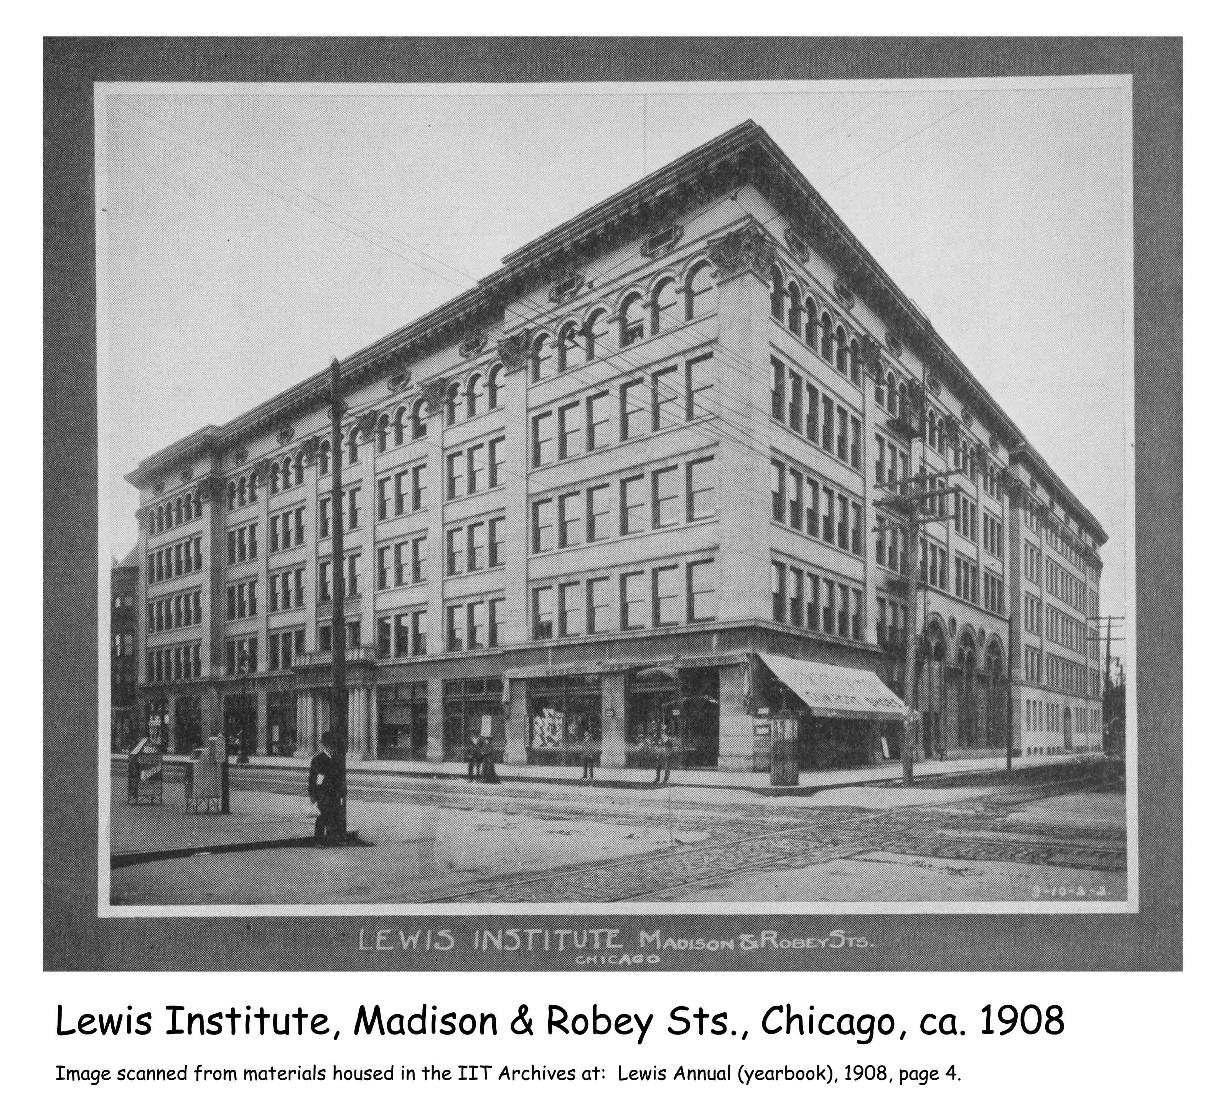
Notes:
At the time of his death, Allen Lewis still owned six lots in the heart of Chicago’s Loop at Washington and Wells Streets, and he had designated this as the location of the school. By the time the school was chartered, however, the commercial district of the Loop had expanded enough to make this location unsuitable. The trustees looked elsewhere and settled on a location “on Madison street, the thoroughfare of the west side at the center of the city’s population.” To make sure that the school could be easily reached by residents from all over the city, the trustees chose a location at the intersection of Robey Street (now Damen Avenue) and Madison Street where Chicago’s street car system crossed both north-south and east-west.
Building-man

Slide 16
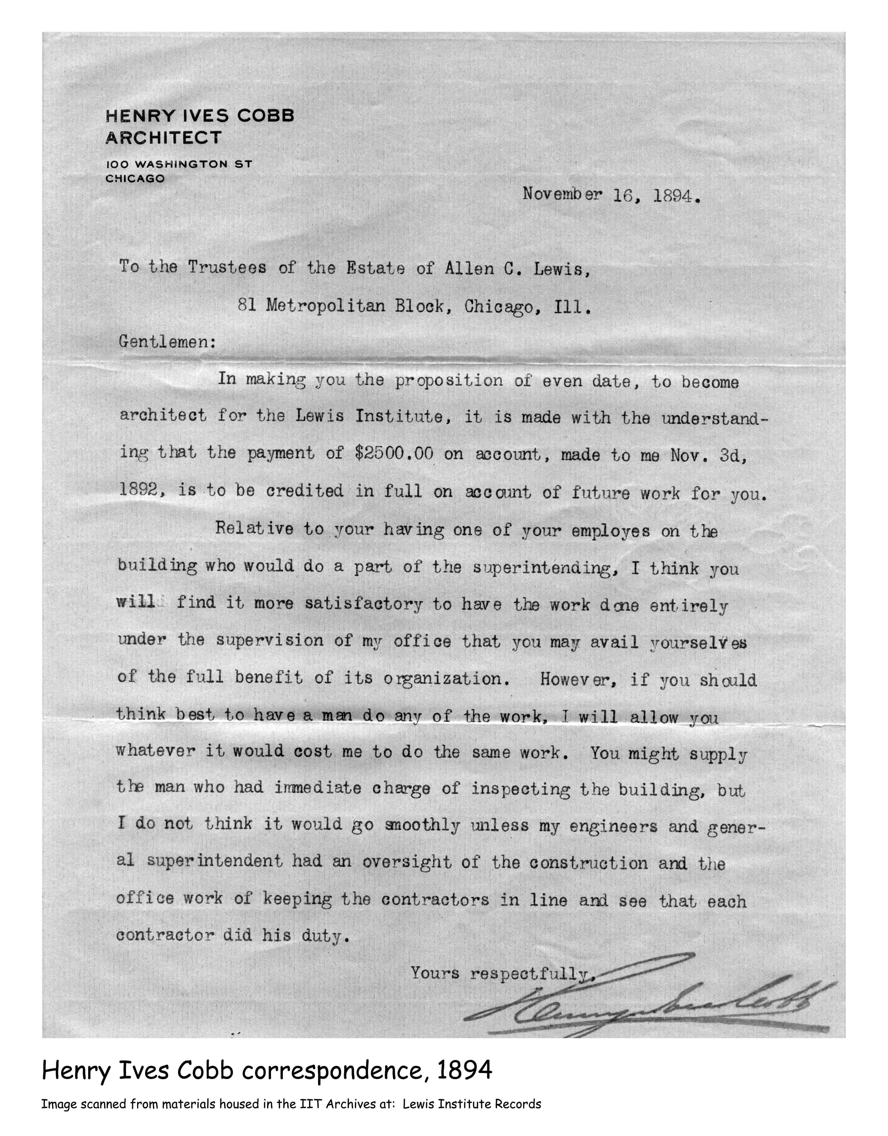
Notes:
The trustees commissioned architect Henry Ives Cobb (who had earlier designed the building which formerly housed Chicago Historical Society) to plan a six-story building, complete with elevator, and large enough to accommodate 1,000 students. Located on the block which now hosts the United Center, the school’s motto - “Science, Literature, Technology” - was carved above the building’s entrance and proclaimed its academic focus to all.
Letter

Slide 17
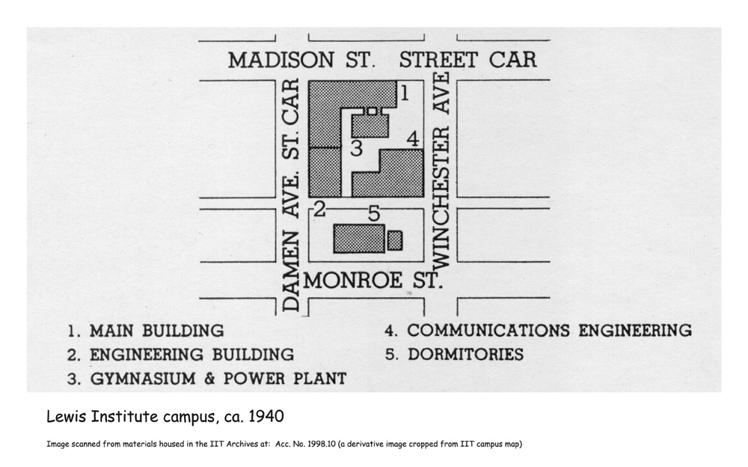
Notes:
As Lewis’ academic offerings continued to expand over the years, it facilities likewise grew, until they encompassed about a two square-block area. An engineering building was constructed in 1903. By 1922 an automotive shop was located on Winchester Ave. and the forge shop had re-located to its own building. Campus map

Slide 18
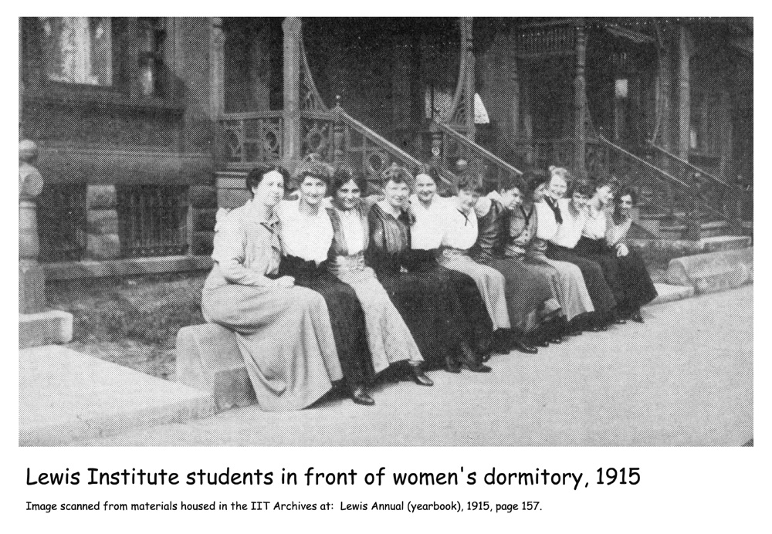
Notes:
In 1915 three adjacent houses on Monroe St., which the school owned, were converted into a dormitory for female students.

Slide 19
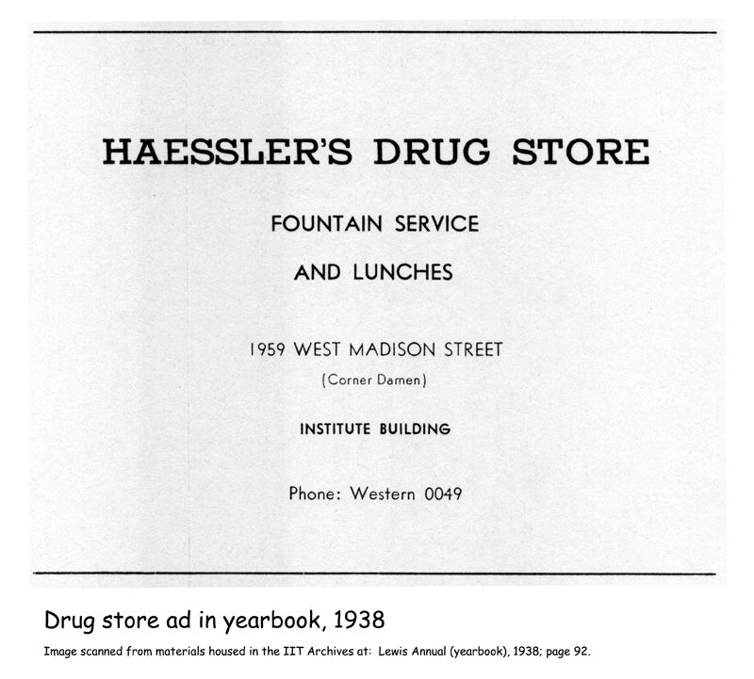
Notes:
Allen Lewis stipulated that the school building was to include a public reading room. The school’s library served as a public reference library until a branch of the Chicago Public Library opened in the building. Also, as outlined in the will, storefronts were located on the ground floor so commercial businesses could bring income to the school in the form of rent.
Drug store ad

Slide 20
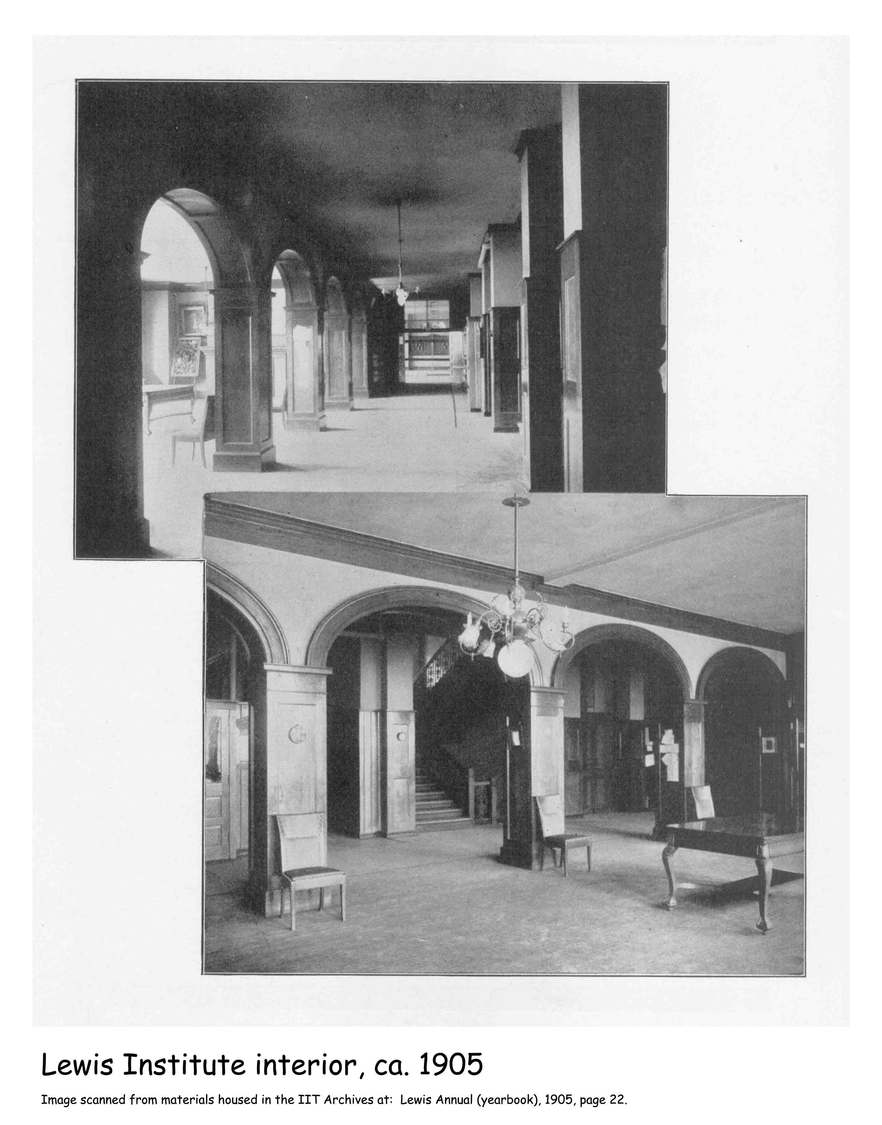
Notes:
We’ll talk a lot in this program about faculty and students who filled these halls, but I want to take a minute to introduce you to some of the staff before we move on.

Slide 21
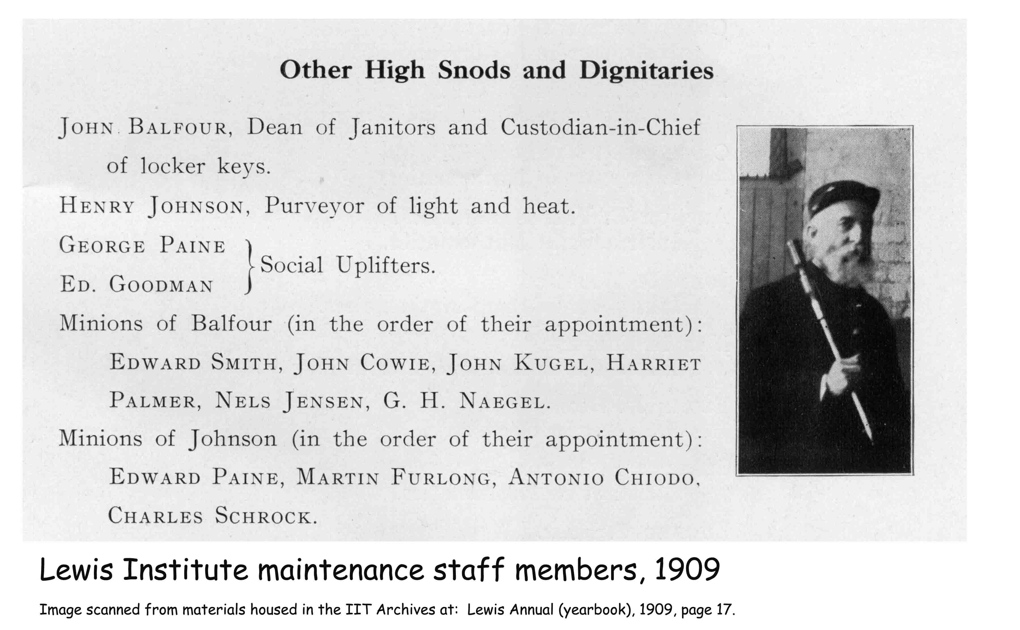
Notes:
Yearbooks typically include photos and rosters of students and faculty, but Lewis’ books went one level further. Here in 1909, we see the names of “Other High Snods and Dignitaries” -- like John Balfour, the Dean of Janitors. The “Social Uplifters” listed there were, I presume, the elevator operators.

Slide 22
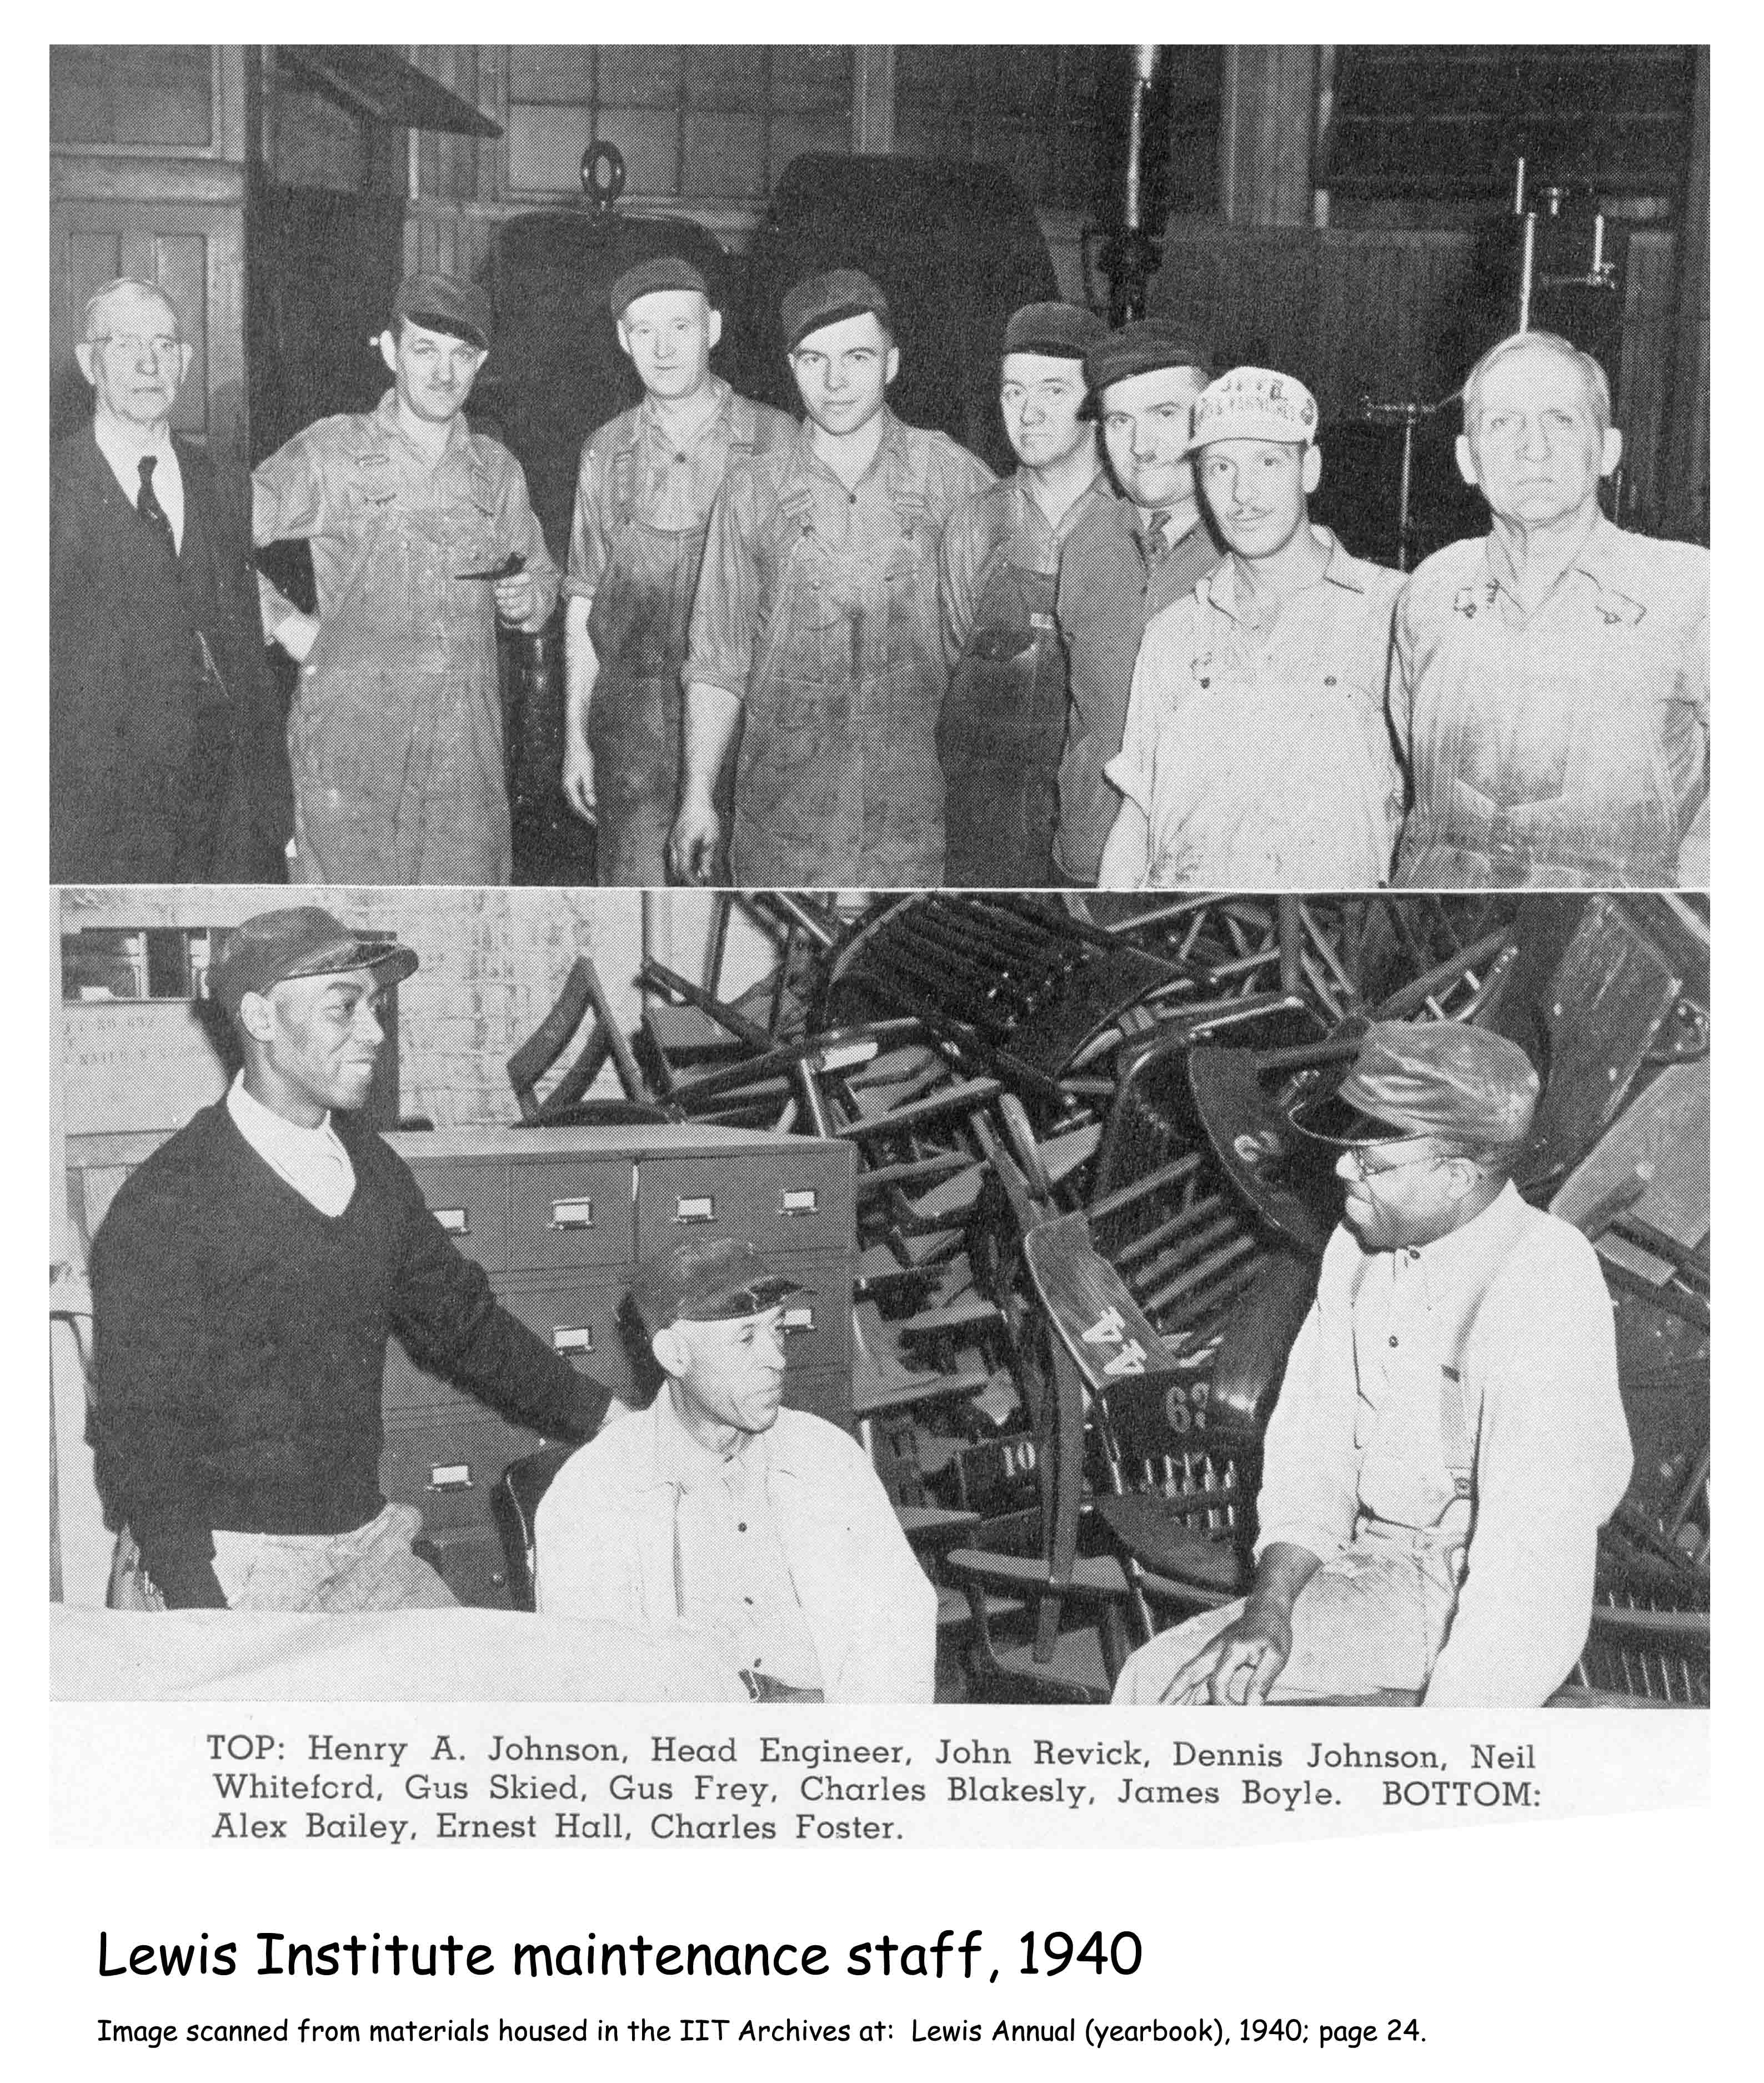
Notes:
And here, some 30 years later, are the school’s maintenance workers in 1940.

Slide 23
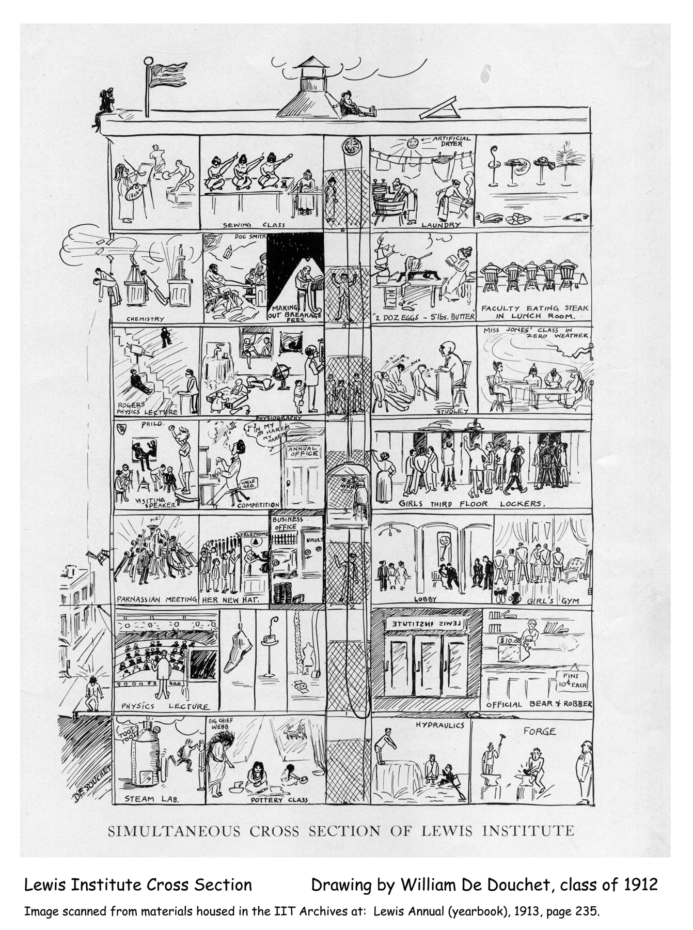
Notes:
I noted Lewis as a nurturer of education, which is accurate. But its role was more fundamental than that: Lewis actually originated educational programs, some of which are common in higher education today.
The school was incorporated having two academic levels, with a single shared faculty, -- a 4-year high school offering technical subjects and liberal arts (we’ll talk about this “academy” later),...
...and a college offering a 4-year engineering program and a 2-year arts and science program for which an Associate of Arts degree was awarded. This makes Lewis Institute the first junior college in the country; that is, the first college to award a degree upon the completion of two years of study. This degree was awarded continually until the school was dissolved by the 1940 merger.
The school operated almost 24/7 with day, evening, and summer classes.
Building-section drawing

Slide 24
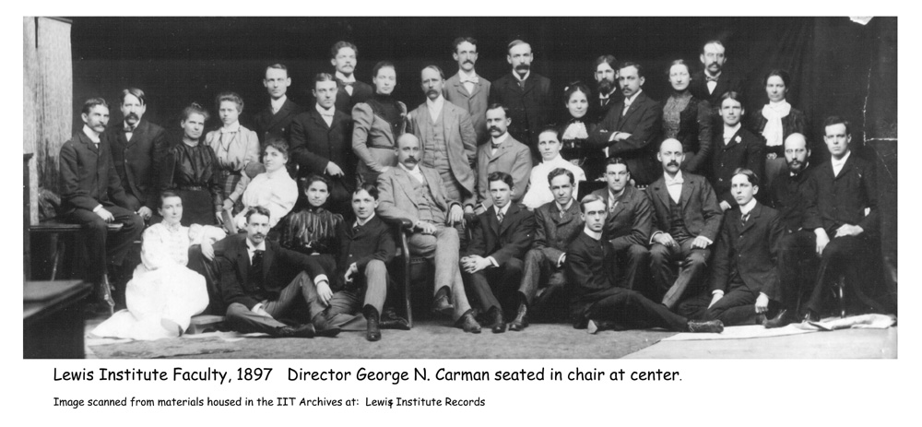
Notes:
Here we see the original faculty members, the two most influential of which were George Noble Carman in the chair, and Edwin Herbert Lewis (2nd from right with the mustache), a descendant of the founder.

Slide 25
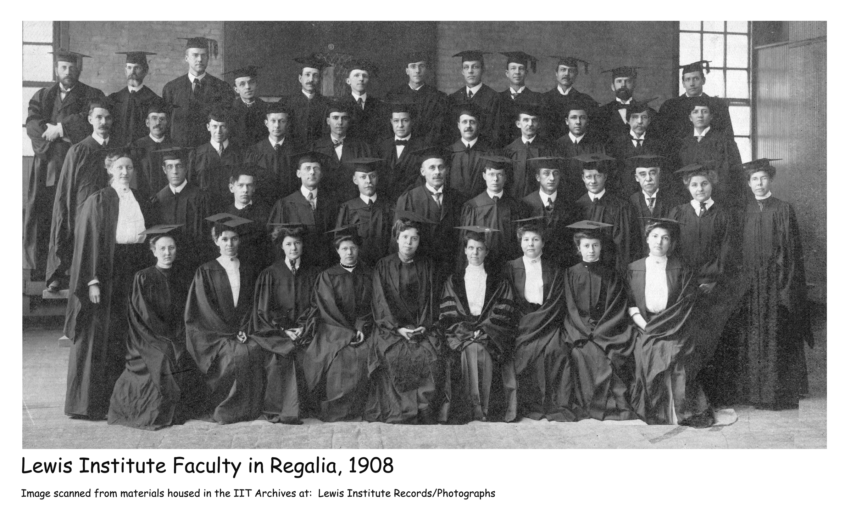
Notes:
This 1908 faculty portrait includes many of the same people. In fact, seven of the original group taught until at least 1935, just 5 years short of the merger.

Slide 26
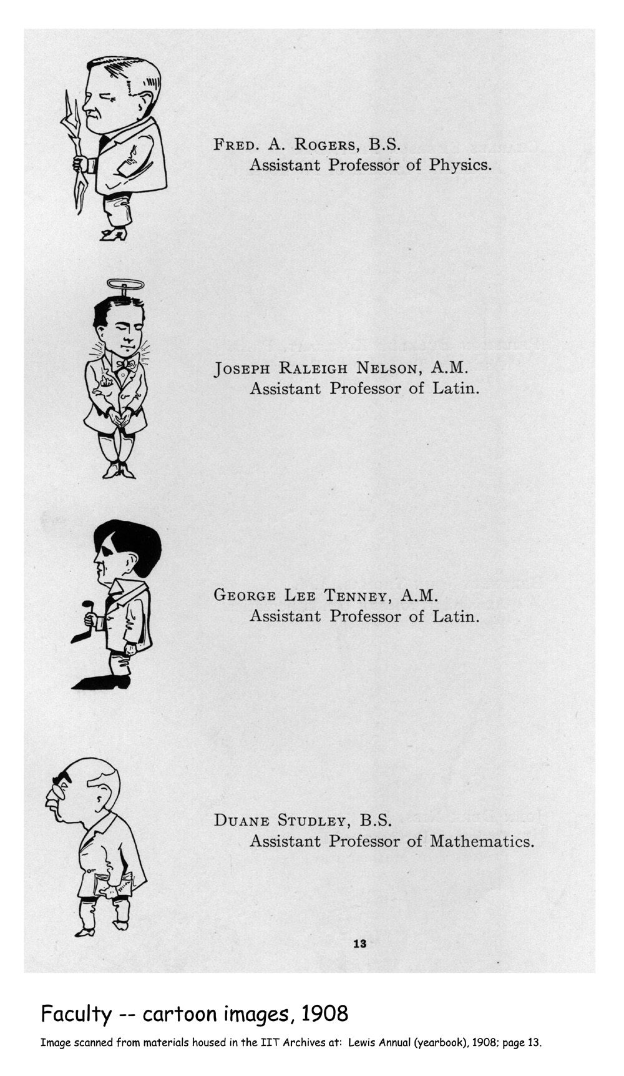
Notes:
For all of its very sober approach to education, the school never took itself too seriously to be light hearted and fun. Humor abounds in various school activities and the fact that this extended to the students’ characterizations of the faculty is evidenced in a couple of the school yearbooks that included something other than the traditional faculty photo headshots -- like the caricatures in the 1908 yearbook…

Slide 27
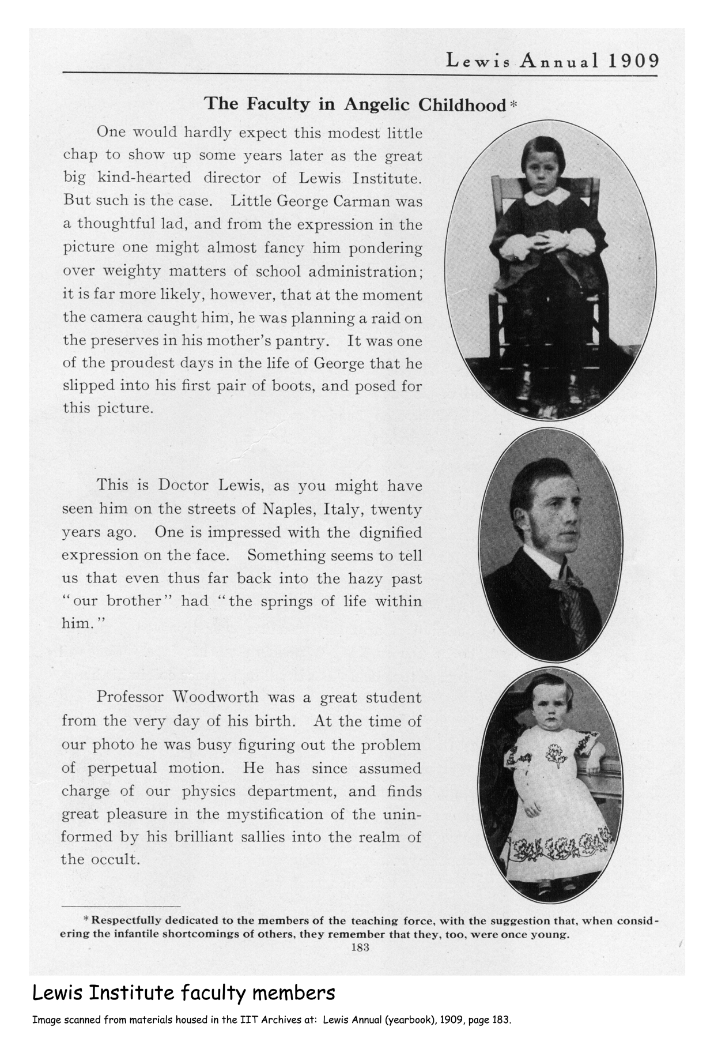
Notes:
…or this one the following year, which reads at the bottom of the page, “Respectfully dedicated to the members of the teaching force, with the suggestion that, when considering the infantile shortcomings of others, they remember that they, too, were once young.”
As babies

Slide 28
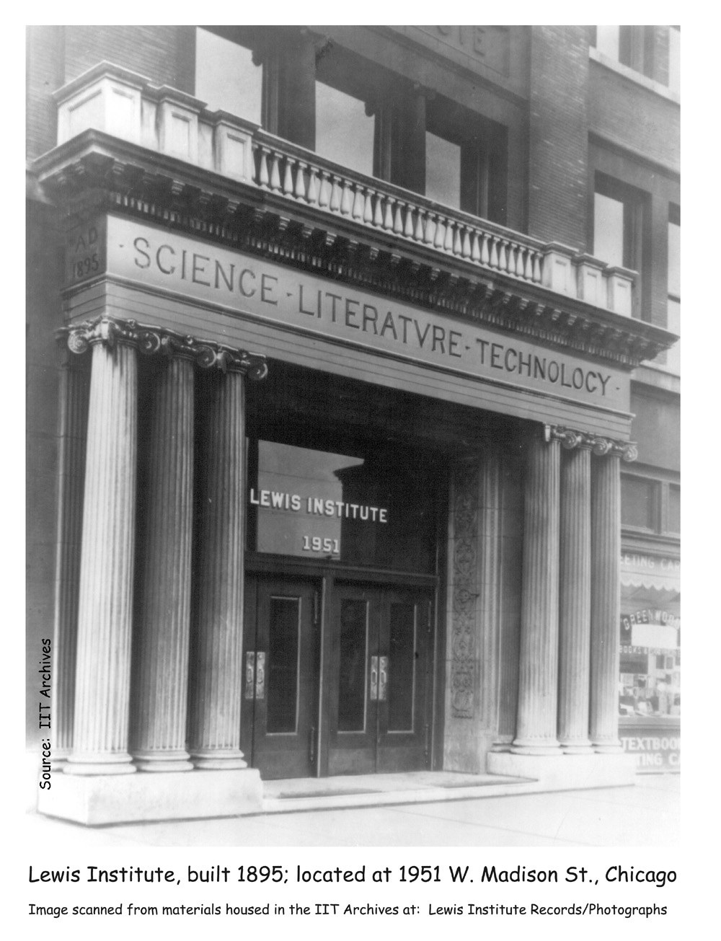
Notes:
During its first decade, the college made refinements to its academic structure as programs grew and defined themselves. By 1906 a structure had emerged which grouped the academic offerings into three broad programs:
General Science, including Home Economics;
Liberal Arts;
and Engineering and Mechanical Arts.
Next, we’ll survey some of the disciplines offered through these programs and meet the people connected with them. We’ll begin with the engineering program.
Building entrance

Slide 29
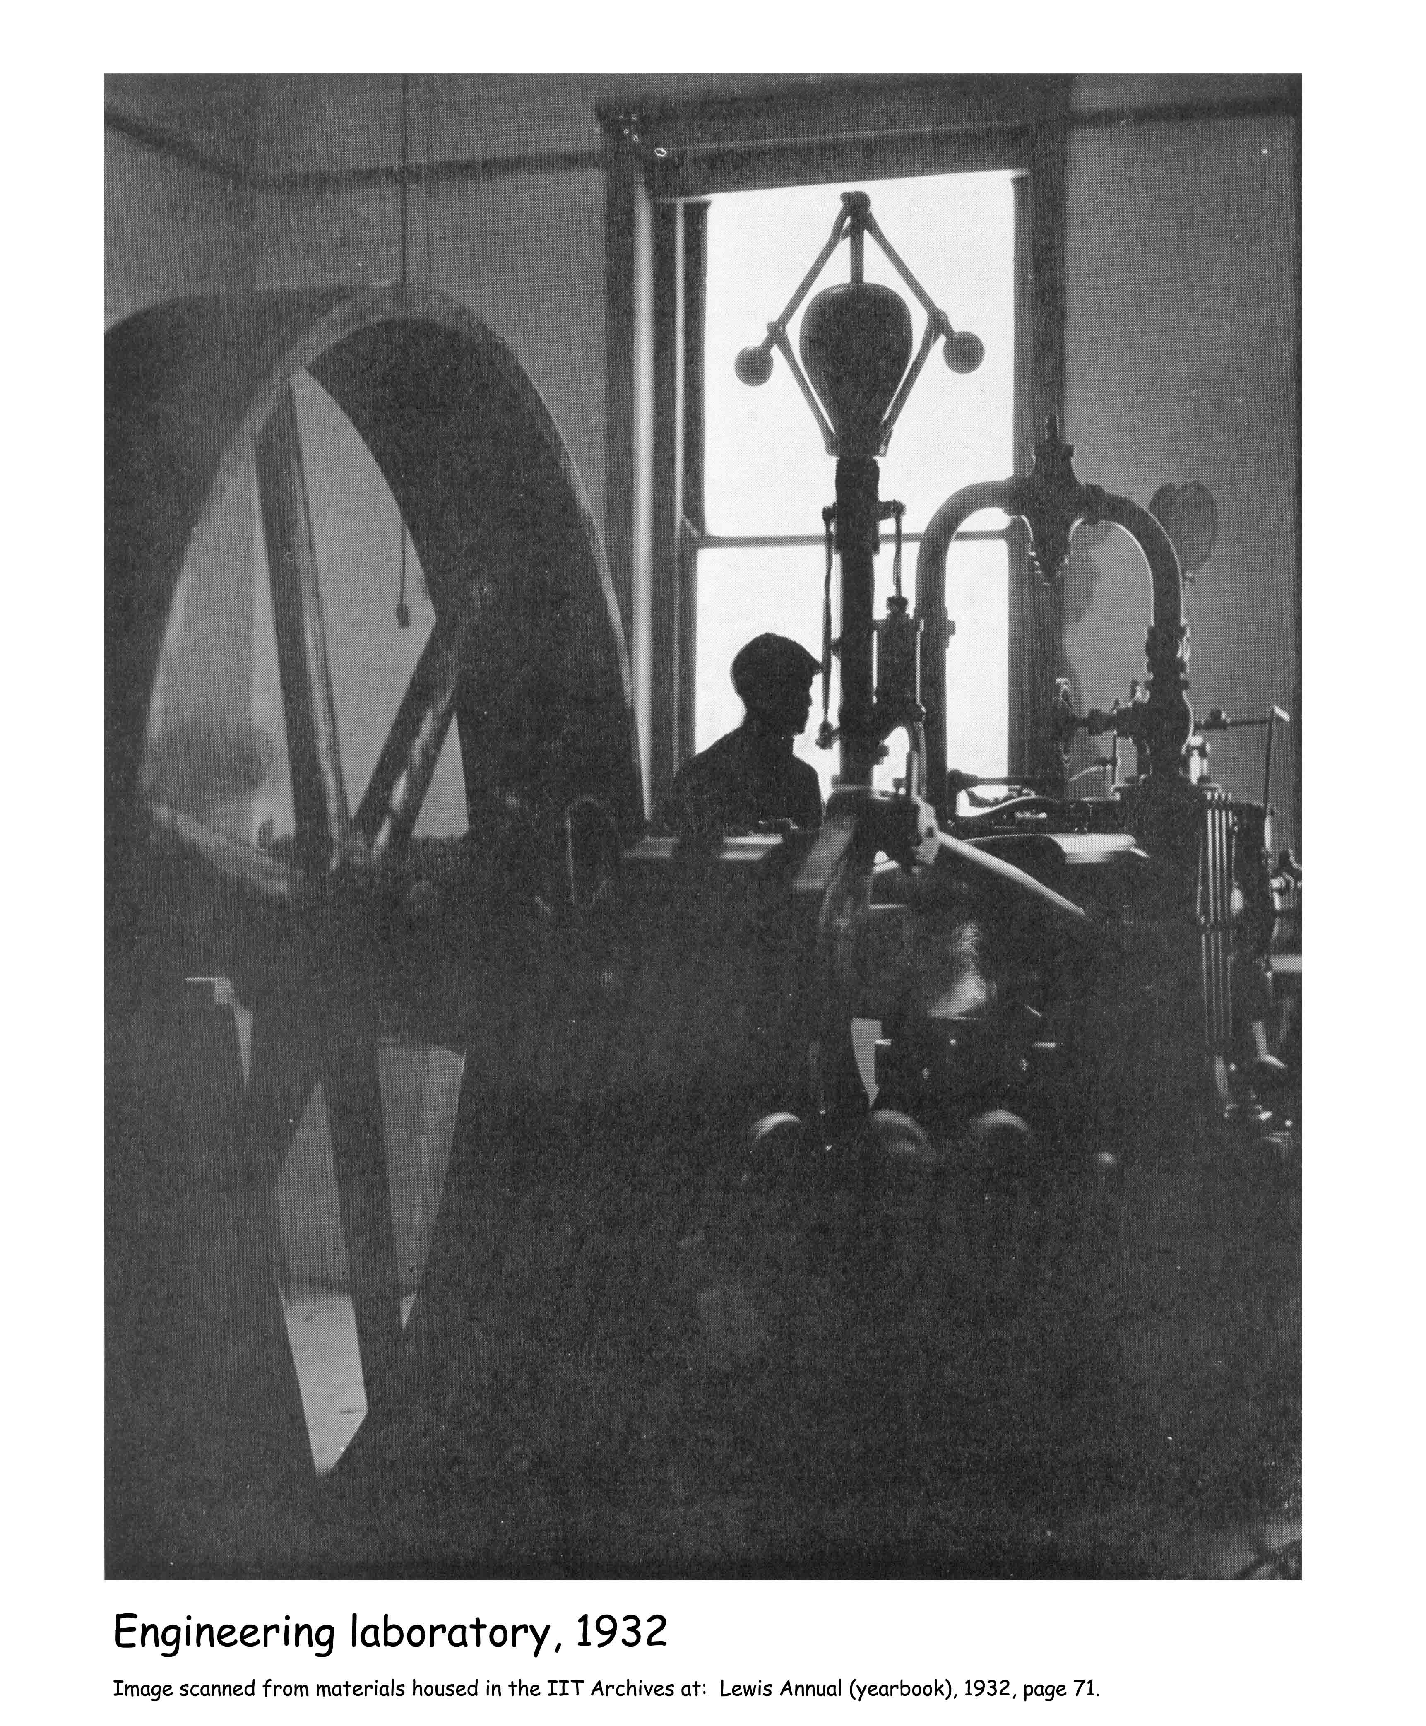
Notes:
The college offered a 4-year course leading to a “Mechanical Engineer” degree which was awarded from 1896 - 1912. In 1912 the degree was changed to a B.S. in Mechanical Engineering. And in 1925, the school began offering B.S. degrees in civil engineering and electrical engineering as well.
Engineering lab

Slide 30
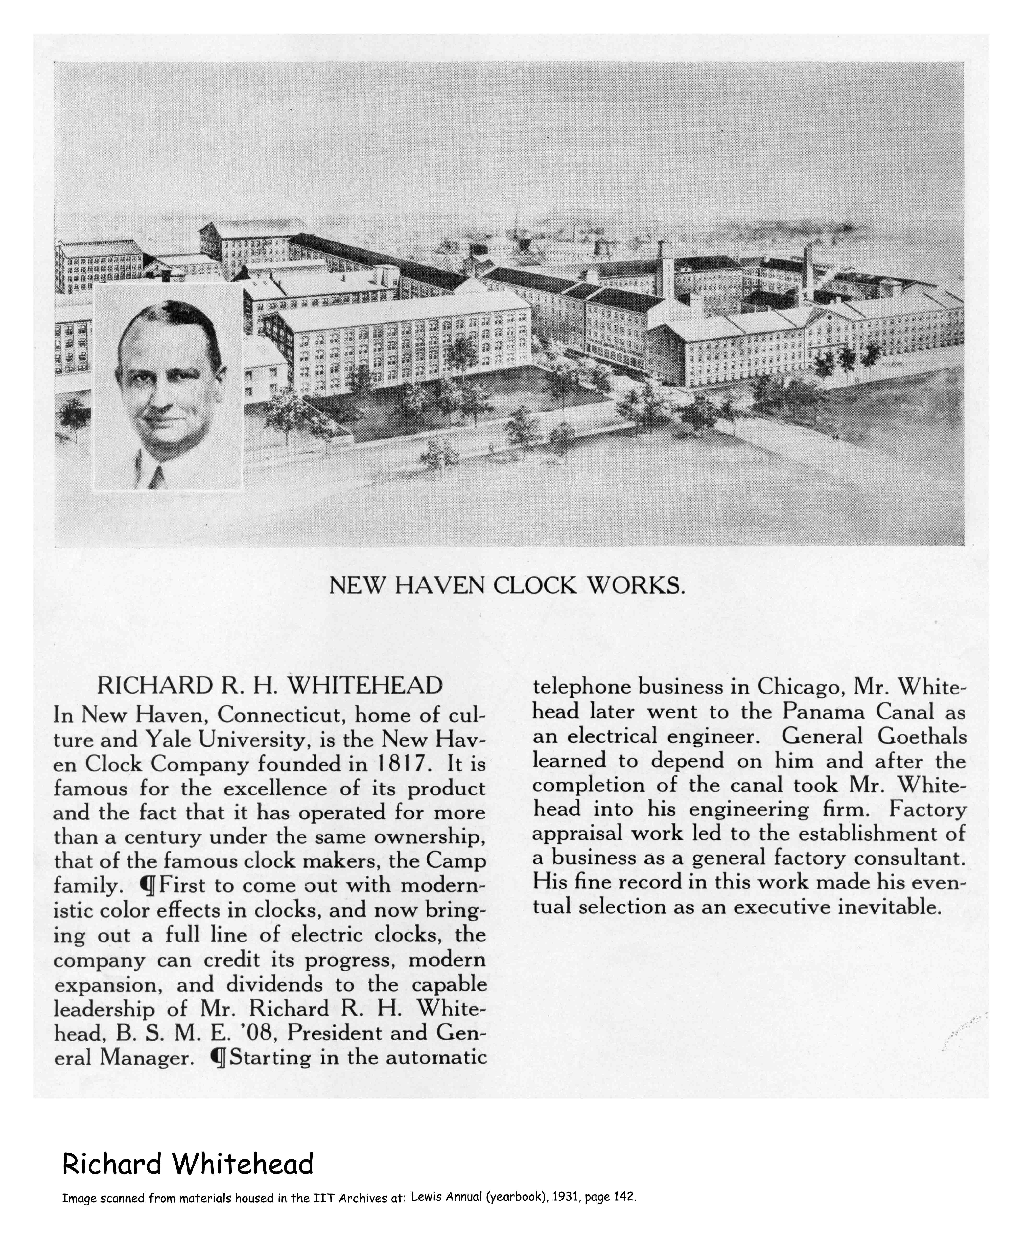
Notes:
One early graduate of the engineering program was Richard Whitehead, who later, as an economist, studied the post-WW II German economy for the U.S. government and made recommendations which were incorporated into the Marshall Plan. But that was after he had served as President of New Haven Clock Co. rescuing it from bankruptcy. He probably also knew a little about the manufacture of clockworks because prior to that job, he had developed the formula for the Panama Canal locks. “[Lewis] gave me the intellectual curiosity, training, and background, and prepared me for this great land of opportunity. Truly I have been thrice blest.”

Slide 31
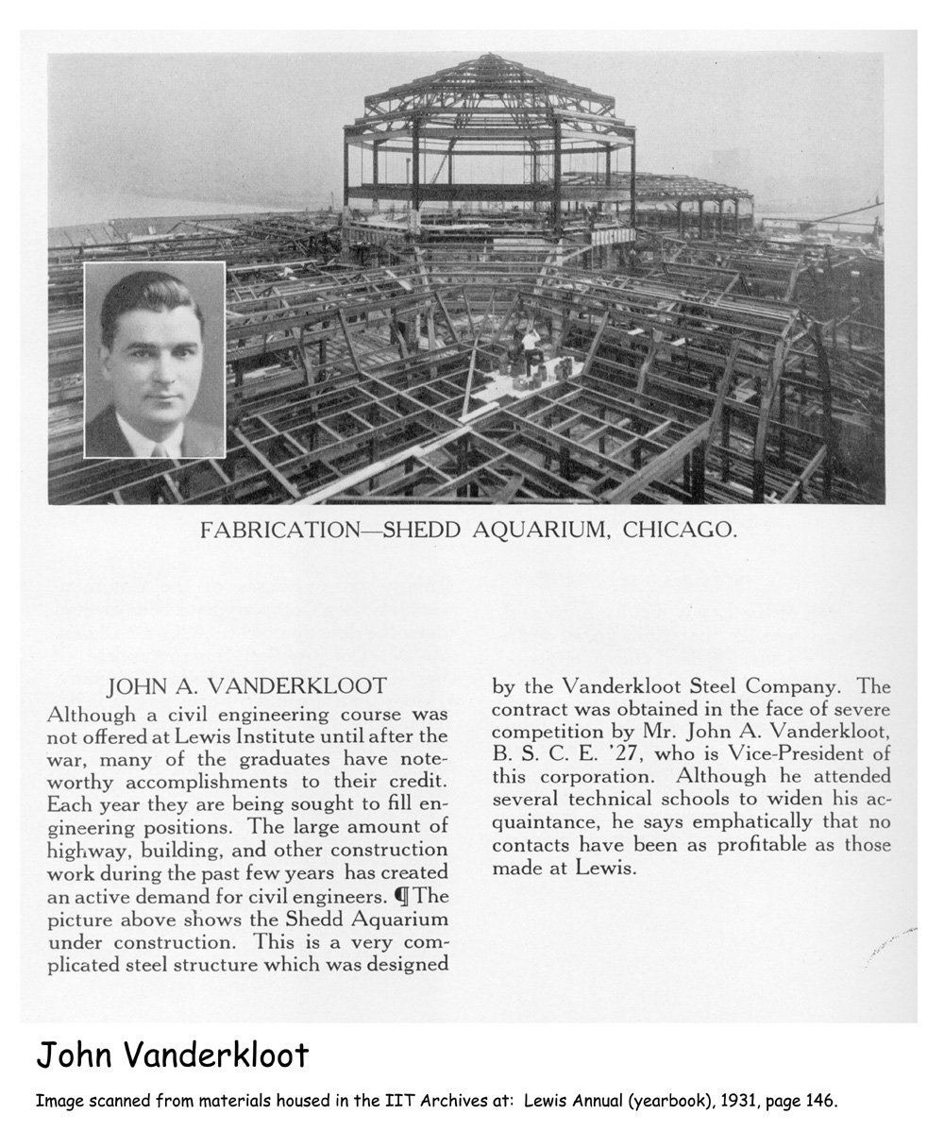
Notes:
Other graduates of the engineering program include John Vanderkloot, of Vanderkloot Steel Co., the company which “in the face of severe competition” won the contract to design Shedd Aquarium.

Slide 32
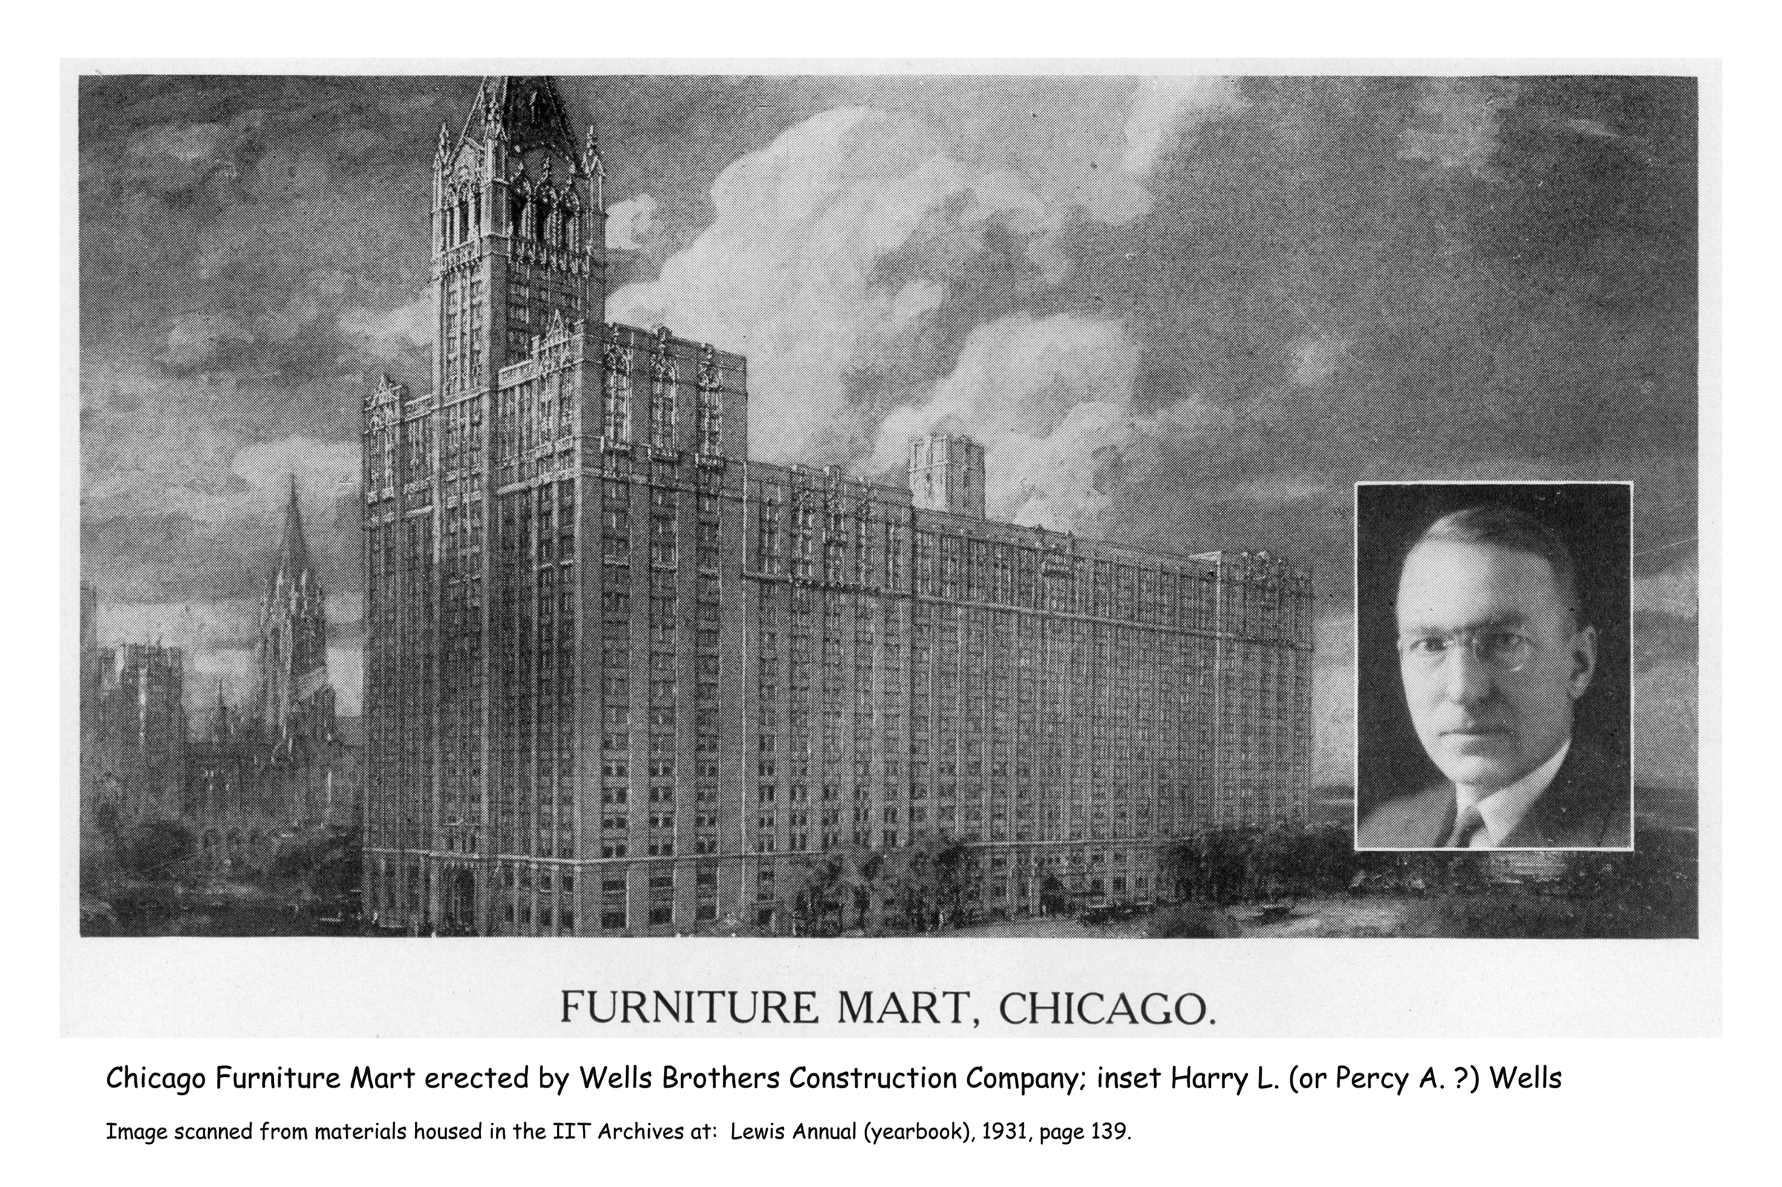
Notes:
And, the Wells brothers, Percy A. and Harry L., who owned Wells Bros. Construction Co. which built the Chicago Furniture Mart, the Montgomery-Ward building, Commonwealth Edison Co., Butler Brothers building, and others throughout the U. S.

Slide 33
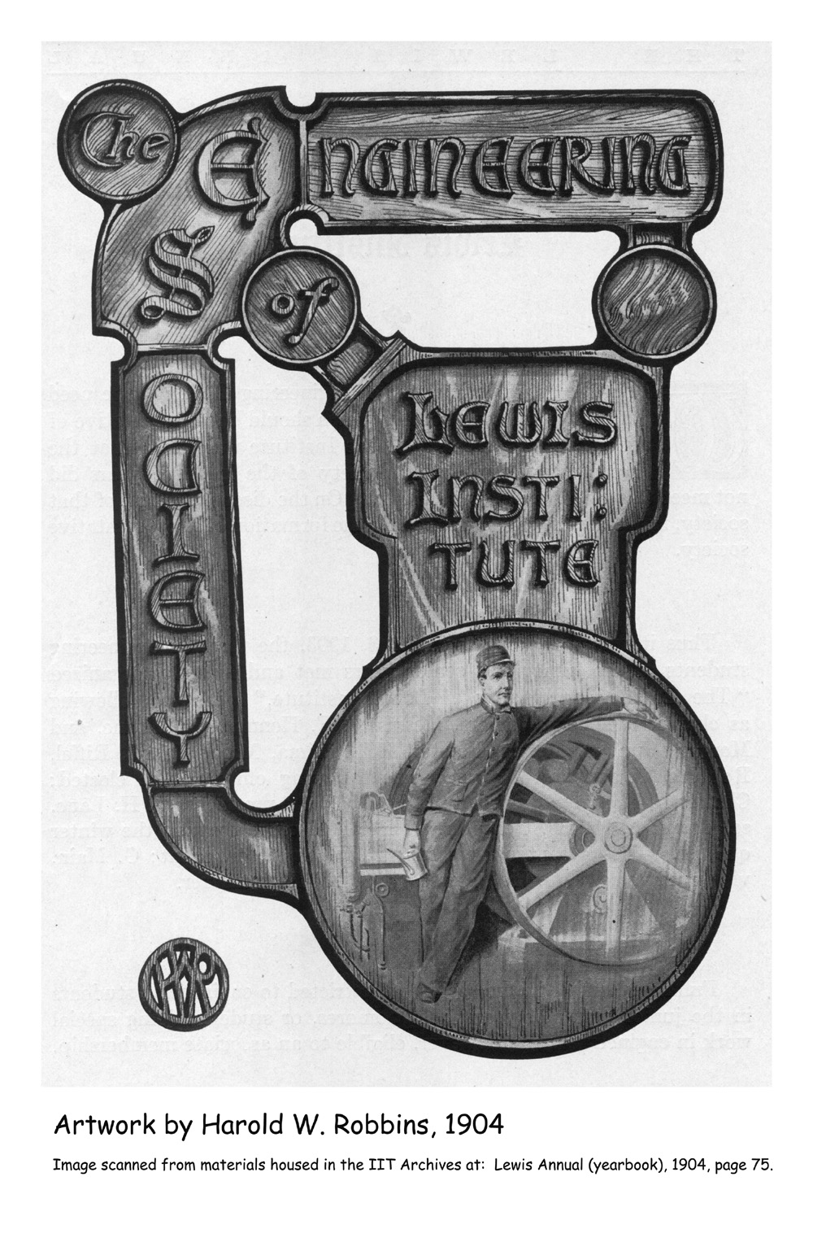
Notes:
During the 1906 - 1916 decade, the Engineering program graduated an average of 14 students a year. During the same time period, the Home Economics program graduated an average of 48 a year. So let’s move to the Home Ec program next. Engineering logo

Slide 34
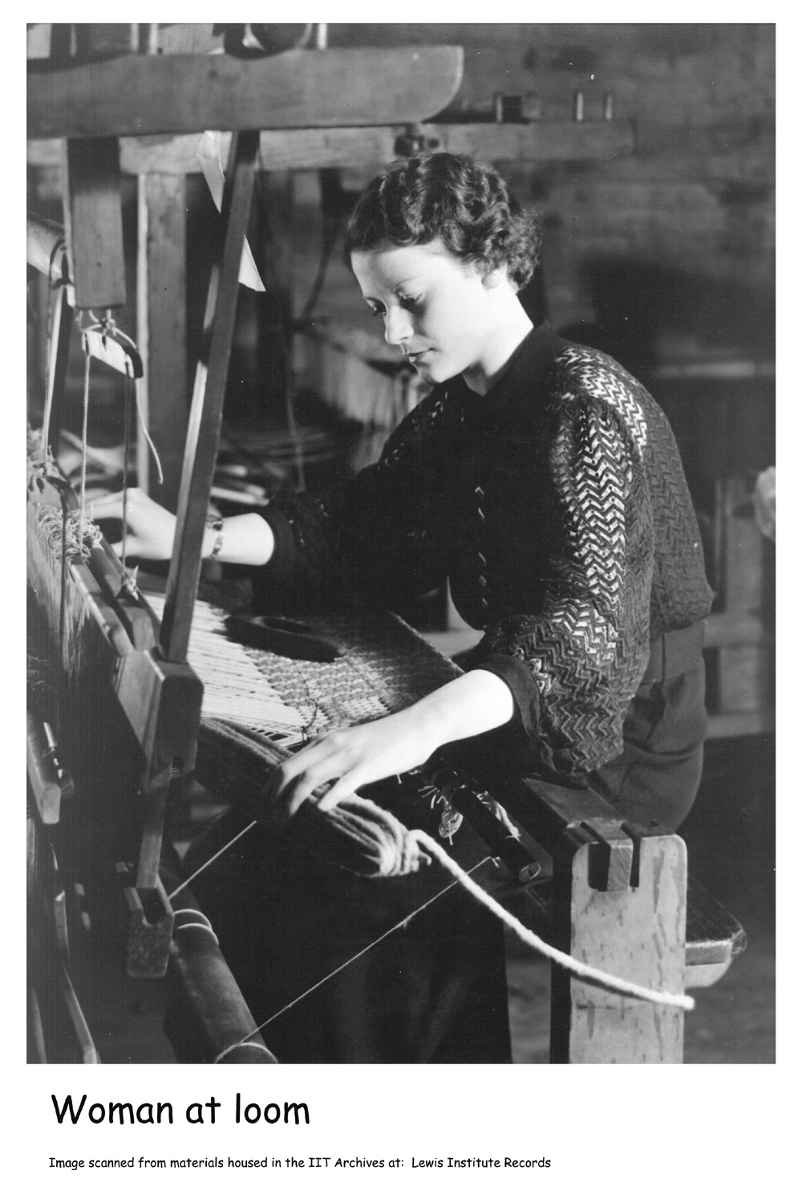
Notes:
Known as “domestic economy” in 1896 when the school opened, the Home Economics program was one of the earliest in the country, and a number of its graduates became the faculty members in other Home Ec programs across the country as they were established. The first Associate in Home Economics degree was awarded in 1908. The first B.S. in Home Ec was awarded in 1912.
Woman at loom

Slide 35
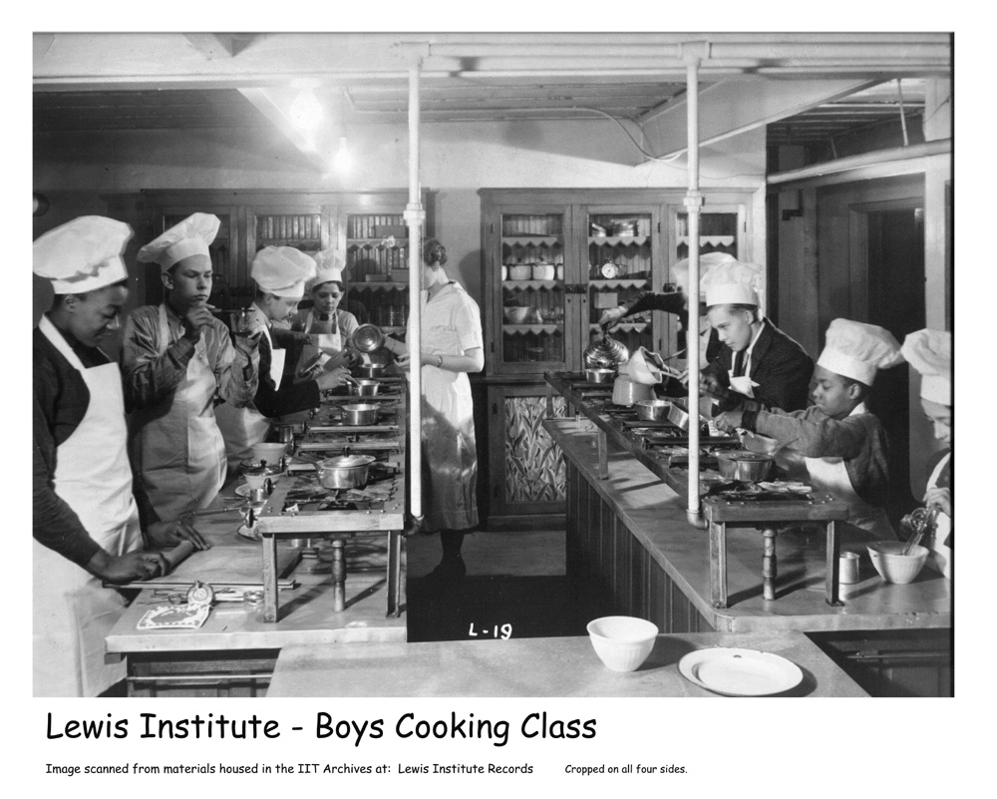
Notes:
This was not, however, your mother’s high school or college home ec program. The Home Economics program at Lewis Institute was designed to prepare women – and men – to become professional chefs, medical workers, dressmakers, interior designers, or pursue a host of other jobs in which they could be gainfully employed. Classes were taught in biology, hygiene, and economics to prepare them for traditional domestic careers. They could take costume design and millinery as entrée into the fields of vogue fashion, shop keeping or stage and theater design. Some studied chemistry, cooking, nutrition, or bacteriology as an entrée into the fields of professional chef, dietitian or culinary arts, or restaurant management.
Boys cooking

Slide 36
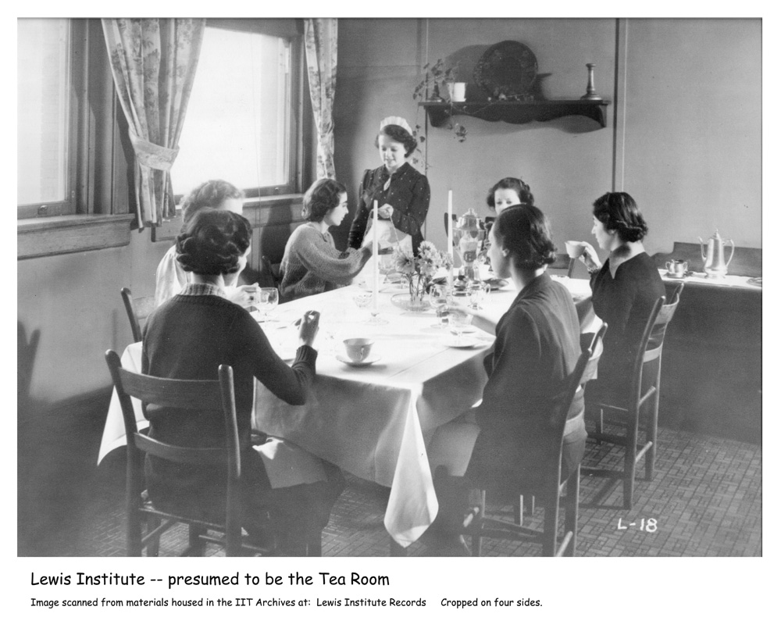
Notes:
A food laboratory and institutional kitchen were located in the school, and Lewis taught the first course in lunch room management ever offered. As part of this course, the students operated a tea room -- a commercial operation which gave students actual practice at planning menus, preparing and serving food, managing the business enterprise, and keeping the books. Account books dated 1930 - 1935, with class rosters, menus, cost of supplies, daily receipts, and patron tallies, survive in the Lewis Institute Records.
Tea room

Slide 37
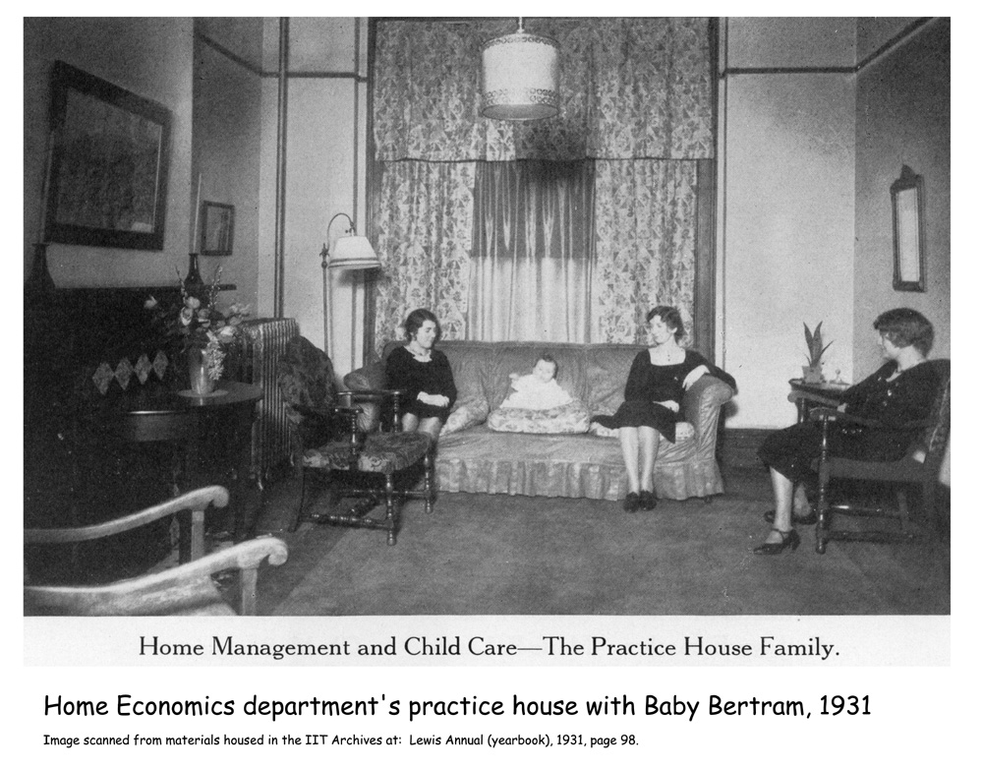
Notes:
A “practice house” was established in 1926 where students were given an opportunity to perform domestic and child care skills in a real life situation. A little too realistic for us today as a parade of toddlers were “loaned” to the Home Management House for up to a year at a time. That’s Baby Bertram sitting on the sofa in 1931.

Slide 38
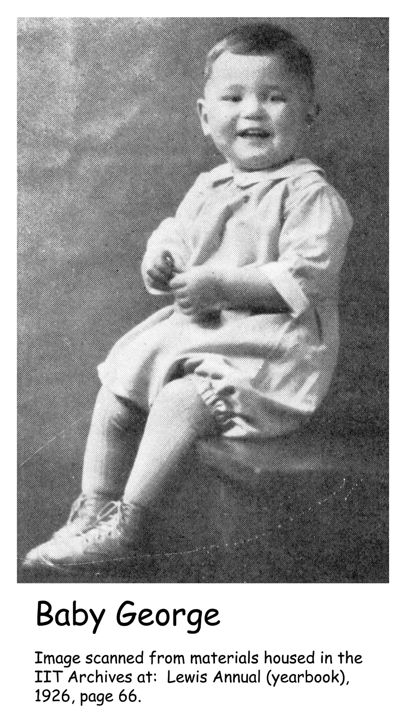
Notes:
But before him there was: George in 1926

Slide 39
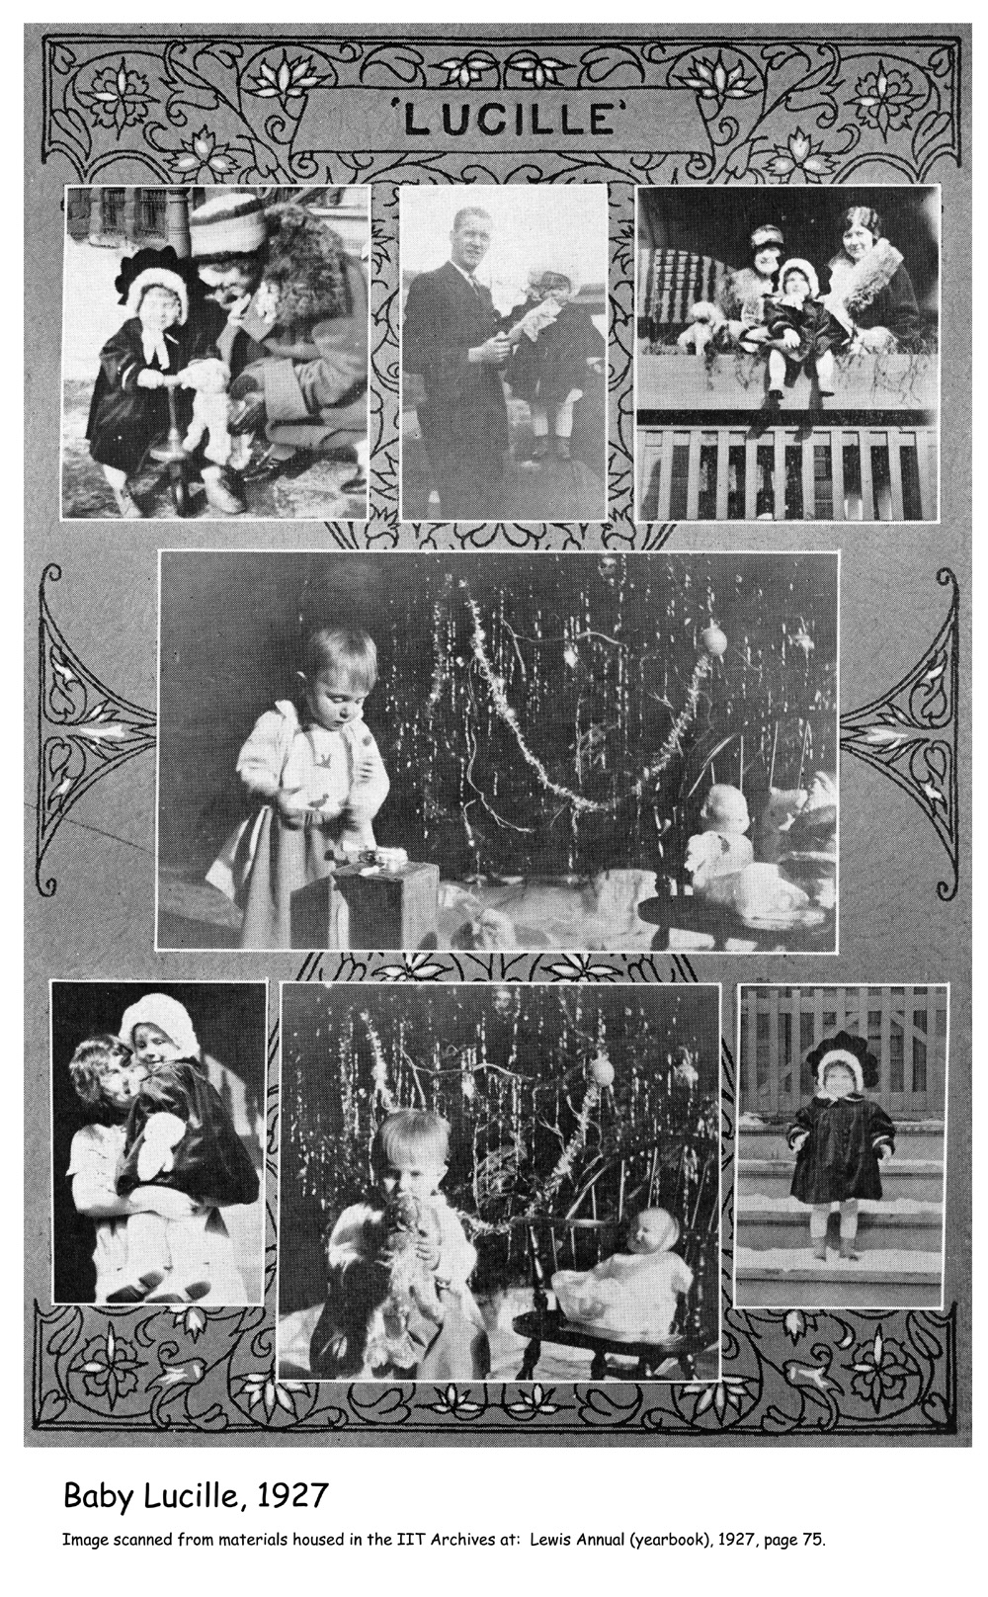
Notes:
Lucille in 1927;

Slide 40
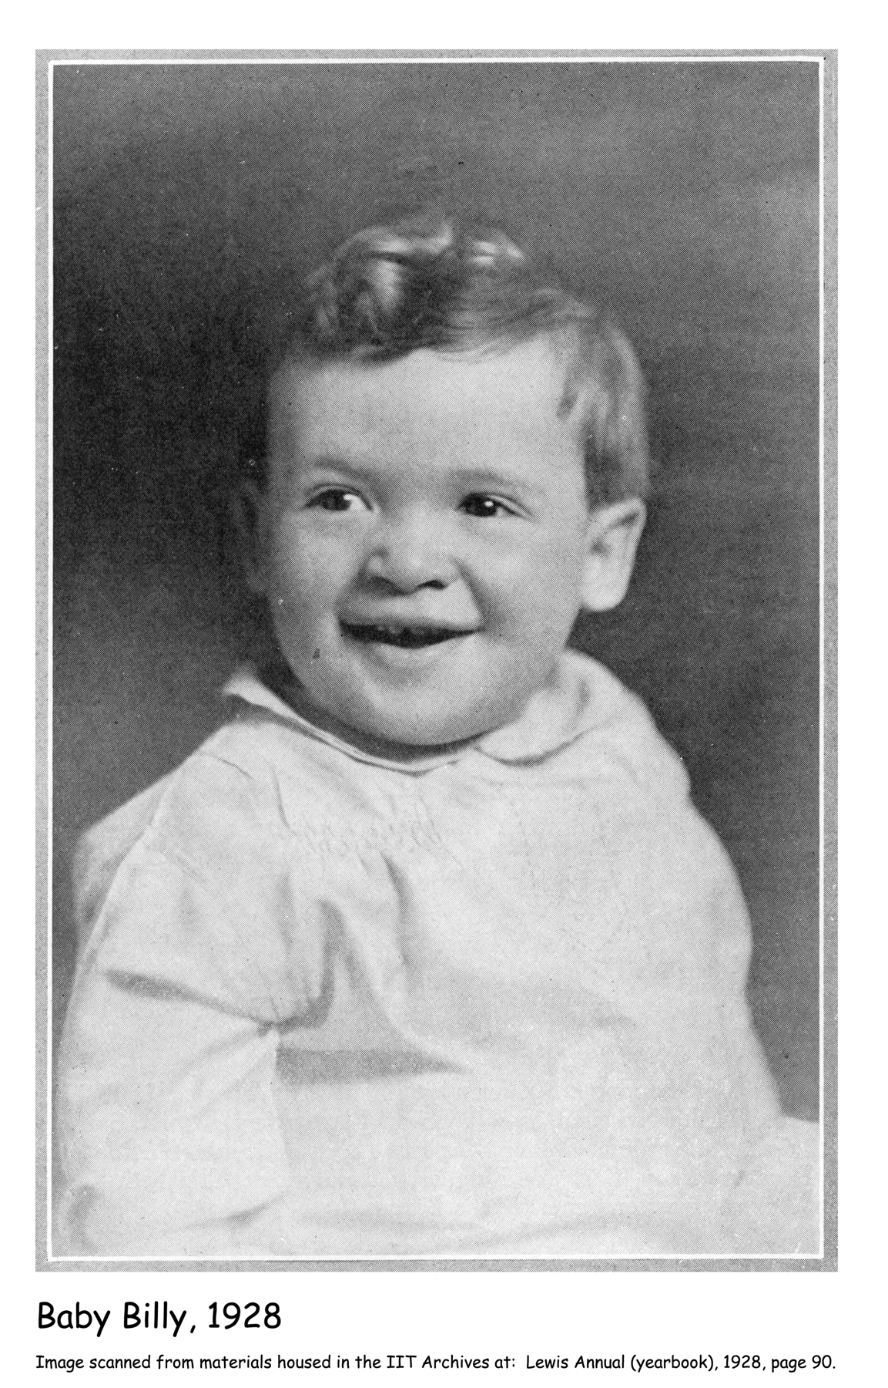
Notes:
Billy in 1928;

Slide 41
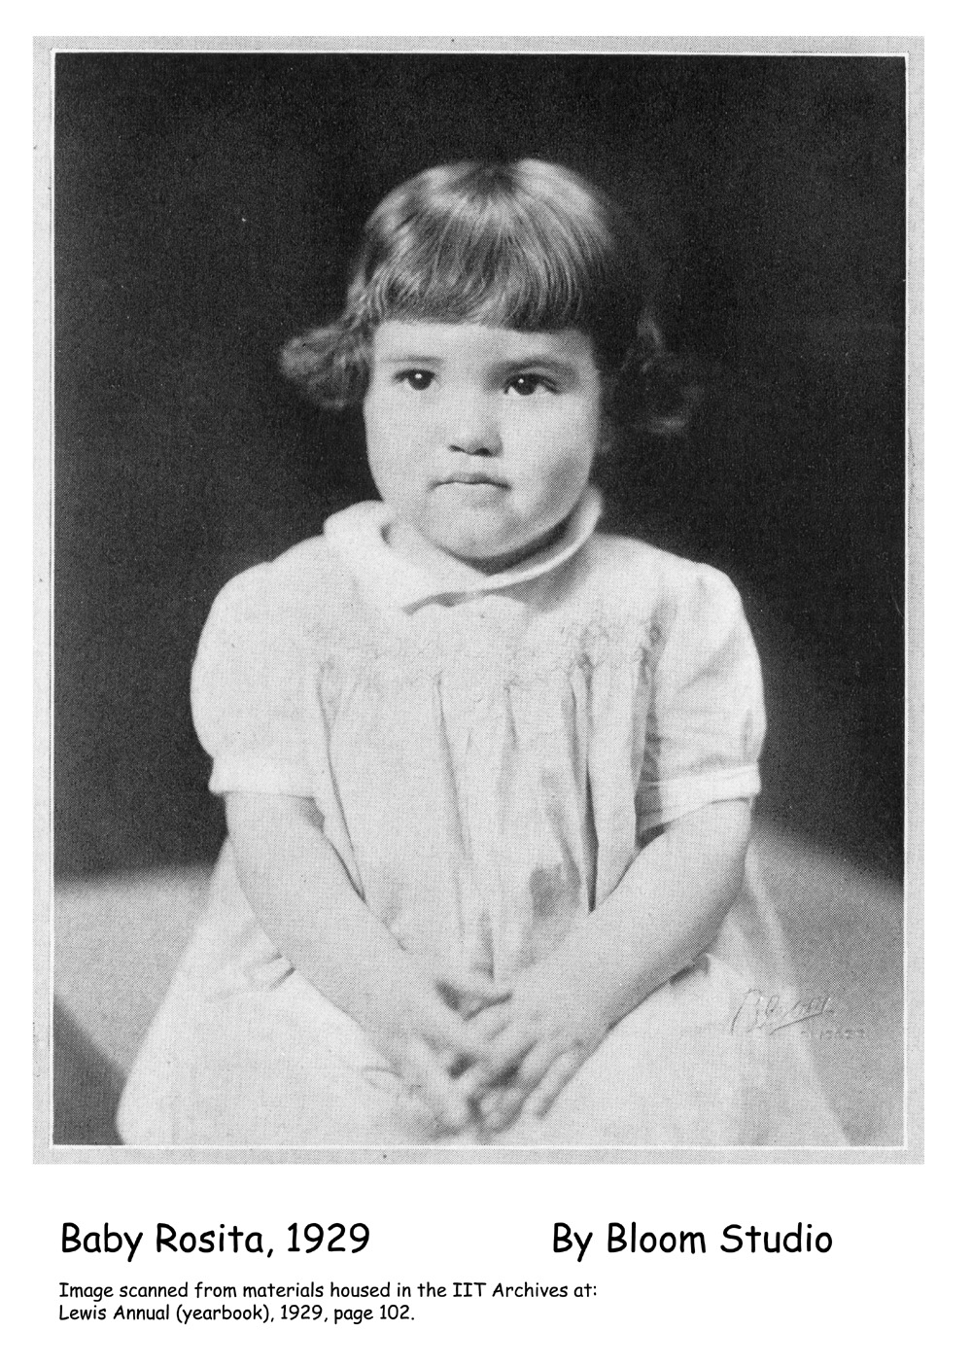
Notes:
and Rosita in 1929.

Slide 42
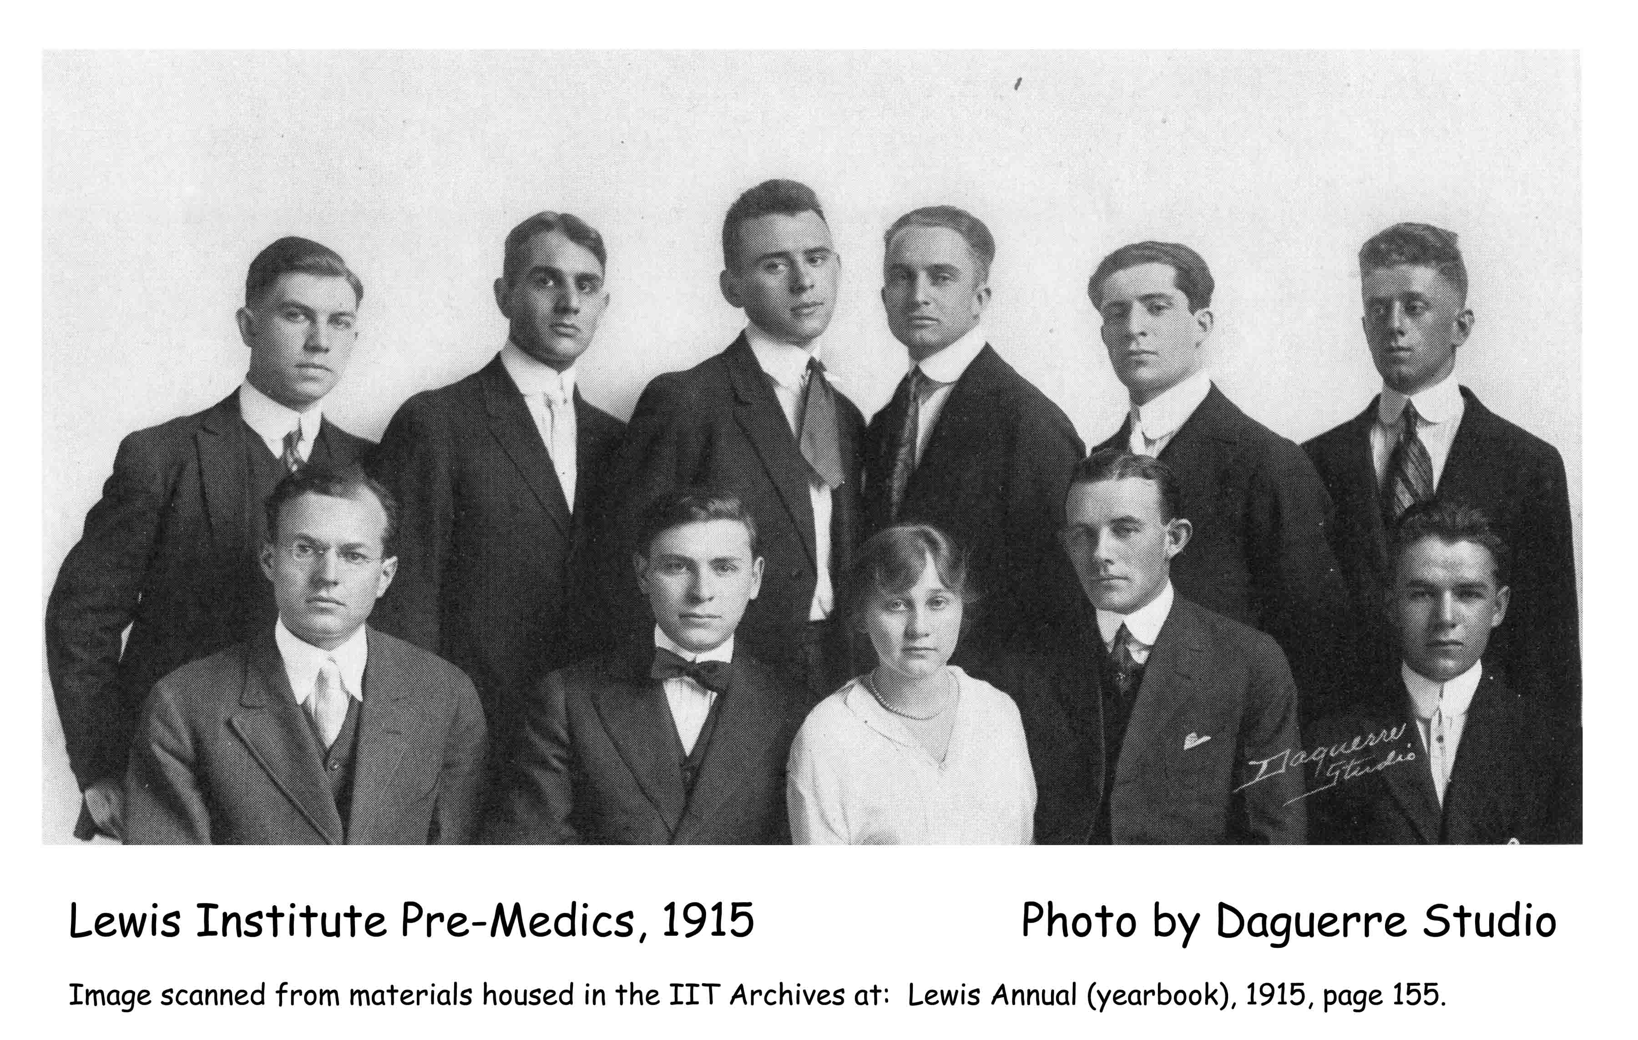
Notes:
Some Lewis students used their education as entree into the fields of medicine and social science. A Pre-Medics organization was formed in 1915,...

Slide 43
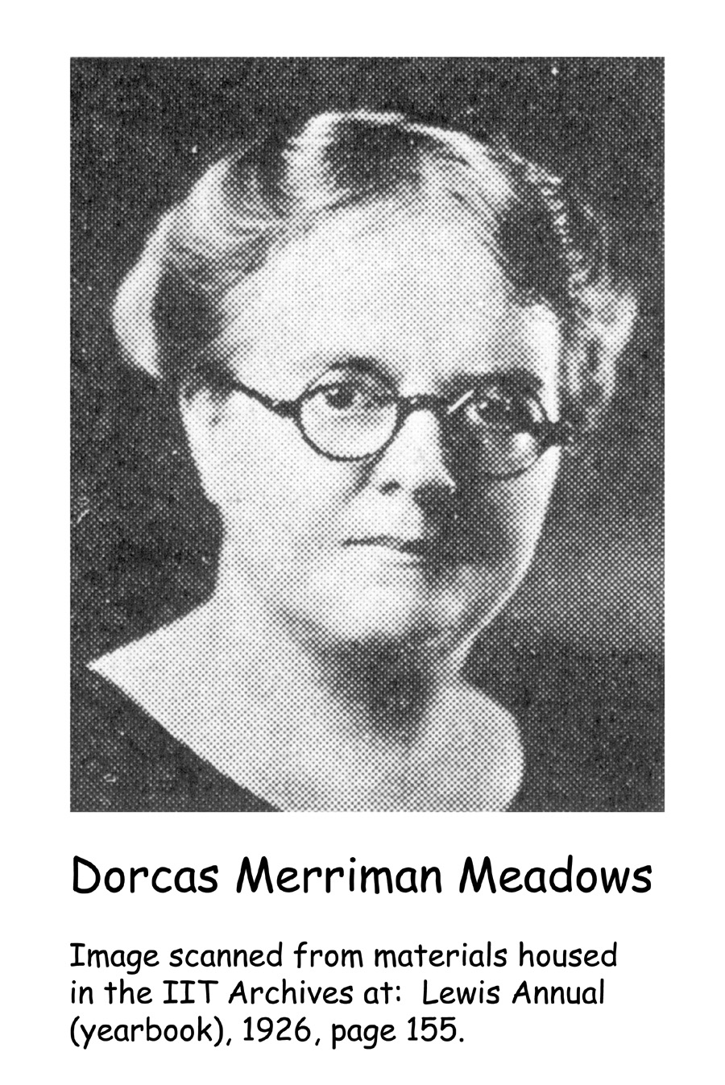
Notes:
...but Lewis’ earliest doctor may have been Dorcas Merriman Meadows who, after leaving Lewis, received her MD from Nashville in 1903, and then served as a doctor in China until 1911. She later taught anatomy at Baylor University.

Slide 44
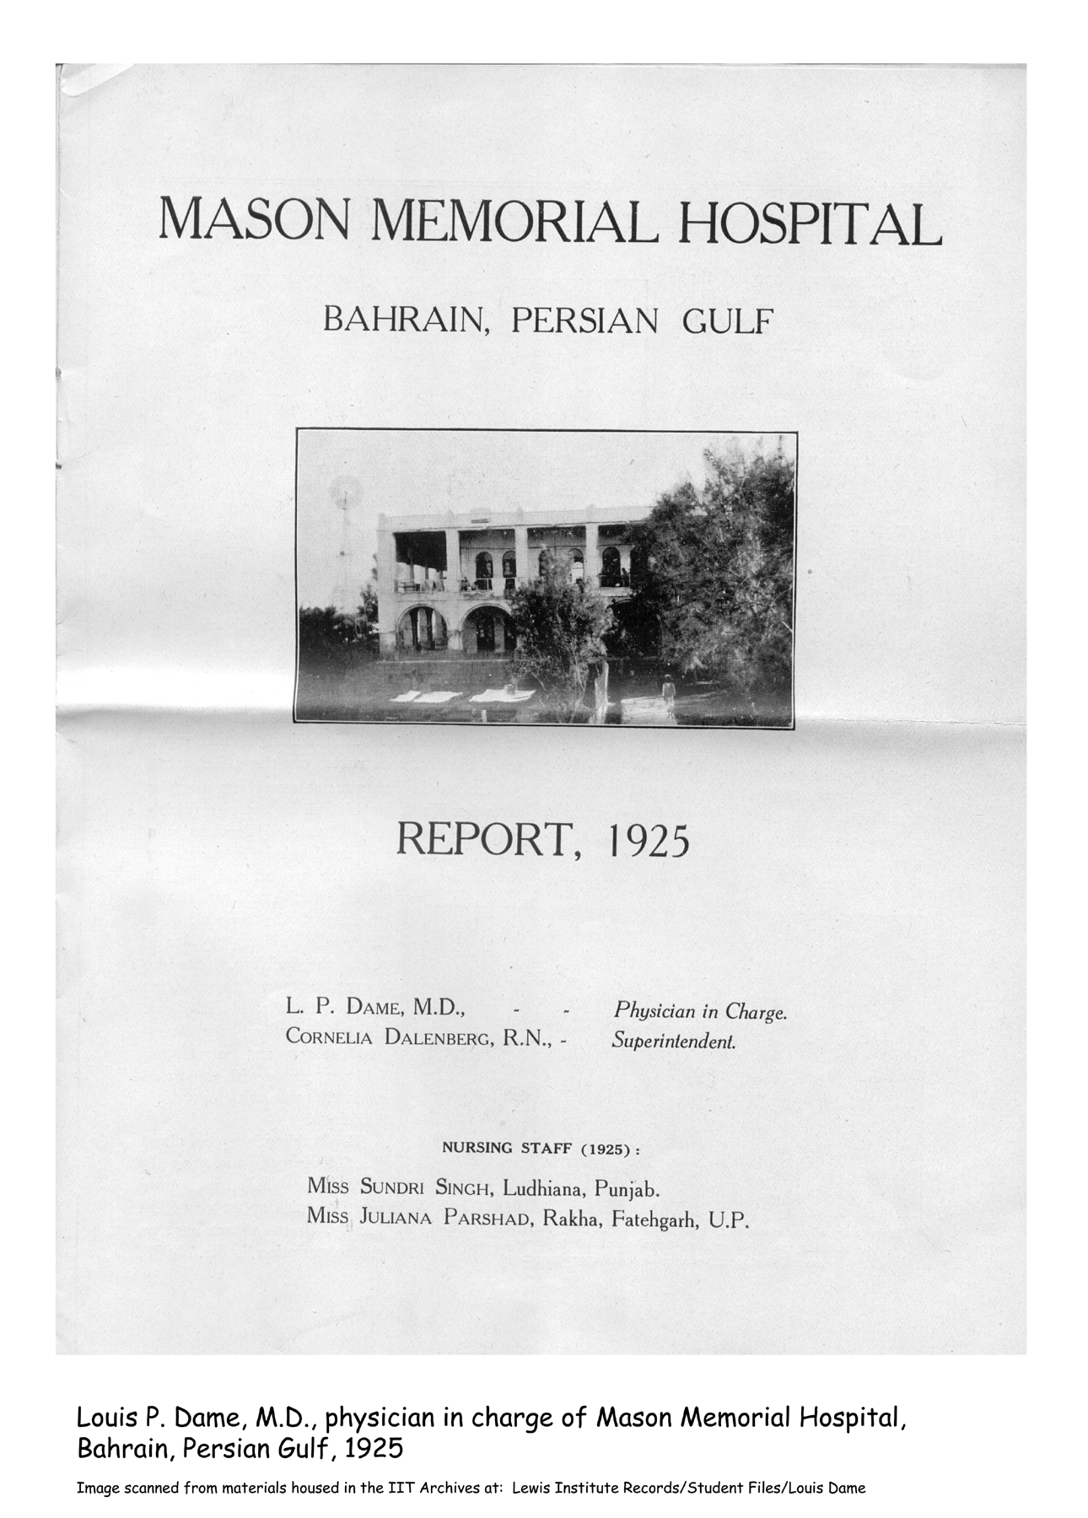
Notes:
Louis Dame served as a missionary surgeon in Bahrain, Persian Gulf, in the 1920s bringing modern medical science to Muslims who, prior to this time, had rejected western medical practice.
Hospital program

Slide 45
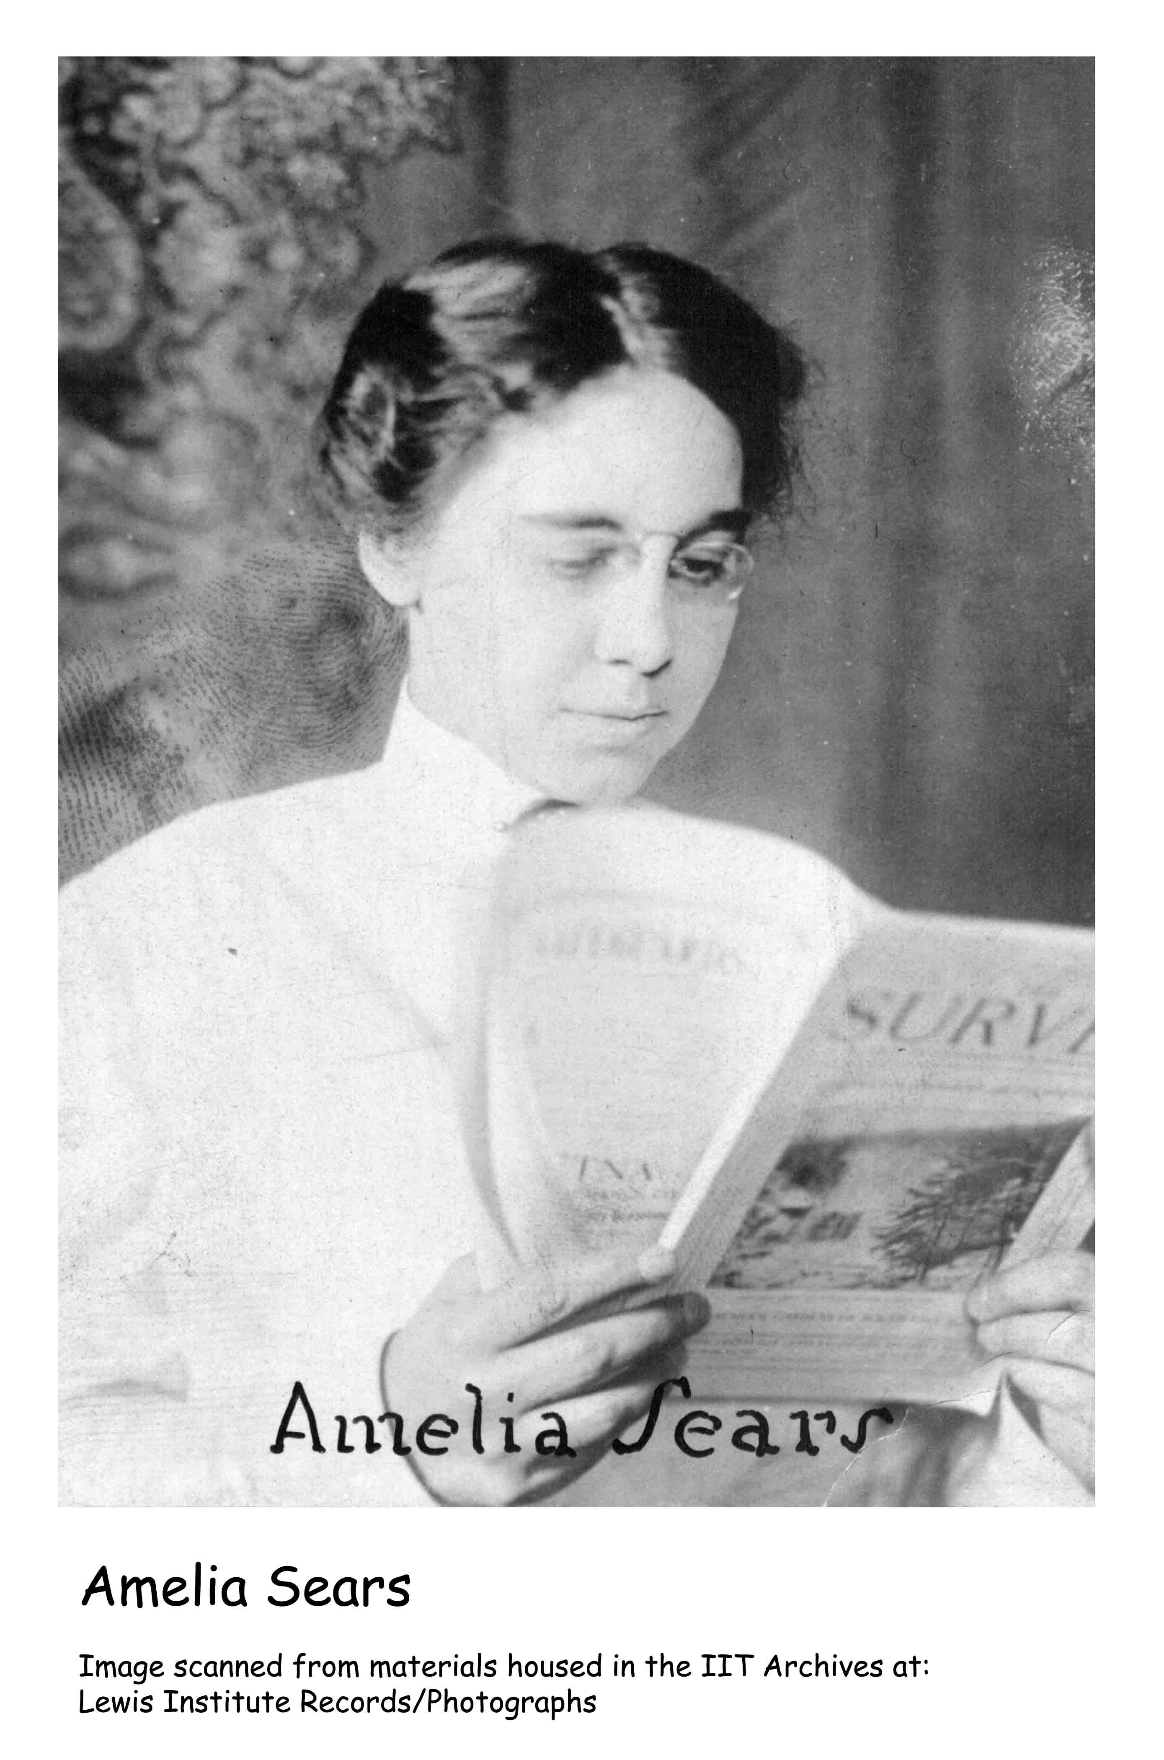
Notes:
A number of social workers began their academic programs at Lewis as well, including Amelia Sears of the United Charities of Chicago and George D. Wells -- remember the Wells Bro. Construction Co.? George was a third sibling to attend Lewis, and he became a Red Cross staff worker. We’ll meet another even more famous social worker later.

Slide 46
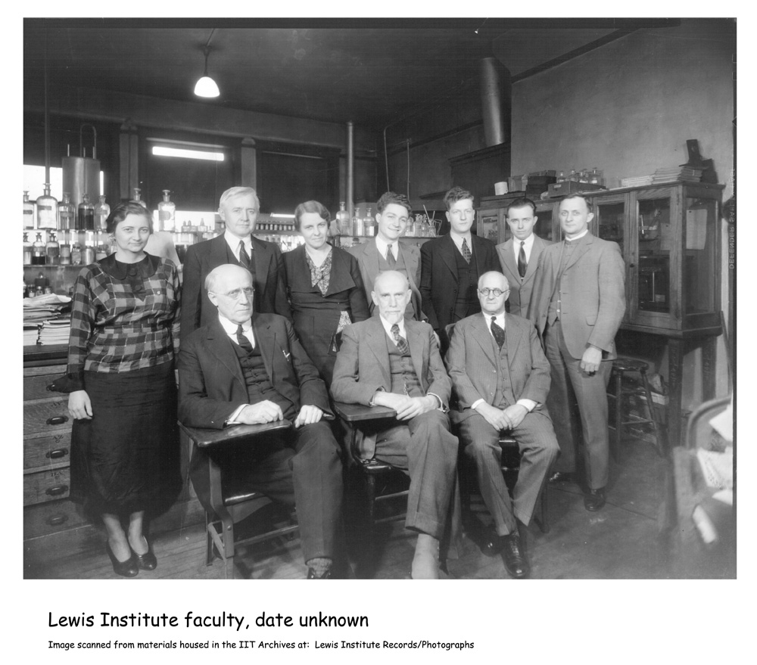
Notes:
Beginning in 1917, primarily in connection with the Evening School which we’ll talk about in a few minutes, students interested in general science or liberal arts careers could pursue a bachelor’s degree in Arts & Science. Lewis offered classes in a number of these disciplines, many of which were well-respected programs by virtue of being led by strong faculty members with outstanding qualifications. We’ll start with the arts programs.

Slide 47
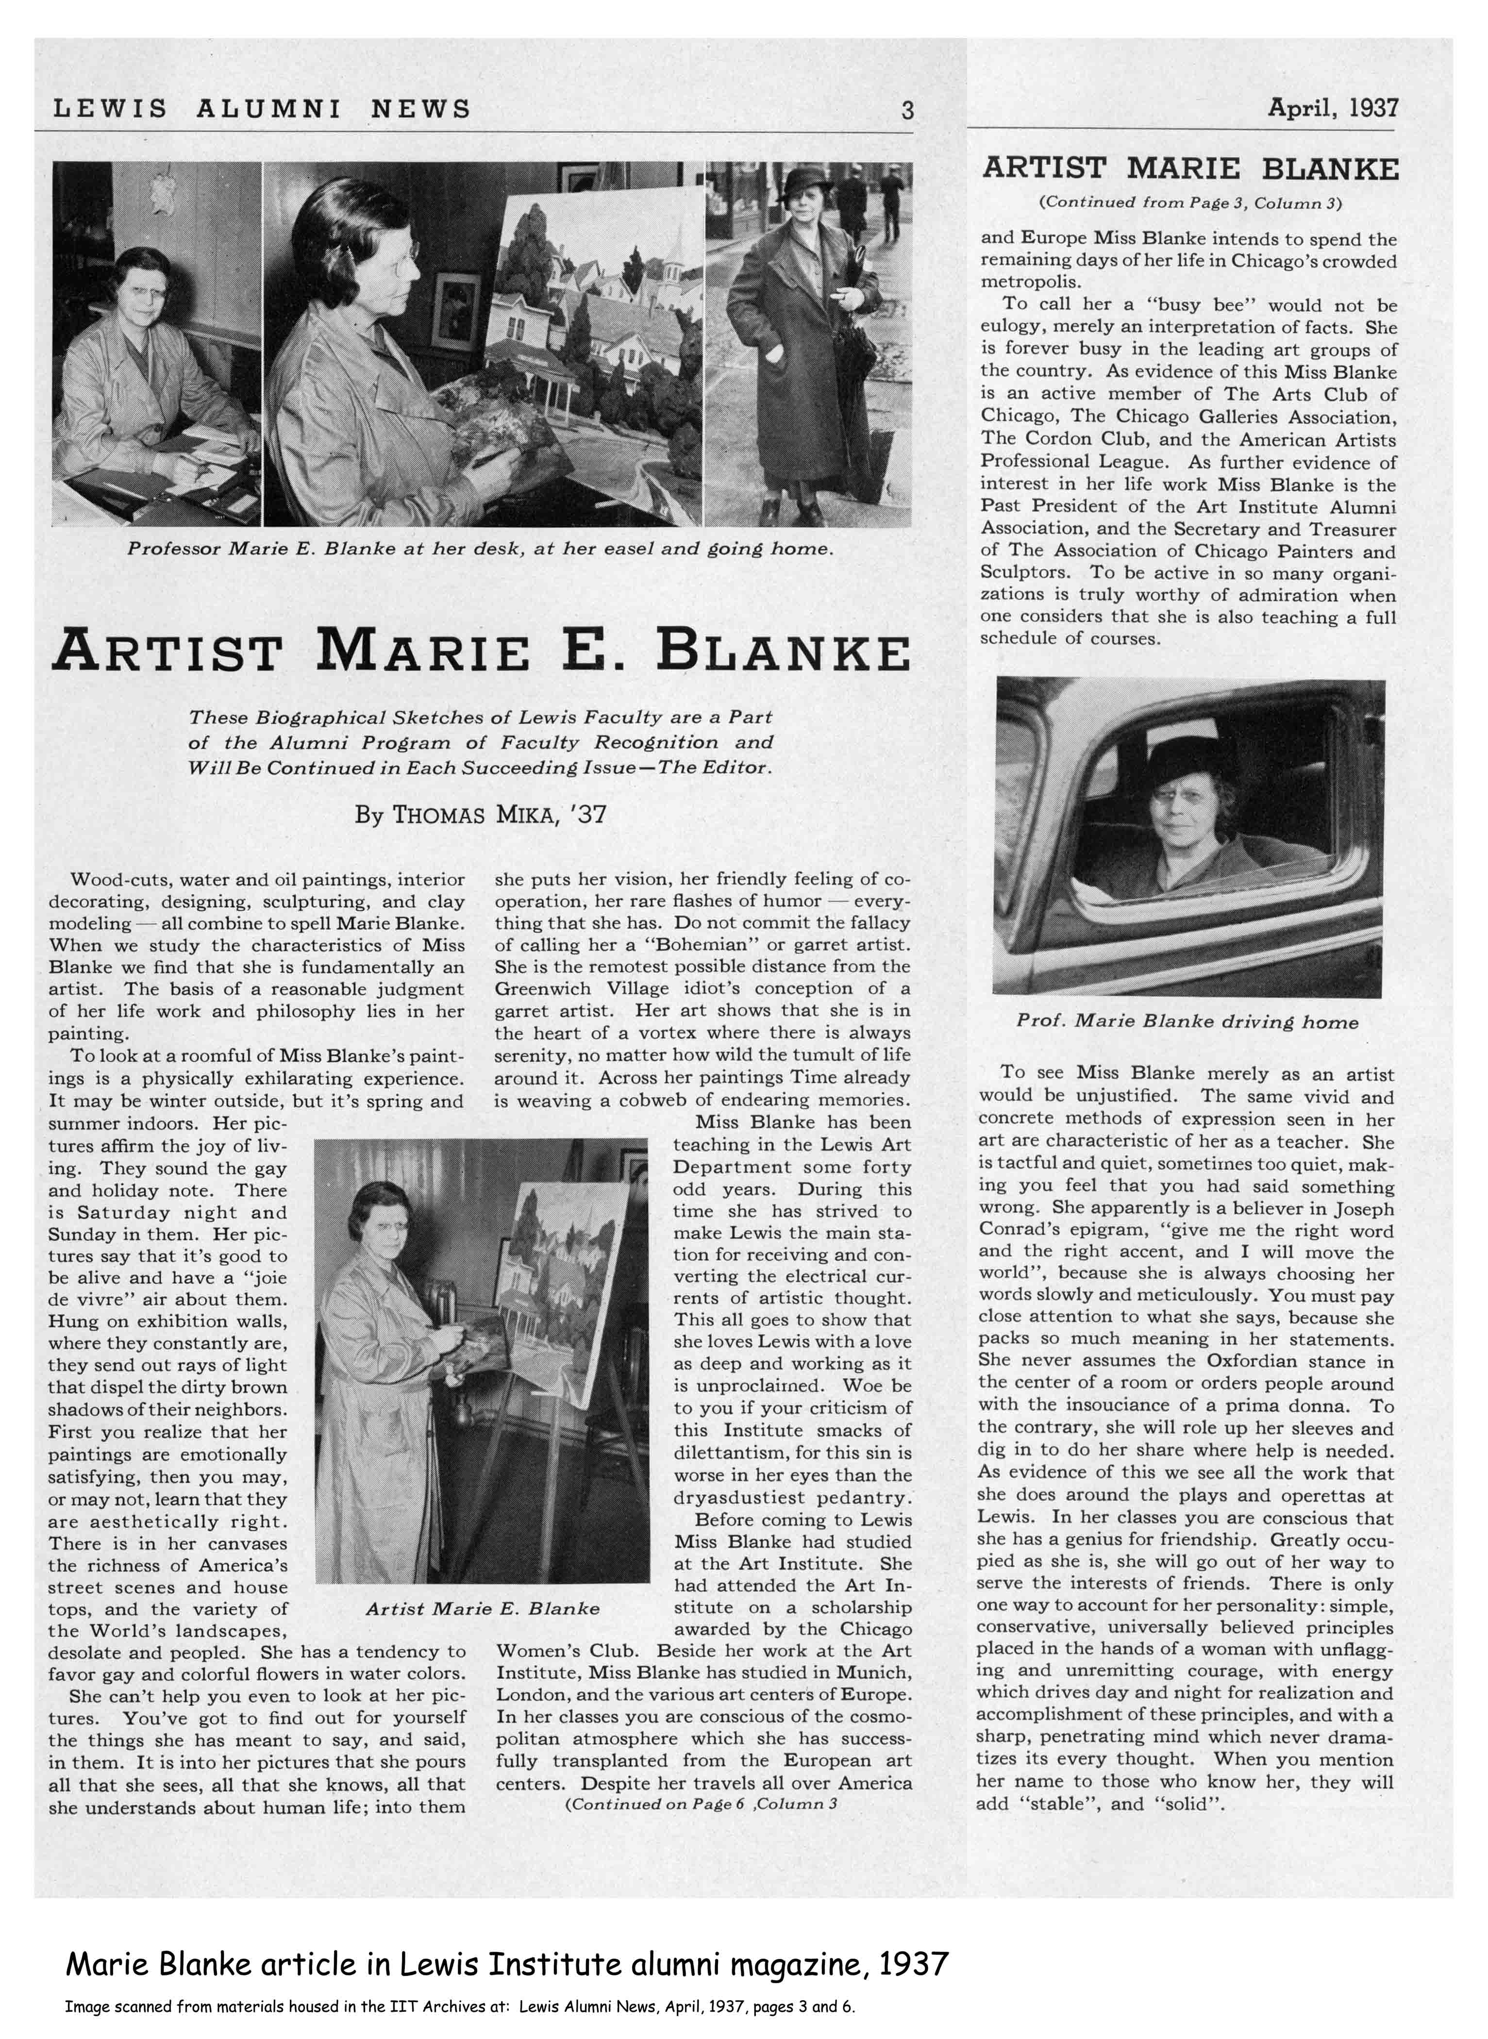
Notes:
Marie Blanke taught art at Lewis from its founding until at least 1937. Blanke was an accomplished artist herself, a mentor of others, and a lesbian lover of Jane Heap who also taught at Lewis for a couple years. A Lewis alumnus once commented of Blanke: “Her pictures affirm the joy of living....[And]...In her classes you are conscious of the cosmopolitan atmosphere which she has successfully transplanted from the European art centers [where she studied].”

Slide 48
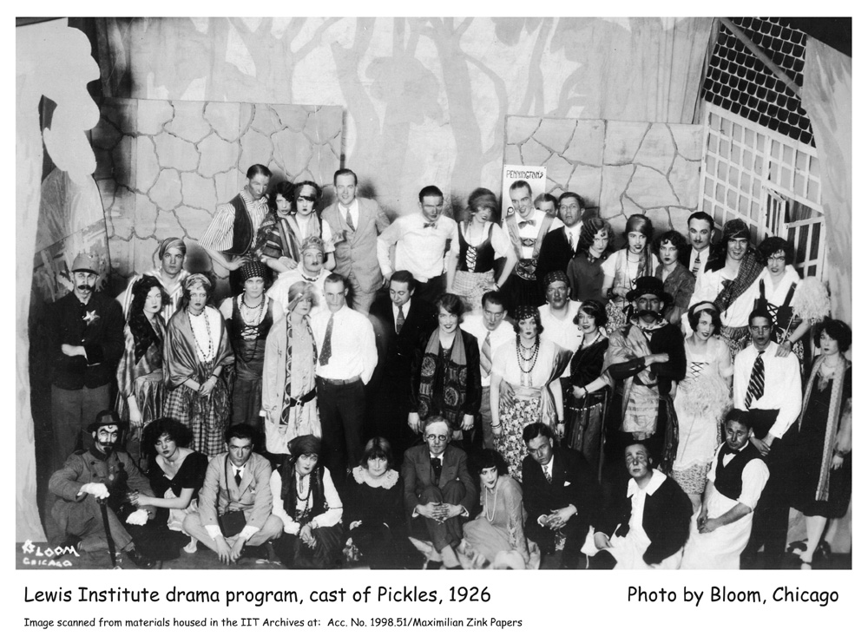
Notes:
Lewis had a notable drama program, ably headed by Olive Pierce Hazel. Theater productions staged at Lewis over the years included the standard Shakespearian, opera, and popular selections, and at least one play performed in German -- Der Dummkopf by Ludwig Fulda, which starred Fanny Butcher in female lead role. And then there were the original plays -- the Lamentable Tragedy of Omelet and Oatmelia or Singbad, The Sailor.
Theater cast - Pickels

Slide 49
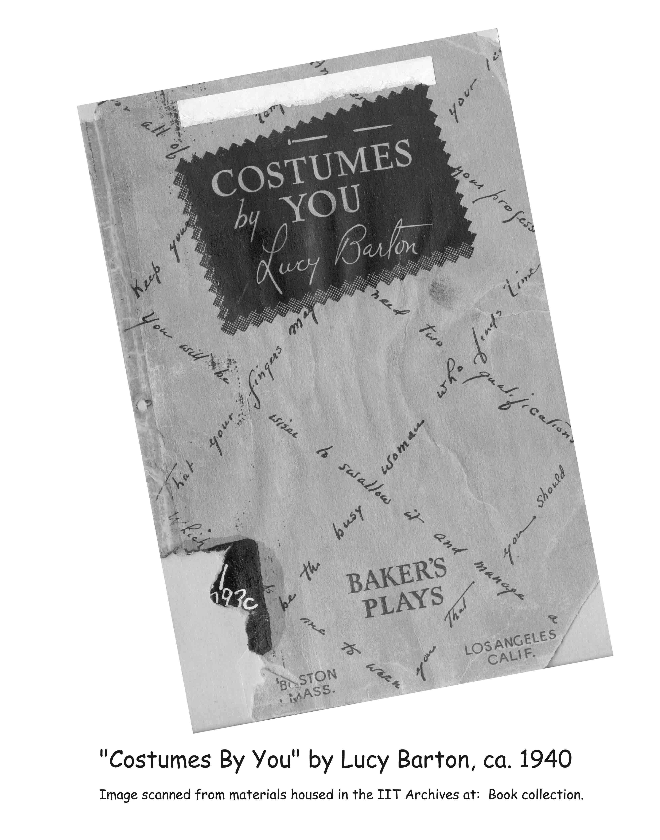
Notes:
Fanny Butcher pursued her professional career in another area, but the Lewis drama program did turn out other alumni who went on to fame and fortune on stage and in theater: Luther Adler who acted in Fiddler on the Roof; Lucy Barton, a nationally-known playwright and costume designer who authored college textbooks on the history of costume; and Helen Tieken Geraghty, who wrote and produced numerous historical pageants during her 20-year career, beginning with Wings of a Century for the 1933 Century of Progress world’s fair.
Lucy Barton book

Slide 50
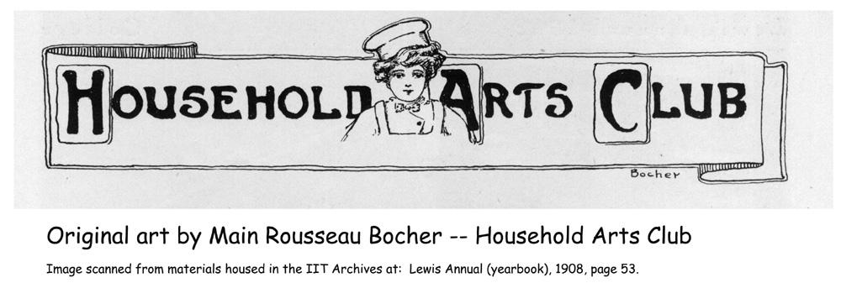
Notes:
How many of you recognize the name Main Rousseau Bocker? He attended Lewis in 1908, drawn there specifically because of its drama program, where he studied dress and stage design. And created art work for use in the school’s yearbook like this image for the Household Arts Club…

Slide 51
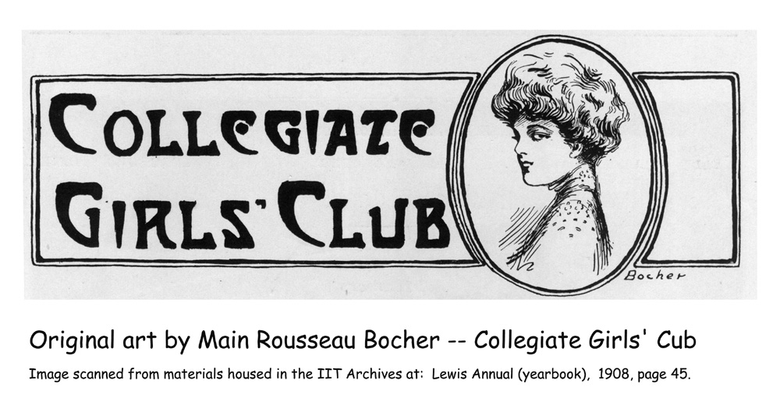
Notes:
…or this fashion plate for the Collegiate Girls’ Club. Well, you may know him better as Mainbocher when his fashion plates graced the pages of Harper’s Bazaar and French Vogue. As a couturier, he designed Wallis Simpson’s wedding dress and was the man responsible for the color “Wallace blue.” Several of his high fashion designs are in Chicago History Museum’s costume collection.
Let’s move on to the sciences.

Slide 52

Notes:
In the discipline of psychology, Lewis Institute was blessed with the presence of David Pablo Boder. Boder was a pioneer in the field of clinical psychology, conducting laboratory experiments, and using machines of his invention to measure physical reaction to stimuli. His particular area of research was trauma and how people reacted to it.

Slide 53

Notes:
Boder was an enigmatic person, who, from what I have found, never openly declared his Jewish identity. He emigrated from Russia to Mexico in 1921 and later came to Chicago. In 1927 he began teaching at Lewis Institute, and he continued to teach at IIT after the 1940 merger until his retirement in 1952.

Slide 54

Notes:
But the fact that Boder is not recognized as a household name today in the area of psychology is only a small part of his unknown story. We, as historians -- and as humanitarians -- owe a debt to him which is only now beginning to be recognized. Boder conducted the first ever recorded oral interviews using the wire recorder invented by Marvin Camras at IIT. In the summer of 1946, Boder traveled to Europe, to various relocation sites still filled with former victims of the concentration camps. There he interviewed 109 survivors of the Holocaust, in six different languages -- all of which he spoke fluently. Remember his trauma research? This is what he intended to study by conducting these interviews: realizing that these “victims of war” had been subjected to trauma, he wanted to study the psychological effect it had on them. I don’t think he knew what kind of trauma he would be subjecting himself to.
Dachau

Slide 55

Notes:
After 13 weeks in Europe, Boder came back to Chicago and spent the rest of his life translating, transcribing, and trying to get published the accounts he had heard. And I think, perhaps also trying to get over what he had heard.
I Did Not Interview The Dead

Slide 56

Notes:
OK, let’s turn to something a little lighter: Math. You’re looking at one of the Associate diplomas for a later student, but one of the original students who attended Lewis and earned his AA degree in 1902, before transferring to Harvard, was George David Birkhoff. Birkhoff became, according to The Columbia Encyclopedia, “perhaps the first American mathematician of international repute.”
Another math whiz was Edwin Nourse, an economist who became the first chairman of the President’s Council on Economic Advisers, under President Truman.
AA diploma

Slide 57

Notes:
Charles Peet and Julia Dumke were professors of biology and German, respectively. These two early faculty members married and, being childless,
“[t]he love which should have poured itself out upon the children of their dreams grew...until it overflowed and spread its benign influence over all the children of Lewis Institute. For forty years they have mothered, fathered, and tutored the children of [Lewis]. They have nourished and cherished us and bathed us in the brightness of their love.”
And the passage goes on and on. And, believe me, the students who wrote this are perfectly serious; this is not “sucking up.”

Slide 58

Notes:
Lewis taught foreign languages other than German – French, Spanish, and Latin, for sure. French instructor Mdmsl. Lea (or Leah) Rachel DeLagneau was another of the original faculty members who served until 1934. In 1933, she was presented with the Palmes Academiques, the most prestigious decoration a scholar can receive from the French Government -- and one rarely awarded to a foreigner.

Slide 59
Image removed
Notes:
The English literature program was particularly strong under the long tenure of two significant faculty members -- Edwin Herbert Lewis (whose name we’ve heard before) and Mollie Cohen. Cohen was one of many Lewis students who, after graduating, was hired to teach there as well. She started as a night school student, transferred to the day program and received a B.S. in Arts and Sciences in 1924. She then taught composition at Lewis and subsequently at IIT until 1967. Mollie also taught English as a second language (though it wasn’t called that then) to adult learners at Lewis, her students being ones who had immigrated to the U.S. speaking a host of other languages as their native tongue. Reportedly, Mies was among them.
Cohen’s academic transcript

Slide 60

Notes:
Under Edwin Lewis and Mollie Cohen, the Lewis English program spawned a number of professional writers, journalists, publishers, and editors, among them:
Jack Lait, associate editor of Variety magazine and managing editor of Hearst Publications; Walter Ansel Strong publisher of the Chicago Daily News; Walter Stowell Rogers, a journalist for U. S. news service; and...

Slide 61

Notes:
... Janet Lewis Winter, daughter of the above mentioned Edwin, who became an author of novels, poetry, librettos, and short stories, perhaps the best well-known of which is “The Wife of Martin Guerre.” The 1993 movie “Sommersby” is based on it.
Janet Lewis poem

Slide 62

Notes:
And then there were the truly famous... Fanny Butcher, the Chicago Tribune book reviewer for nearly 50 years, is only one of many people who publicly acknowledged the debt they owed to Edwin Lewis. Butcher wrote of her mentor in her autobiography, Many Lives-One Love, “God or fate or whatever divinity that shapes our ends must have seen to it that I landed in a class in English taught by Edwin Herbert Lewis.”
We’ll return to both Fanny and Edwin again in a few minutes, but we can’t leave English until recognizing...

Slide 63

Notes:
...Dorothy Thompson who played center for the basketball team while at Lewis, only later becoming better known as an author who, at the early date of 1934, earned the “honor” of being the first American foreign correspondent expelled from Germany by Hitler for her outspoken criticism of him in her book, I Saw Hitler!. She then worked as a radio commentator for NBC and began her long career as New York Herald Tribune columnist in 1936.

Slide 64

Notes:
Thompson was also outspoken in 1940 when she opposed the merger of Lewis Institute with Armour Institute as revealed in this letter in the Lewis collection,...

Slide 65

Notes:
...but she reconciled with IIT later when she returned in 1956 to serve as commencement speaker.

Slide 66
Image removed
Notes:
For the historians among us, we owe a particular debt to two Lewis alumni: Theodore Calvin Pease, who had attended Lewis for six years before transferring to the U. of I., was to become an Illinois historian and author, director of the Illinois State Historical Society, and the first editor of the journal American Archivist. A quote by him in 1938 says, “As I look back on my student years at Lewis, I am convinced they were spent in the best-balanced and most normal social environment I have ever been in.”

Slide 67
Image removed
Notes:
Another would-be historian, Seymour Pomrenze, noted on his 1933 application to attend Lewis…

Slide 68
Image removed
Notes:
So let’s see how he did career-wise: He received a B.S. in 1936, and in 1941 he began working at the National Archives before pursuing a military career where he helped repatriate documents looted by the Nazis, and still later, taught records management to a generation of U.S. government archivists.
Pomrenze transcript

Slide 69

Notes:
Lewis didn’t offer a normal program, as such, but a number of graduates did enter the field of education as teachers and administrators. One who filled both positions during her 64-year career was Ethel Percy Andrus who became the first woman to hold the position of principal in a California high school. After her retirement from the field of education, she founded the American Association of Retired Persons (now know as AARP), which she headed until her death in 1967. She also served on President Lyndon Johnson’s White House Conference on Aging.

Slide 70

Notes:
A pottery department was established in 1908 “primarily for Art Teachers.”

Slide 71

Notes:
And, according to the 1928 Lewis Annual, “75% of the pottery instructors in the United States were trained at Lewis.”

Slide 72

Notes:
By 1938, Lewis Institute made its kilns available to other schools and to individual artists. If anyone knows of extant samples of Lewis pottery, please contact me.

Slide 73

Notes:
There was no business program at Lewis, but students could study economics, and a number of alumni went on to become involved in commerce at all levels. To its credit, Lewis turned out a few successful Chicago entrepreneurs, like: Stuart Brent who started a Chicago bookstore you may have heard of.
Business ledger

Slide 74
Image removed
Notes:
And there was Raymond C. and Werner A. Wieboldt who ran a department store chain. “There are [now] three great Wieboldt department stores….What with Wieboldt at Ashland and the Smyths farther east, Lewis alumni will get a big slice of West Side trade.” And who were the Smyths? Well,…
Wieboldts’ files

Slide 75

Notes:
…none other than John M. Smyth and John Usher Smyth, who “are kept busy selling the best furniture in the world.”
Smyth letter

Slide 76

Notes:
And in the area of serious money, there was financier Harold Leonard Stuart, president of the brokerage firm Halsey, Stuart & Co., (later Halsey Stuart Bache). In 1953, he was described by the financial editor of the Chicago Tribune as “probably the Chicagoan most widely known in national financial circles...[and who] had a large part in keeping Chicago one of the world’s great financial centers.”
IIT’s Stuart School of Business owes its existence to the Stuart family.

Slide 77

Notes:
Lewis wasn’t all academics. George Lee Tenney was both the music instructor and director of physical education. Known as “Uncle George” by all at the school, in the 1927 Lewis Annual, the students wrote to him, “...sweet singer and brilliant musical director; patient professor of a dead language which you make to live again;...the Annual now grants you the degree of Avuncular Georgos, with all the nephews and nieces thereunto appertaining.”

Slide 78

Notes:
One student in particular who apparently did better on the athletic field than in the classroom was William Hogenson who made a name for himself in local track and field meets -- and then went on to win three medals in the 1904 Olympics.

Slide 79
Image removed
Notes:
Notes removed

Slide 80

Notes:
One of my two thesis statements about Lewis Institute is this: Lewis Institute, through its founder, director, and dean (whom we have yet to talk about) created innovative learning opportunities which were instrumental in shaping higher education in Chicago in the early 20th century. Here’s more evidence of that.
Building auditorium

Slide 81

Notes:
In addition to its traditional college program which we’ve been discussing, and the junior college program I already mentioned, Lewis Institute created other opportunities for post-elementary level learners. Some of these innovations we now associate as standard offerings in community colleges across this country. For instance, through its academy, Lewis offered remedial program opportunities to older children and adults who were not academically ready to enter a college program.
High school 1907

Slide 82

Notes:
The Lewis academy operated from 1896 - 1916, and students were allowed to choose some elective courses for their program -- a radical idea at the time which drew criticism from the professional academic community. The Academy was discontinued in 1916, only after free public high schools became generally available in Chicago. This is the Academy Class of 1912. The flag, by the way, measures about 8 yards wide which I take to be a measure of the degree of patriotism which permeated this school filled with first and second generation Americans.

Slide 83

Notes:
One of the academy’s most famous son’s was none other than Benny Goodman who recalled, in his autobiography, The Kingdom of Swing, his account of going to Lewis in 1923 at age 14: “...the best thing about it was the fact that you didn’t have to get there before 11:30 in the morning. Since I was working several nights a week, this sounded good; ....” That said, Benny only attended for one or two terms: “...One year of high [school] was all the schooling I ever had. Then, too, as I have said, the laws in Chicago at the time didn’t require a kid to go to school after he was fourteen.”

Slide 84

Notes:
From the time it opened, Lewis offered a night school to provide college level education to working adults (defined as those over 18 years old) who could not attend during the day. A provision for this program was included in the Lewis Will, and is believed to be the first such legal provision for adult education in the country. By 1915, over 25,000 people had taken one or more evening classes. Beginning in 1917, evening students could receive a B.S. or Associate degree on completion of their program.

Slide 85

Notes:
Reportedly, some students took 10 or 15 years to complete the work, attesting to the dedication of these adult learners to partake in one promise of the American Dream which had drawn them to this country in the first place. Classes were held from 4 - 6 pm, 6 - 8 pm, and 8 - 10 pm -- 100 minutes each.
Mechanical lab

Slide 86

Notes:
To further strengthen academic degrees, as evidence of a graduate’s qualification to enter the work force, Director Carman was one of the originators of the North Central Association of Colleges and Secondary Schools which became the accrediting body for high school and college programs. In fact, Lewis hosted the first meeting in 1897 at which the organization was formed.
Carman portrait/Moffett

Slide 87
Image removed
Notes:
During the 44 years of its existence, Lewis Institute enrolled over 100,000 students. I must say, when I encountered that figure, I was skeptical, but one of the record series in the Lewis collection is the student files, 815 boxes containing some 65,000 files. In addition to these records of the day students, there are two hand-typed volumes with 1500 pages showing names and student counts for classes like “Glassblowing, 1940” or “evening and summer students.”
Box 604 and folders

Slide 88

Notes:
Agness (sic) Kaufman was, first, a student, then secretary of the alumni association, and later an instructor at Lewis before becoming its registrar. Described by one student as the person who “faithfully maintained and protected [emphasis mine] the records of the students,” Kaufman continued as registrar at IIT after the merger, until 1947, and is the person who counted the100,000 Lewis students.

Slide 89

Notes:
Many of the students who enrolled at Lewis took only a few classes or transferred after receiving the Associate Degree, but Director Carman was proud to know that on leaving the school, transfer students were accepted at other colleges and universities, including the University of Chicago, Northwestern, Armour Institute of Technology, or the University of Illinois, and at the most prestigious eastern colleges like Vassar, where…
Building with streetcar tracks

Slide 90

Notes:
… Lea Demarest Taylor chose to continue her academic program. Lea was the daughter of Graham Taylor who founded Chicago Commons. Lea later returned to Chicago where she became a social reformer and head resident of Chicago Commons until the 1970s.

Slide 91

Notes:
Graham Taylor also sent one of his sons to Lewis, Graham Romeyn Taylor. The elder Graham Taylor wrote, in a 1935 letter, “The Institute’s early offer of Junior College work ... enabled my son and daughter to secure a thorough preparation for their further academic courses at Harvard and Vassar, for which they and their parents have ever been grateful.”

Slide 92

Notes:
That Lewis Institute was built in the midst of the city's west side, walking distance from Hull-House at the time when the neighborhood was a cultural mosaic of European immigrants, was no accident. Jane Addams solicited the trustees of the Lewis Estate to build in the area of Hull-House, indicating the need of area residents for just such a school as was being planned.
Hull-House letter

Slide 93

Notes:
By 1928, there were 52 nationalities represented at Lewis, and the school’s polyglot student body included persons from Scandinavia to Eastern European nations to India to China to the Philippines. Religious tolerance, cultural exchange, and ethnic encounters were offered to students through formal classes, official school programs, and extra-curricular activities.
Seniors - 1937

Slide 94

Notes:
And here’s my second thesis statement about Lewis Institute: I believe Edwin Herbert Lewis, who served for 40 years as head of the English department and dean of faculty for 30 years, was the person most responsible for Lewis Institute’s character. Edwin, a descendant of the school’s founder, was a humorist, musician, and poet; a man of letters who corresponded with the same, and fathered a woman of letters; a benefactor generous to a fault; and the embodiment of Lewis Institute. Edwin Lewis claimed international potentates among his acquaintances, an East Indian Nobel laureate among his personal friends, pure scientists among his colleagues, and nationally-known journalists among his students. His daughter Janet, whom we met earlier, followed his lead as a writer, enjoying success there which eluded him.
Edwin Lewis – half length

Slide 95

Notes:
Edwin found his own vocation in teaching others the literary arts and, along the way, exposed his students to classical and contemporary authors and theorists from diverse cultures and wide-ranging philosophies, many of whom were invited to the school as guest speakers. Among those persons whose characters he helped shape and whose careers he influenced were those writers, publishers, and journalists we discussed earlier, as well as future teachers and educators, who then spread his message of diversity appreciation and cultural tolerance to another generation of students.
Edwin Lewis with cake

Slide 96

Notes:
Lewis was himself an alumnus of University of Chicago and a faculty member there, along with George Noble Carman, before coming to Lewis Institute as one of its charter faculty members. The University of Chicago connection is significant, as we discover in this quote by Fanny Butcher: “[Edwin] looked incredibly like William Shakespeare, was a purist in the use of words, and loved and respected them the way an artist loves his colors or a sculptor his clay. He was able to communicate the sheer life-giving joy of writing, a bliss that to some authors I have known is what dope addicts seem to get out of their ‘trips.’ ... [Dr. Lewis] had come as a young professor from the English Department of the University of Chicago, where, by a crook of fate, he had had some East Indian potentate’s son as a student. When the young crown prince got back to India, he sent other eager learners to Dr. Lewis. They followed him [emphasis mine] to Lewis Institute, and in our classes there were always five or six brilliant young Indians.”
Edwin Lewis bust

Slide 97

Notes:
I haven’t established the definite connection but the East Indian potentate, whose son came to the University of Chicago, may have been the Indian poet and Nobel Prize winner Rabindranath Tagore. We do know for sure that Edwin Lewis entertained the older Tagore as a personal friend in his home and invited him to visit the Institute in 1920 where he (Tagore) read from one of his plays for a roomful of faculty and students, “packed two to a seat.”
Tagore’s book

Slide 98

Notes:
Another of Edwin Lewis’ students who would recall him more than 60 years later was Arthur Krock, the New York Times journalist who, in his biography Memoirs: Sixty Years on the Firing Line, wrote “A classmate told me that if I would go...to Lewis Institute, a small but very high-grade institution that offered respected college degrees, I could maintain myself by assisting professors and working on the college yearbook. All this was borne out by the events, and I encountered one of the richest experiences of my life by attracting the favor of Dr. Edwin Herbert Lewis....He thought I was a promising student in his subject, English....I acquired the degree of Associate in Arts in 1906...and took the first train I could get to Louisville with a newspaper job as my objective.”

Slide 99

Notes:
The ethic of tolerance (remember Dr. Herrick’s speech), individuality (remember “Carman likes ’em different”), and diversity appreciation (52 nationalities by 1928 alone) must have pervaded the school at all levels – in formal instruction, school assemblies, hallway conversations, and extra-curricular activities. Something in this combination of morés somehow resulted in that “best balanced and most normal social environment” that Theodore Calvin Pease had ever experienced. Just for fun, here’s a sampling of the student organizations at Lewis:…
Organizations page from yearbook

Slide 100

Notes:
There was the Classical Club…

Slide 101

Notes:
…and the literary offerings.

Slide 102

Notes:
Sororities…

Slide 103

Notes:
…and fraternities.

Slide 104

Notes:
This was an organization for the high school students.
Co-op

Slide 105

Notes:
Music…

Slide 106

Notes:
…and athletics.
And there were the ethnic organizations:…

Slide 107

Notes:
The Polish Club.

Slide 108

Notes:
The Menorah Society. Note David Boder and Mollie Cohen as faculty sponsors.

Slide 109

Notes:
The Chinese Students’ Club, including one woman, 1929.

Slide 110

Notes:
And the Phil-Lewisian Society, with Edwin Lewis as faculty sponsor.
Finally…

Slide 111

Notes:
There are two final images that I want to leave you with – one that summarizes the make up of the student body who entered into the school, and the second which suggests, I think, the character of the individuals who, transformed by the education s/he received there, came out of it.
Here’s the first one:…
Records on shelves

Slide 112

Notes:
This is page three of the 1936 yearbook. At a time when the “melting pot theory” may still have been promoted in some ivy covered halls, is there any doubt that Lewis Institute’s multi-national student body recognized the diversity and individuality of its students? And celebrated it?
OK; before I put up the last slide, recall the images we saw early on of the janitors and maintenance workers. I have one more “behind the scenes” image of a staff laborer at the school. The slide is about her, but it is also about the students at Lewis Institute who published her photo in their yearbook, about the faculty members who cultivated the students’ character engendering this level of inclusivity, and about Allen Lewis, the founder who provided them all with the opportunity to do so. From the 1918 Lewis Annual,…

Slide 113

Notes:
...meet Venus.
And read what the students wrote about her….

Slide 114

Notes:
[image with poem]

